Slide 1
AHSS Council
September 2015

Slide 2
Initial Recovery Strategy Deliverable
Due to PSP in early October
Focused on documenting / describing our work to date
Will be used to place our proposed future work in context:
The NTAs we propose at the end of December
Our new recovery strategy
Preliminary – does not limit our future recovery strategy development
Three parts:
Results chains
Schematics
Narratives

Slide 3
Results Chains
Developed in the Maridi software to show how our work is contributing to Puget Sound recovery
Based on standard language and prototypes developed by PSP
Menu of substrategies from the Action Agenda
Prototype results chains from the Action Agenda
Standard language and relationships of substrategies to pressures / stressors and to vital signs

Slide 4
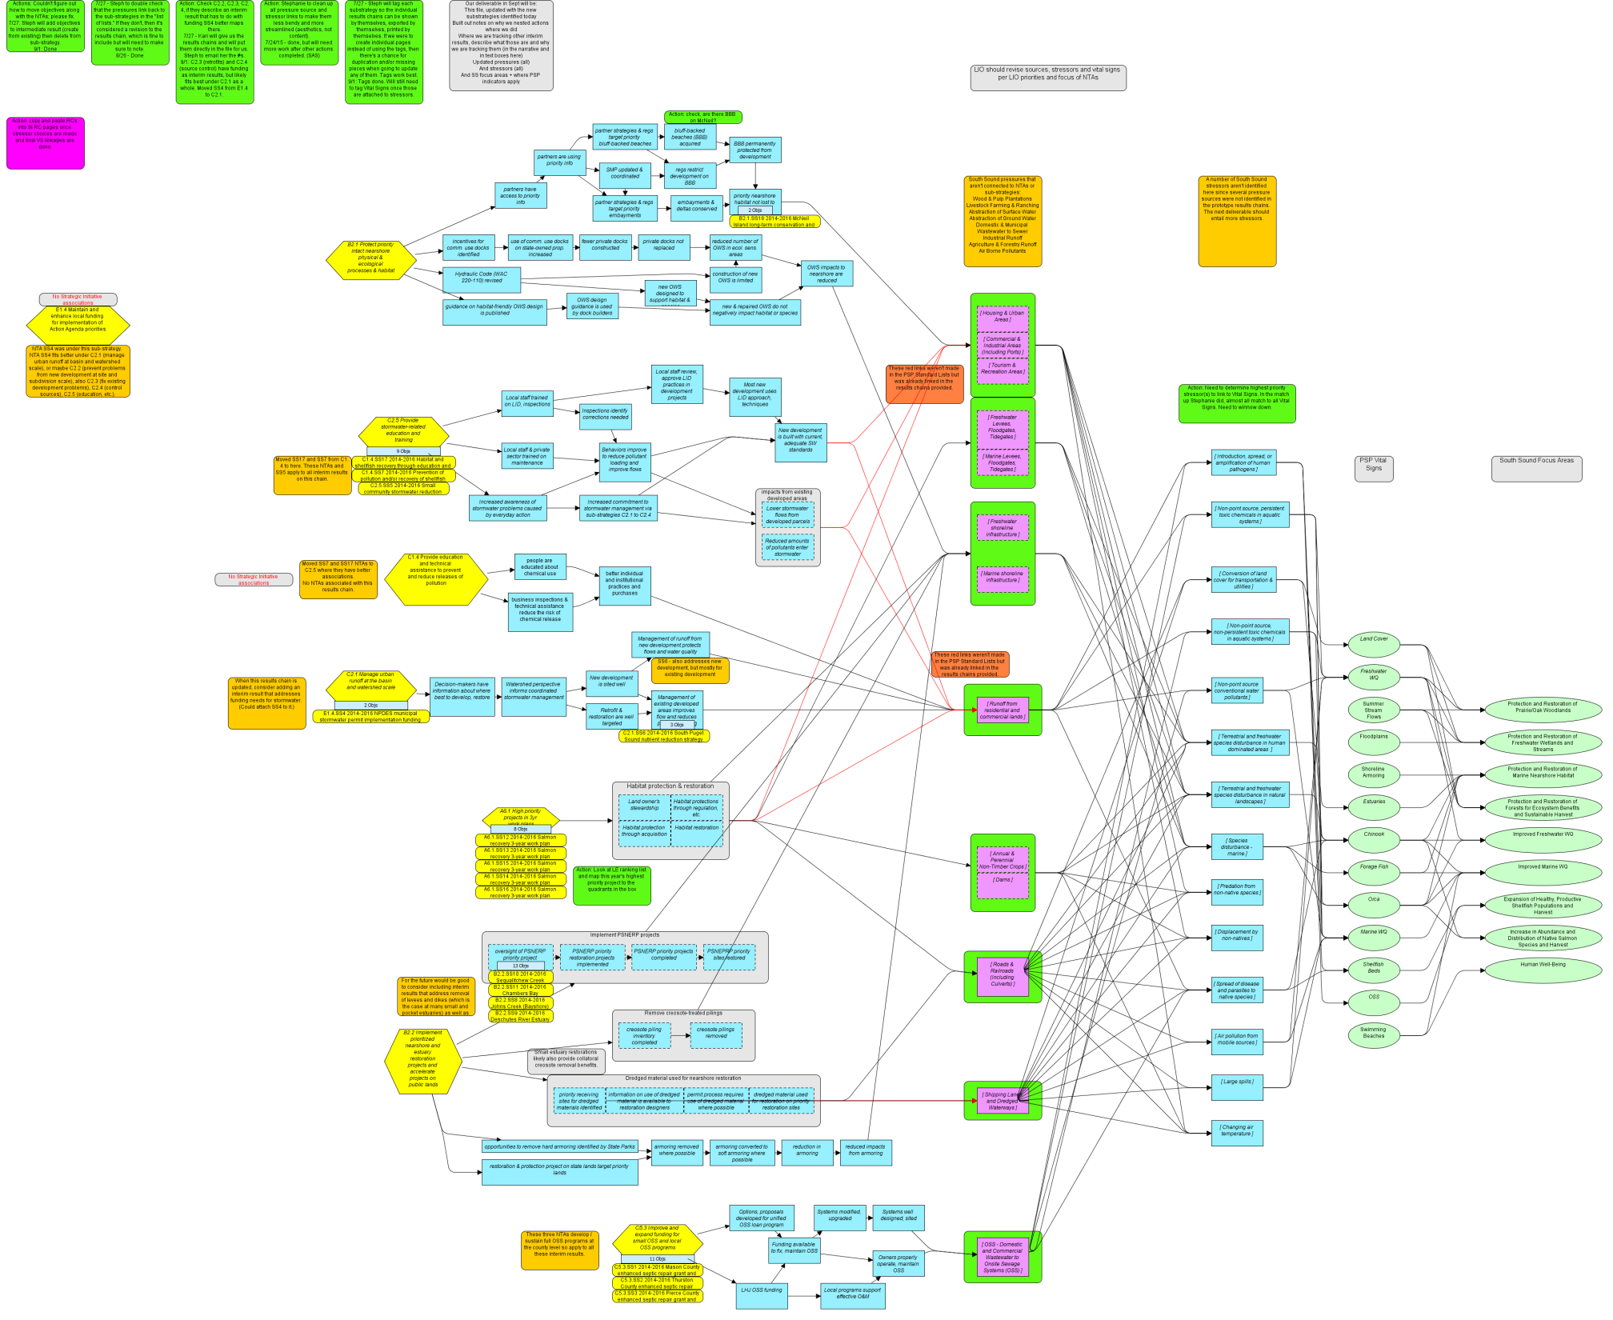

Slide 5
 | Substrategies Implied by Current AHSS Actions
A2.2 | Implement and maintain priority freshwater and terrestrial restoration projects | Habitat | SS12-16 | Salmon recovery workplan projects
A5.3 | Protect and maintain intact and functional floodplains | Habitat | SS12-16 | Salmon recovery workplan projects
A5.4 | Implement and maintain priority floodplain restoration projects | Habitat | SS12-16 | Salmon recovery workplan projects
B2.1 | Permanently protect priority nearshore physical and ecological processes and habitat, including shorelines, migratory corridors, and vegetation particularly in sensitive areas such as eelgrass beds and bluff backed beaches | Habitat | SS 18 | McNeil Island long-term conservation and low-impact public access.
B2.2 | Implement prioritized nearshore and estuary restoration projects and accelerate projects on public lands | Habitat | SS 8 | Johns Creek (Bayshore) Estuary restoration.
 |  | Habitat | SS 9 | Deschutes River Estuary restoration.
 |  | Habitat | SS 10 | Sequalitchew Creek restoration.
 |  | Habitat | SS 11 | Chambers Bay estuarine and riparian enhancement project.
C2.1 | Manage urban runoff at the basin and watershed scale | Stormwater | SS 4 | NPDES municipal stormwater permit implementation funding strategy
 |  | Stormwater | SS 6 | South Puget Sound nutrient reduction strategy.
C2.5 | Provide focused stormwater-related education, training, and assistance | Stormwater | SS 17 | Habitat and shellfish recovery through education and outreach.
 |  | Stormwater | SS 5 | Small community stormwater reduction program.
 |  | Stormwater | SS 7 | Prevention of pollution and/or recovery of shellfish beds through education, outreach, and advocacy.
C5.3 | Improve and expand funding for small OSS systems and local OSS programs | Shellfish | SS1 | Mason County OSS
 |  | Shellfish | SS 2 | Thurston County OSS
 |  | Shellfish | SS 3 | Pierce County OSS

Slide 6
Schematics
Simplified communication of our past approaches
Use standard PSP recovery language and relationships
Developed to focus on how we’re working towards South Sound vital signs
Current approaches based on current SS actions in the Action Agenda
A few potential future approaches to round things out
Secondarily shows how South Sound vital signs contribute to PSP vital signs

Slide 7
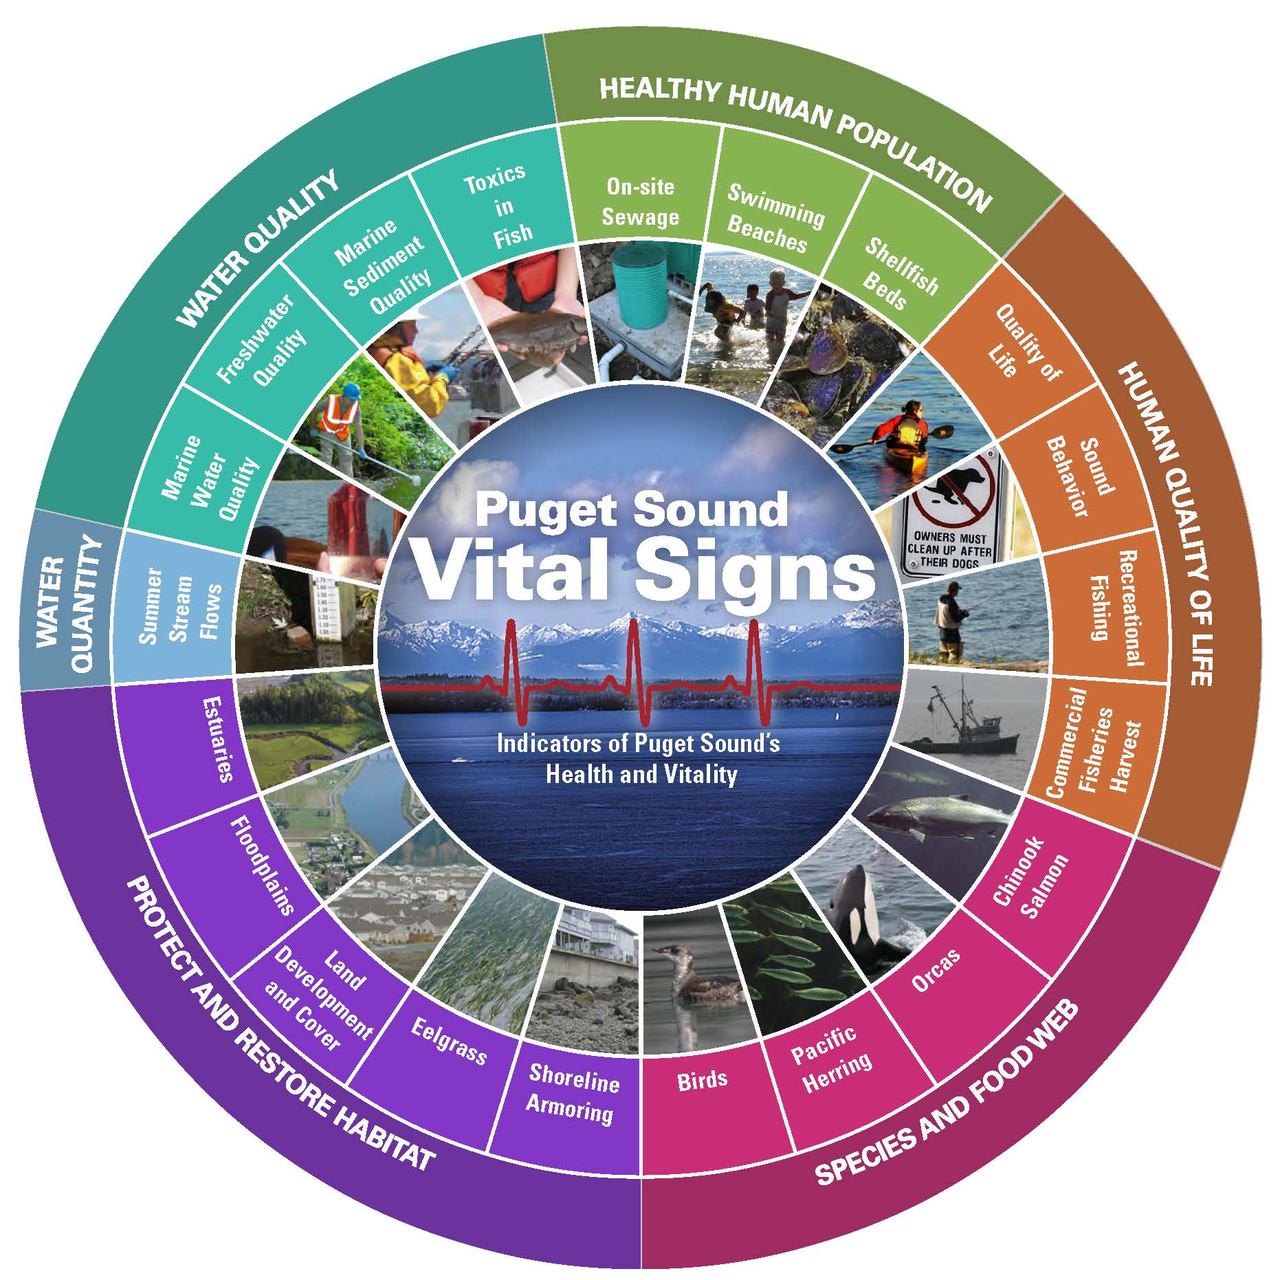
How to Read a Schematic
Sub-strategy: from the PSP strategic initiatives with current actions
Approach: what we are doing; what problem we are trying to solve
What we think will happen as a result of our actions
Pressure (Source of problem) affected
AHSS Vital Sign: the part of the ecosystem that is improved by this work
PSP Recovery Target
Which PSP recovery targets our work contributes to
Sub-strategy: from PSP strategic initiatives; no current actions, but a potential priority
NTA: Our Actions
Likely new approaches

Slide 8
DRAFT – EXAMPLE -- AHSS Approaches to Shellfish
9/7/2015
B3.1 Protect intact marine ecosystems
Increase amount of shoreline in protected status
Marine water quality
C5.3
OSS Funding
Target:
Provide resources to support OSS repair and replacement
Increase in number and pace of repairs & replacements
Less pollution from OSS
Improved Marine Water Quality
C2.5 Focused stormwater-related education, etc.
SS1
Increase in harvestable shellfish acres
SS2
SS3
More reporting of OSS problems
Target:
Shellfish focused stormwater & pollution education
SS17
Increase in healthy and productive shellfish populations and harvest
C7.2 Restore and enhance native shellfish
SS5
SS7
Better OSS maintenance
OSS
Target:
Restore Olympia oysters
Better onsite stormwater management
Less pollution from runoff
D5.3
informed stewardship actions
Swimming beaches
Encourage community shellfish use and harvest
Target:
Notes:
B3.1 -- Increase amount of shoreline in protected status: land trust work/easements; move McNeil Island from B2.1 (or combine B3.1 & B2.1)
C7.2 -- olympia oyster work; what else?
D5.3 -- Encourage community shellfish use and harvest: shellfish protection district work; community shellfish farms
Stressors reduced when OSS pollution is reduced:
S2. Introduction, spread, or amplification of human pathogens
U2. Non-point source, persistent toxic chemicals in aquatic systems
V2. Non-point source, non-persistent toxic chemicals in aquatic systems
X2. Non-point source conventional water pollutants
Stressors reduced when runoff is reduced: Same as above

Slide 9
Narrative
Approximately 12 pages, plus tables and charts
Describes the South Sound area
Work we are currently doing, by strategic initiative
Substrategies
Pressures
Vital signs
Multiple tables and charts (pressures, stressors, vital signs, etc.)

Slide 10
Development /Review Approach for Deliverable
Working with expanded Technical Team on the details of production
Will have draft schematics and results chains by 9/18 and can provide to Council for review
Also will provide tabular summary of key relationships / decisions
Executive Committee will make decision on their review at their meeting next week
Remember these documents are preliminary: working to balance getting them “right enough” with focus on the broader recovery strategy effort

Slide 11
In addition: South Sound 2016 NTA Call
We will turn in updated NTAs for inclusion in the 2016 Action Agenda December 31, 2015.
Significant additional detail will be required for 2016 NTAs
Emphasis will be on local actions that further PSP’s strategic initiatives
More detail on what PSP is looking to fund will be forthcoming very soon
Assumption is that all current NTAs can / will continue provided:
A clear owner can be identified
The additional information required for 2016 can be developed
Please see table of current NTAs
We do not know how much funding will be available

