Slide 1
the HCCC Integrated Watershed Plan
Alliance for a Healthy South Sound Council
19 May 2015
Purpose:
  Establish strategic priorities for the HCCC to implement and guide regional actions
  Establish a framework for accountability of strategy implementation, identification of strategic gaps, and continuous evaluation and adaptive management

Slide 2
the HCCC Integrated Watershed Plan
Desired future conditions:
  Human health
  Human well-being
  Species and food web
  Habitats
  Water quantity
  Water quality

Slide 3
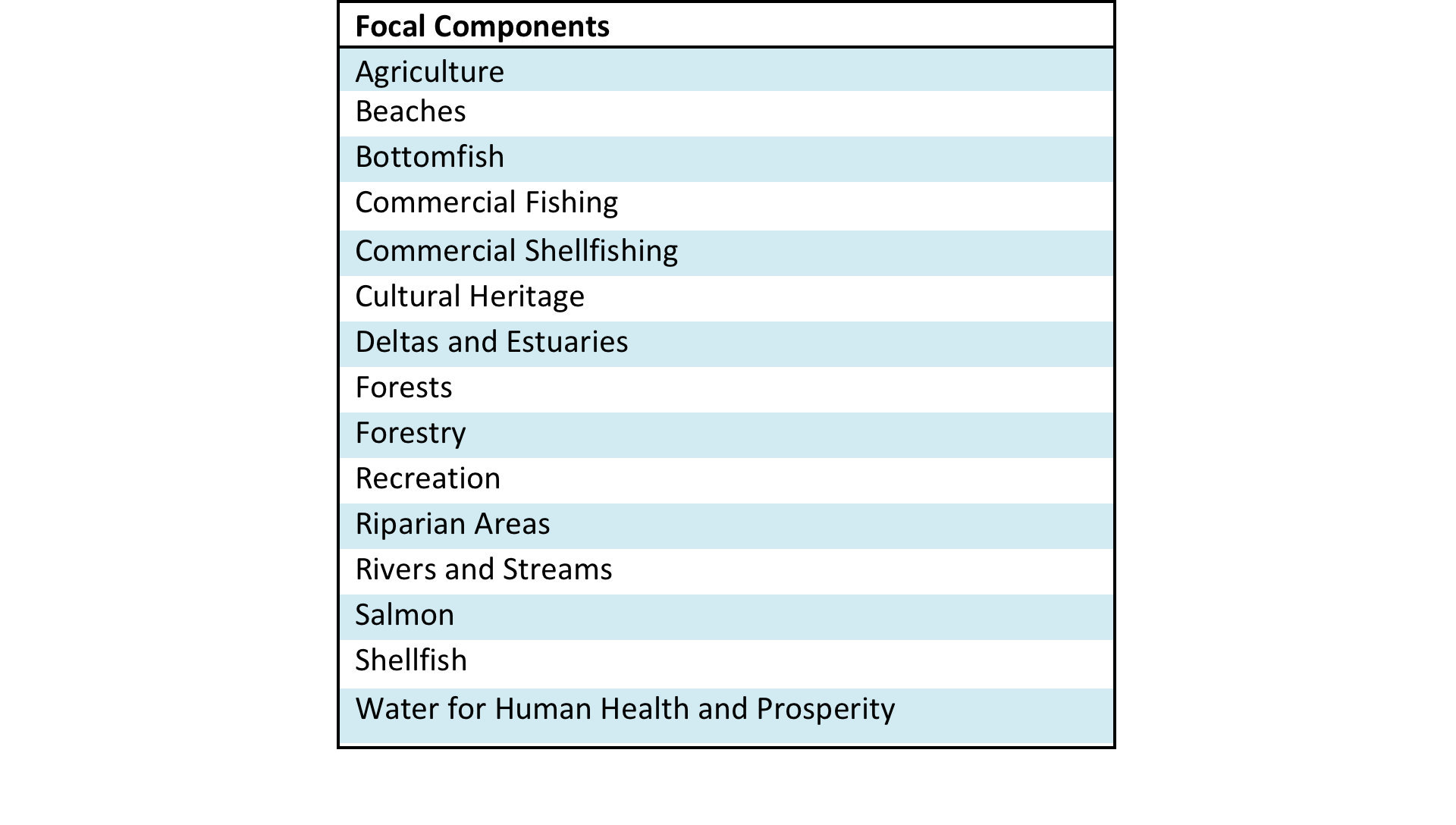
the HCCC Integrated Watershed Plan

Slide 4
the HCCC Integrated Watershed Plan
Establish five year strategic priorities for HCCC
Focus on five focal components:
  Shellfish, Commercial shellfishing, Salmon, Forests, forestry
Four primary pressures:
  Commercial and residential development, transportation and service corridors, Climate change and ocean acidification, wastewater discharges and stormwater runoff

Slide 5
the HCCC Integrated Watershed Plan
Key strategies: HCCC is uniquely positioned as regional entity to advance:
  Policy and regulatory
  Ecological restoration, remediation or enhancement
  Education, outreach and communication

Slide 6
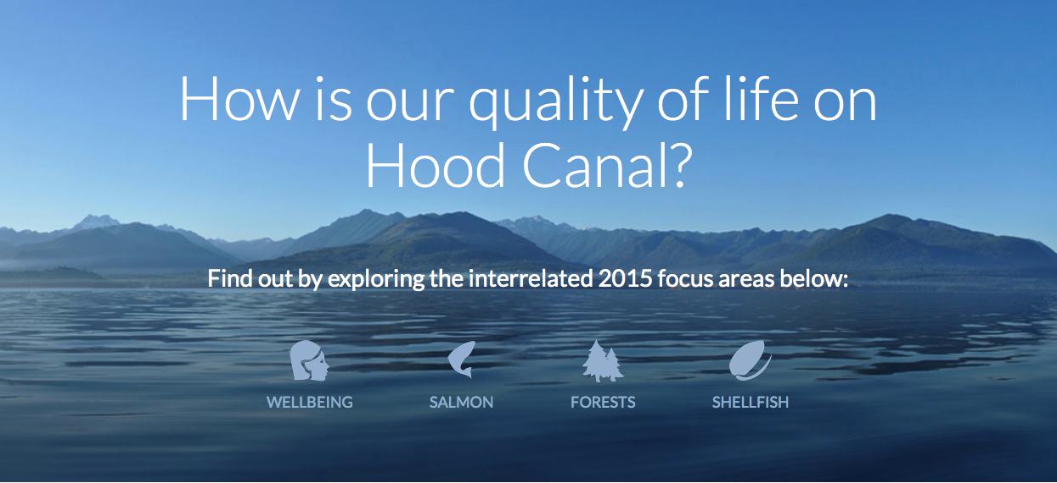
the HCCC Integrated Watershed Plan
Notes:
The Hood Canal Coordinating Council is a forum for local and tribal governments from across the canal to work in partnership with state, federal, and tribal agencies, community groups, and residents to protect and improve Hood Canal’s natural environment for the benefit of all. Out Integrated Watershed Plan is designed to help keep Hood Canal a unique and special place for generations to come.

Slide 7
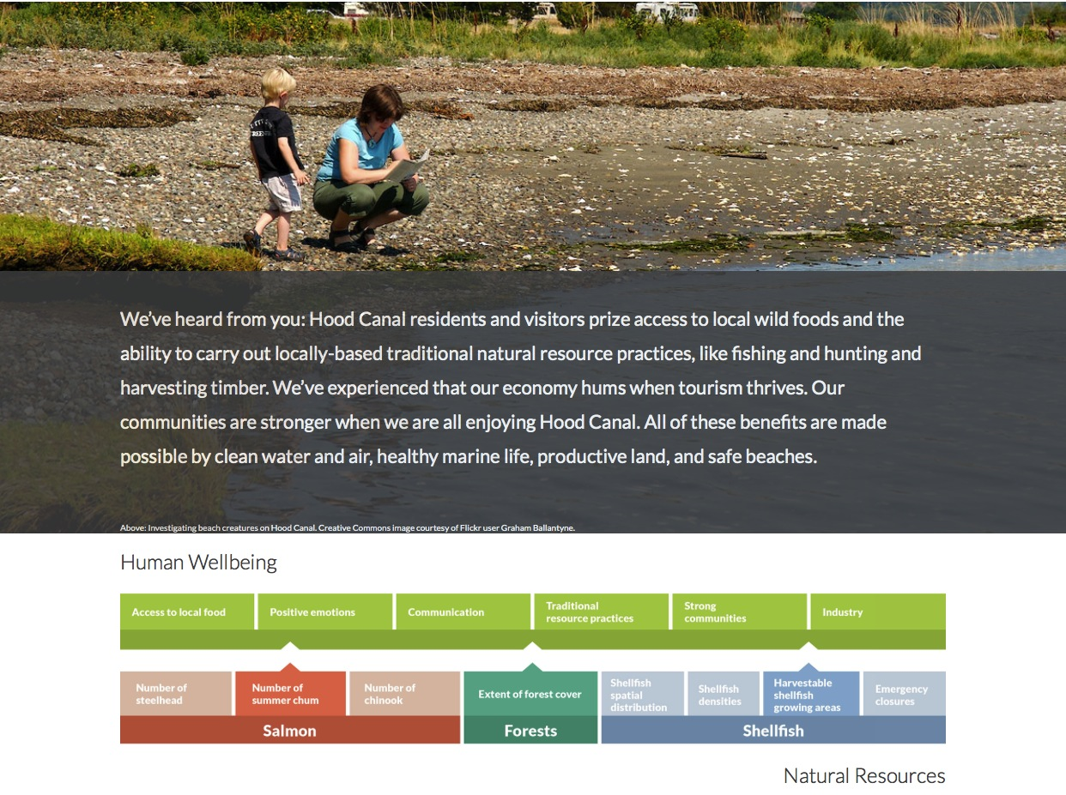

Slide 8
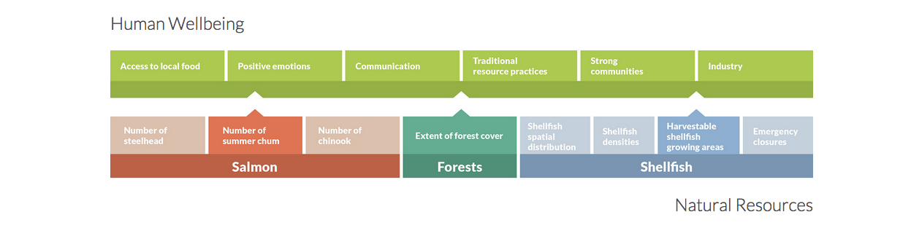
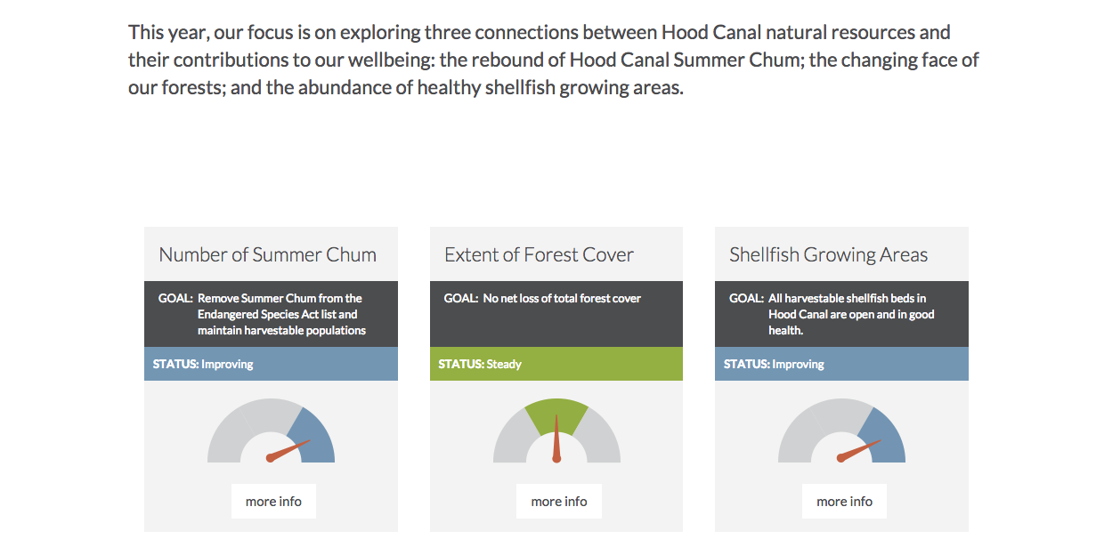

Slide 9
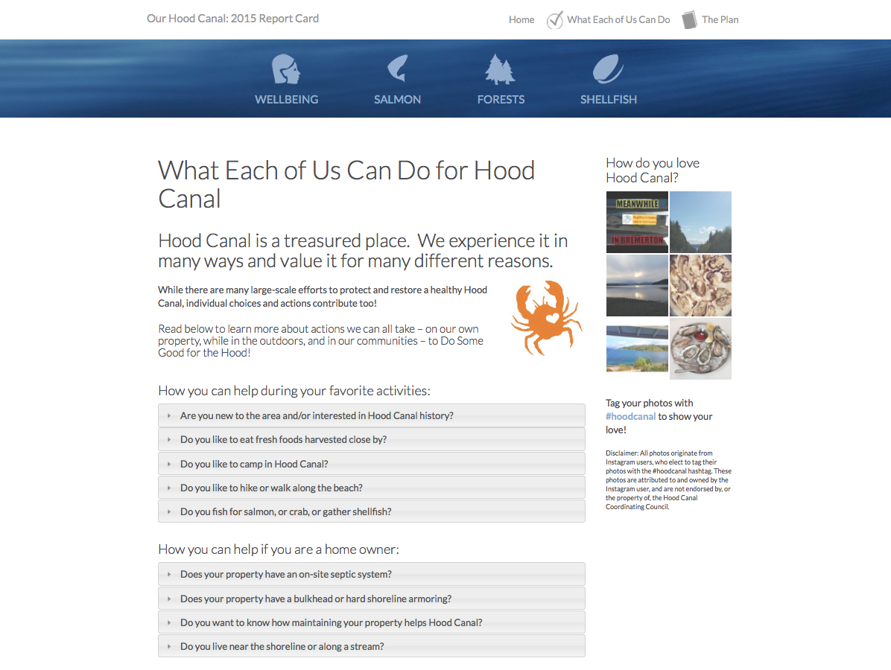

Slide 10
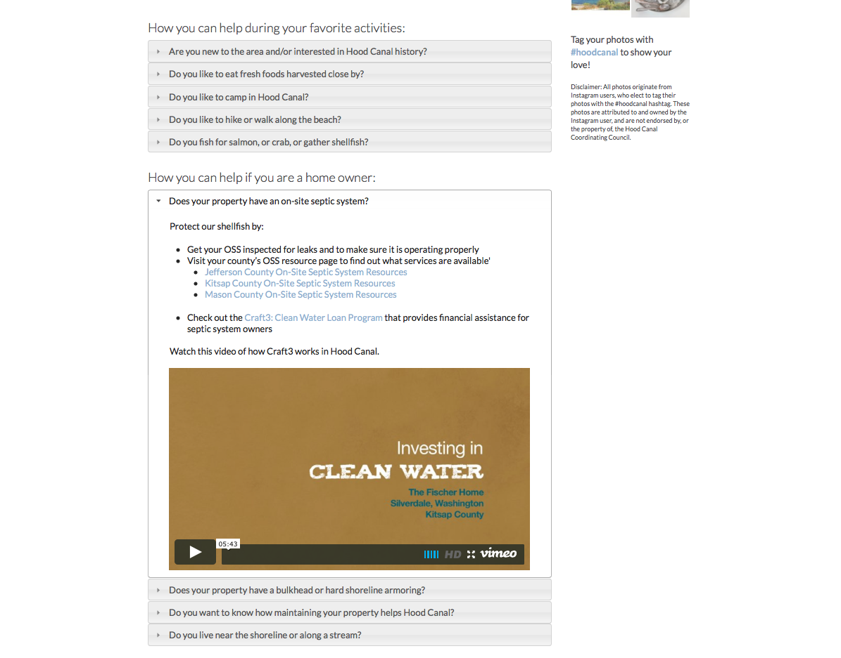

Slide 11
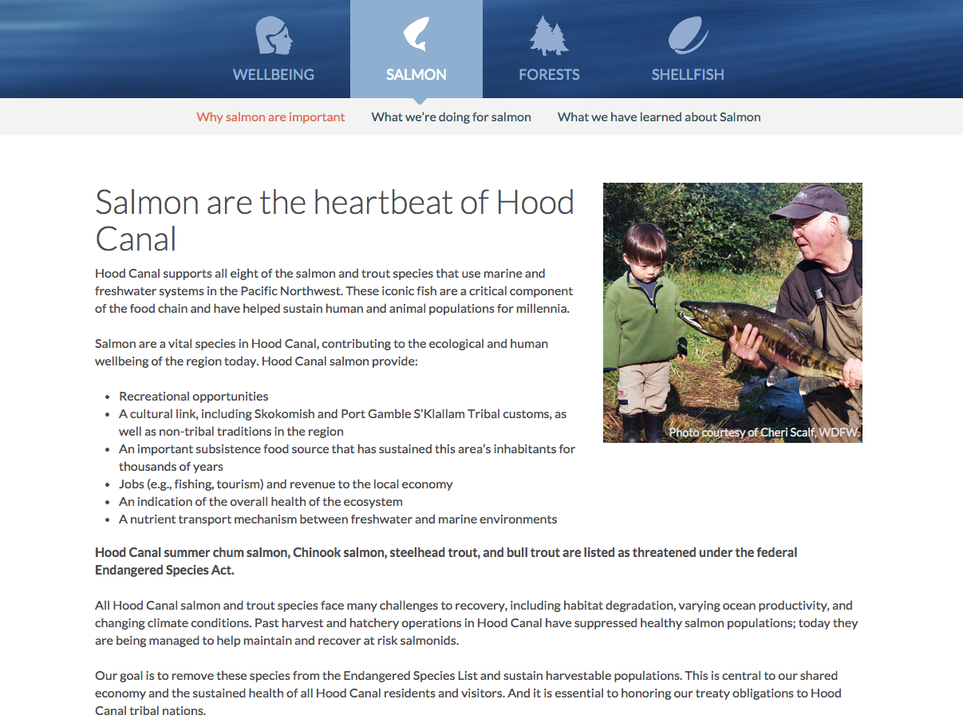

Slide 12
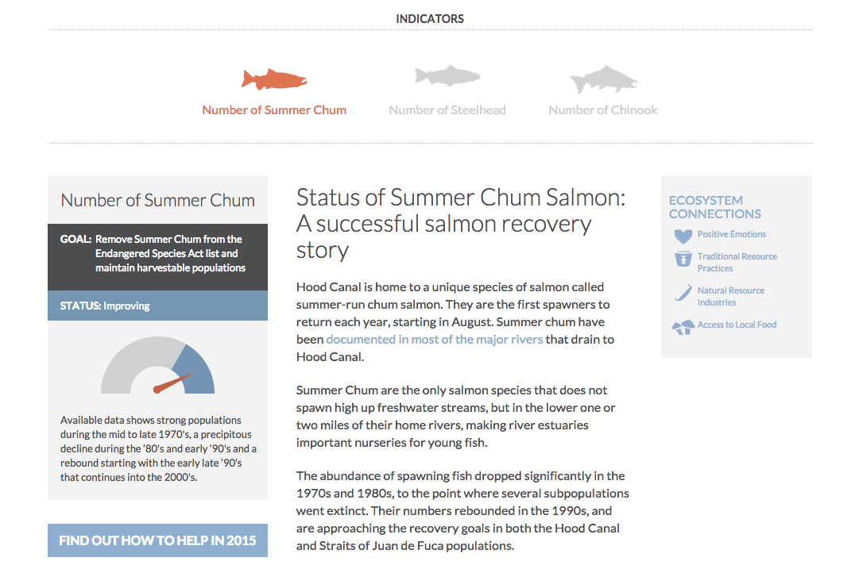

Slide 13
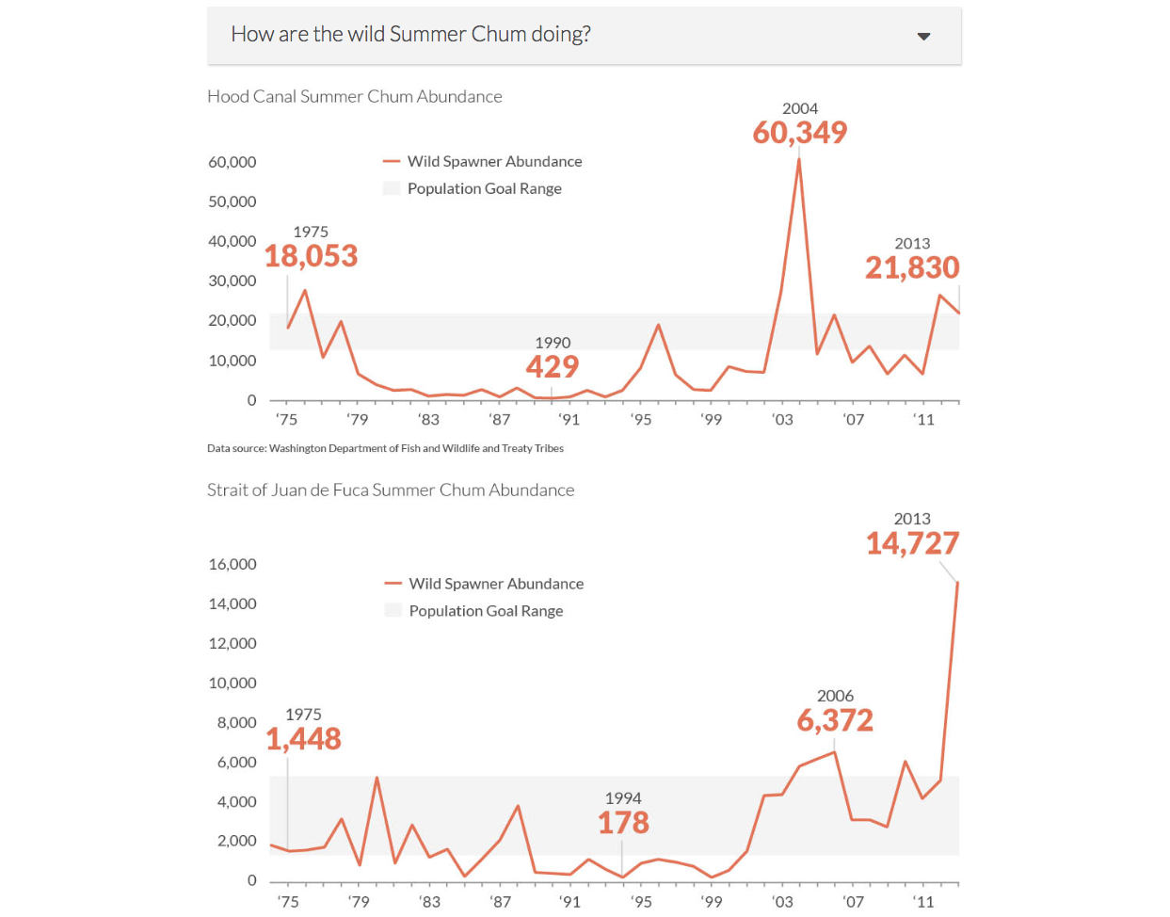

Slide 14
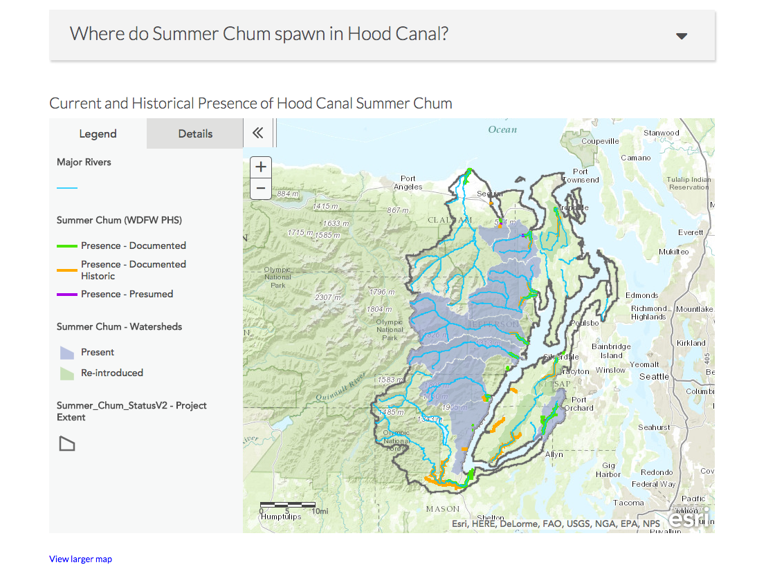

Slide 15
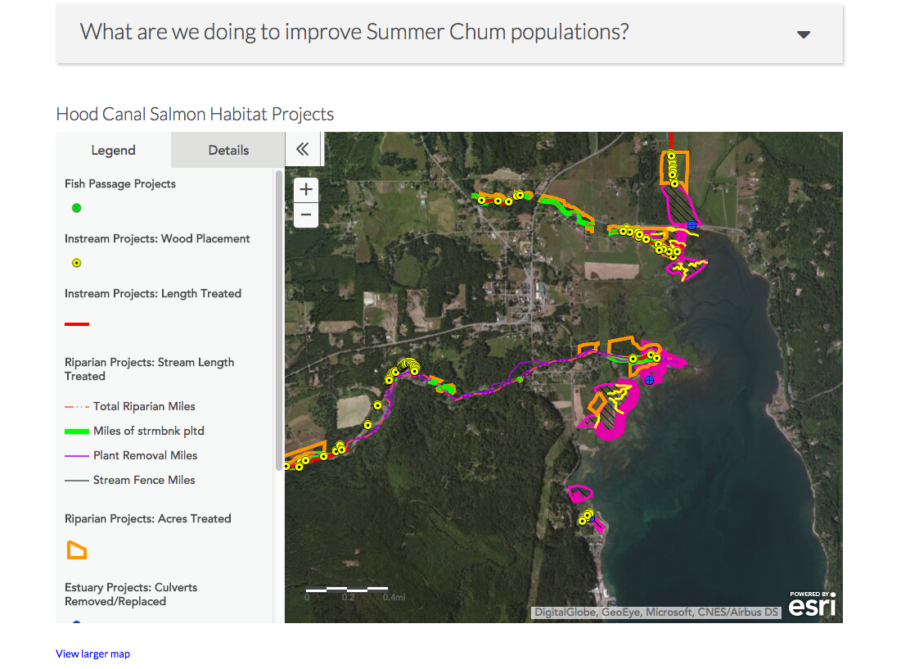

Slide 16
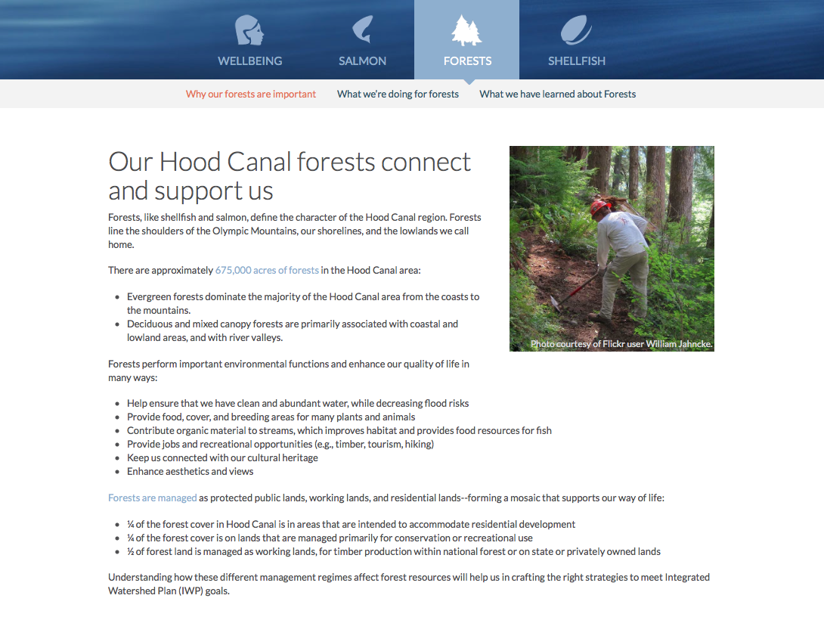

Slide 17
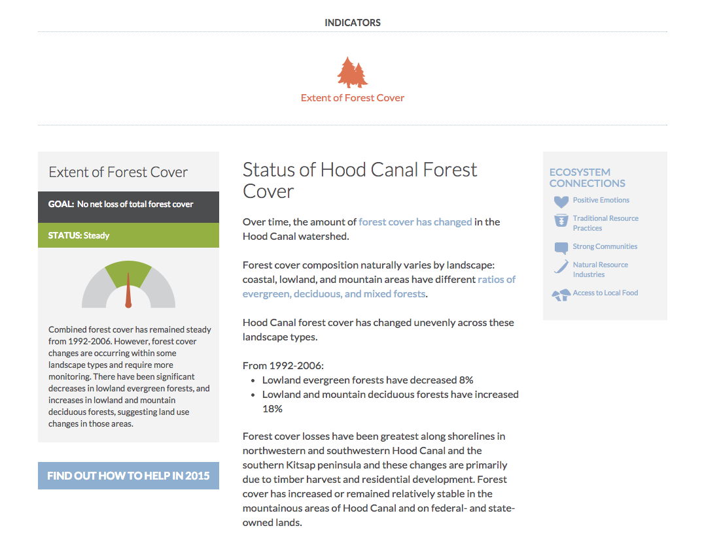

Slide 18
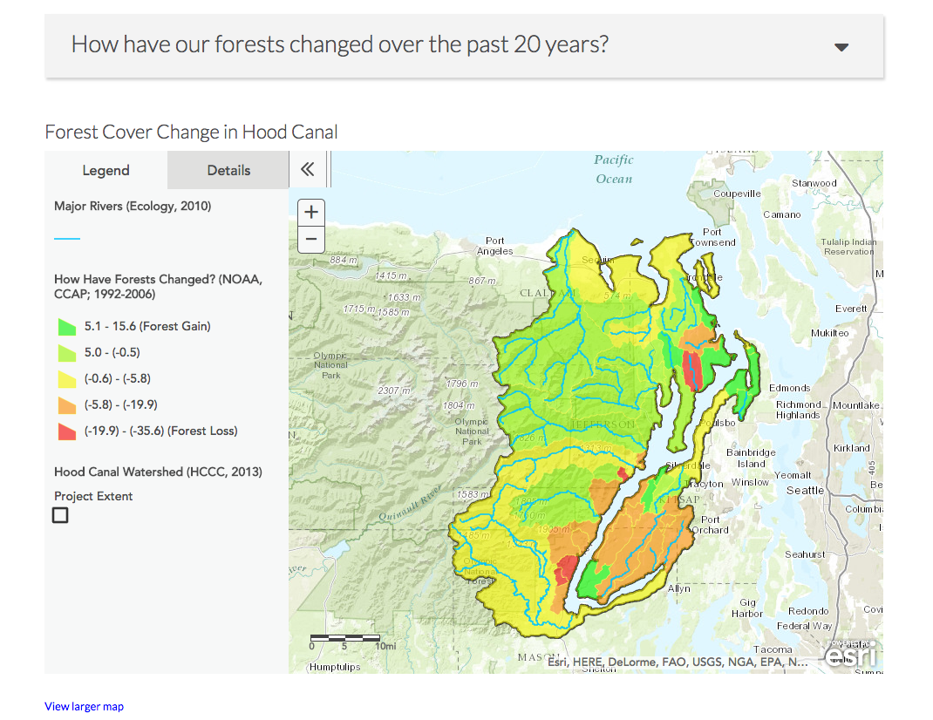

Slide 19
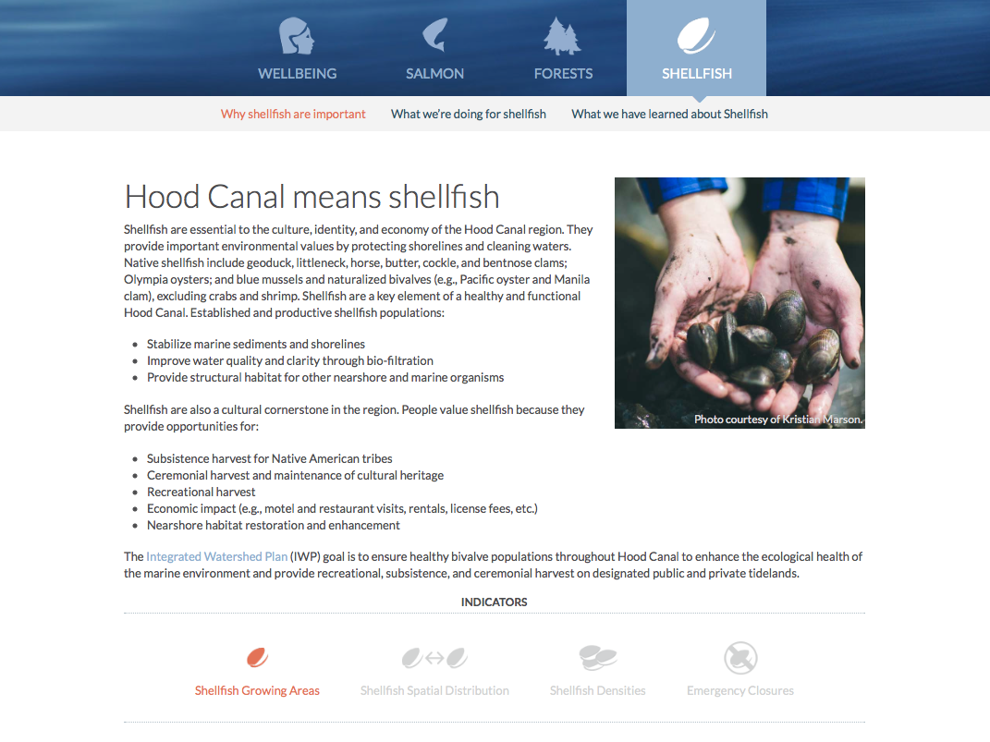

Slide 20
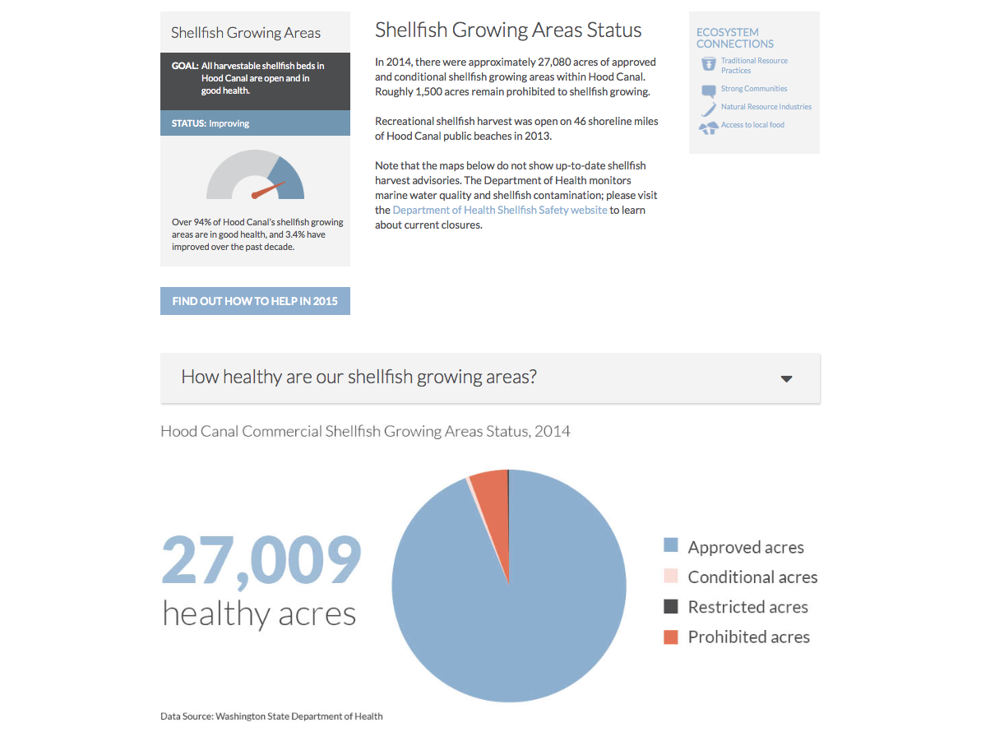

Slide 21
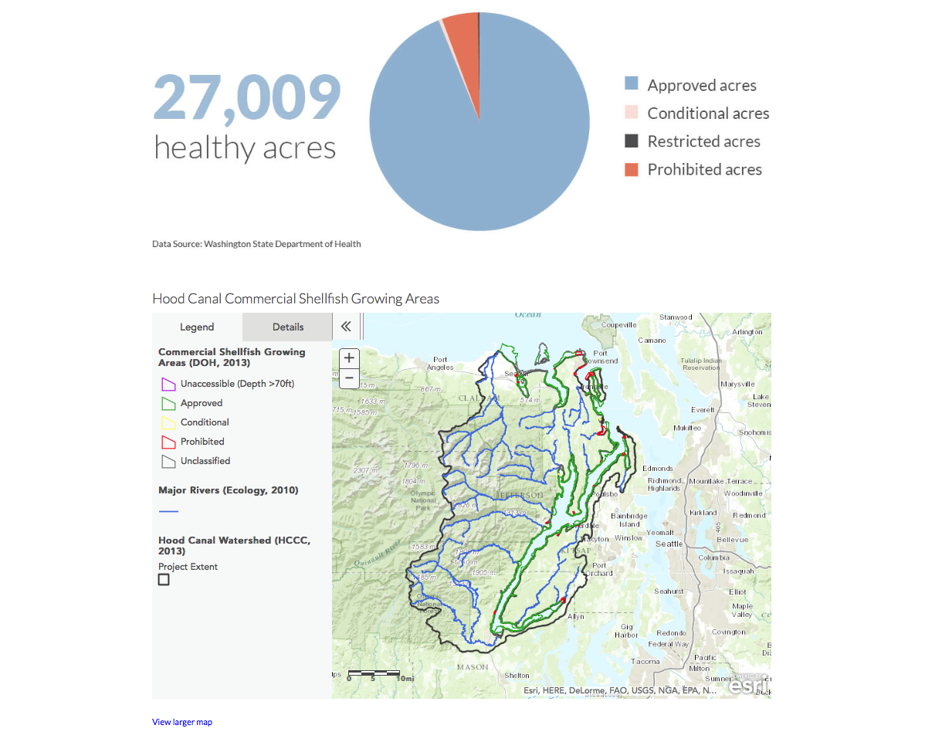

Slide 22
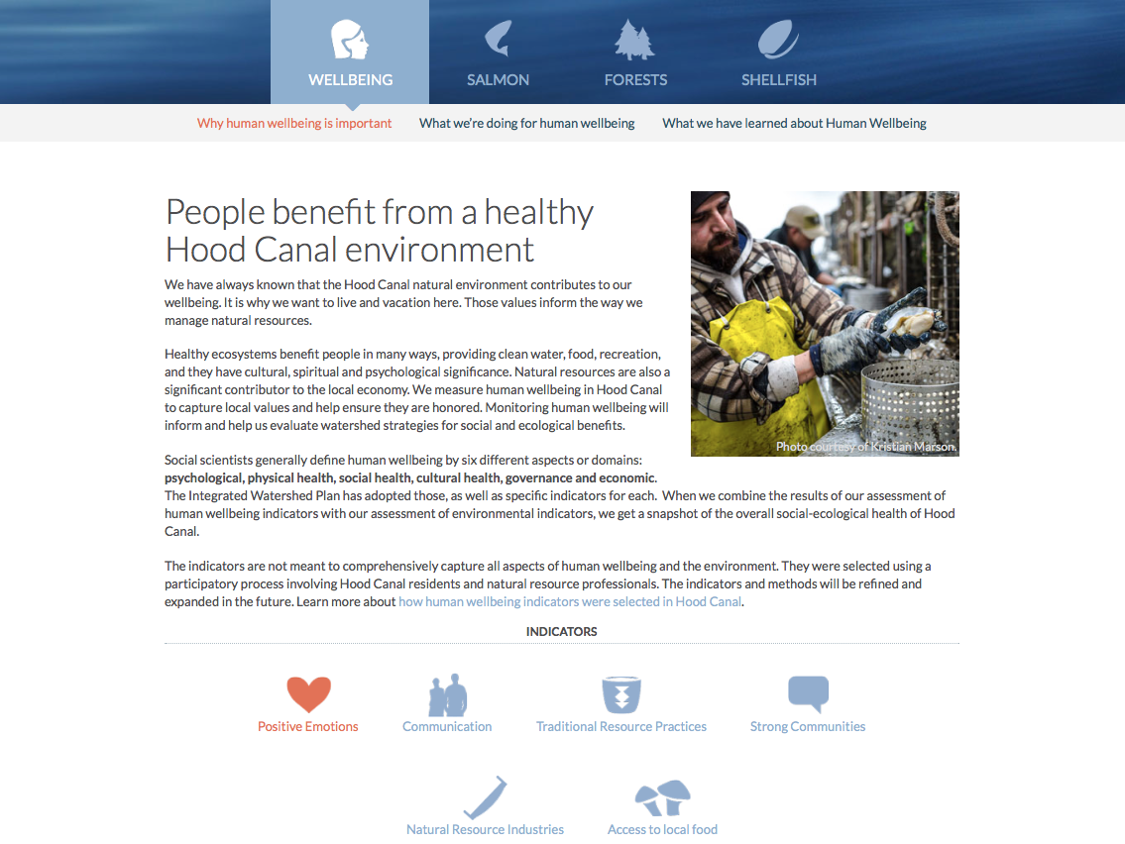



Slide 23
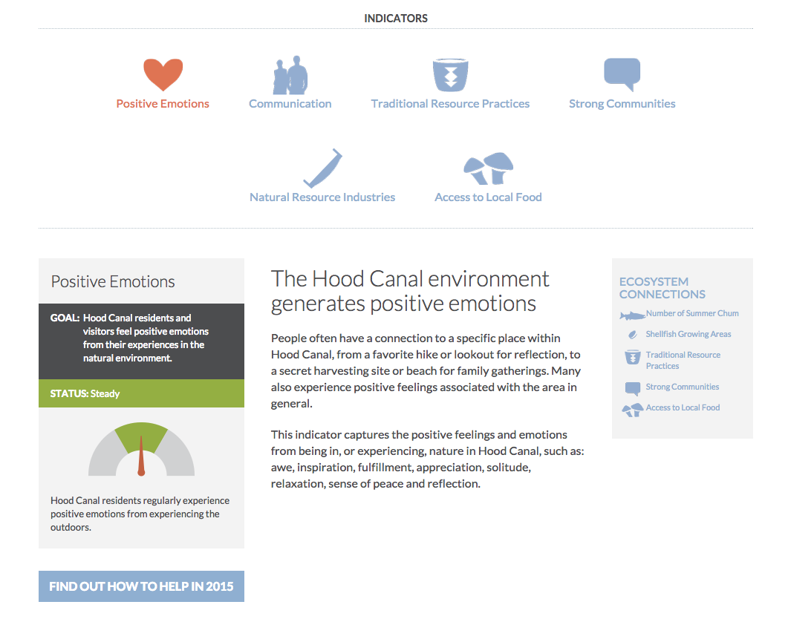
Positive Emotions

Slide 24
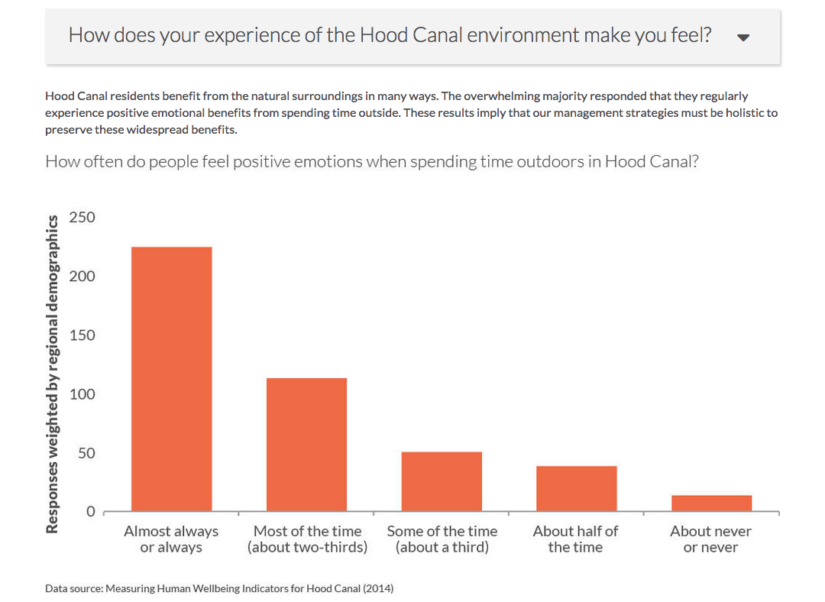
Positive Emotions

Slide 25
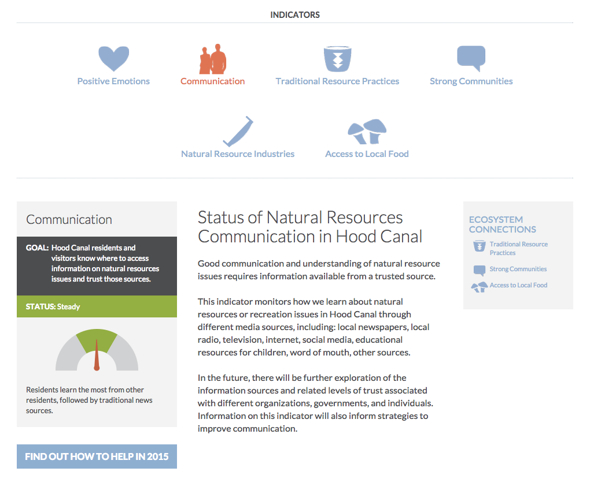

Communication

Slide 26
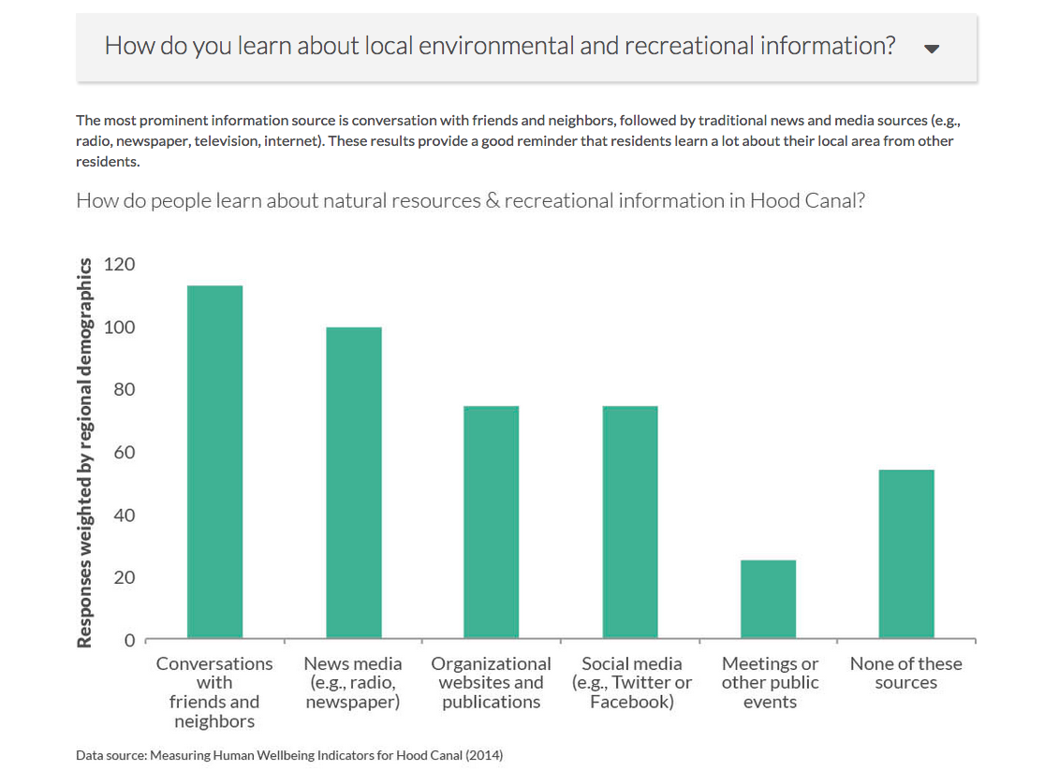
Communication

Slide 27
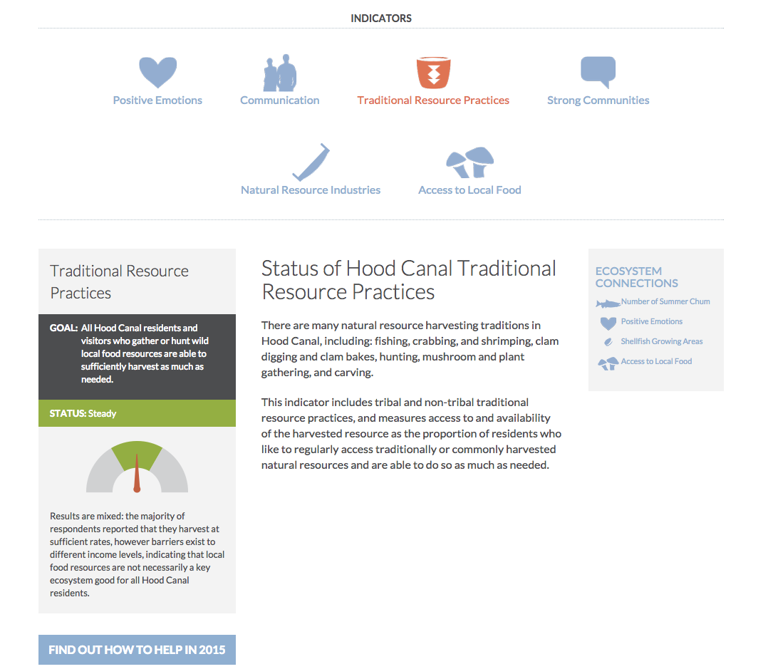
Traditional Resource Practices

Slide 28
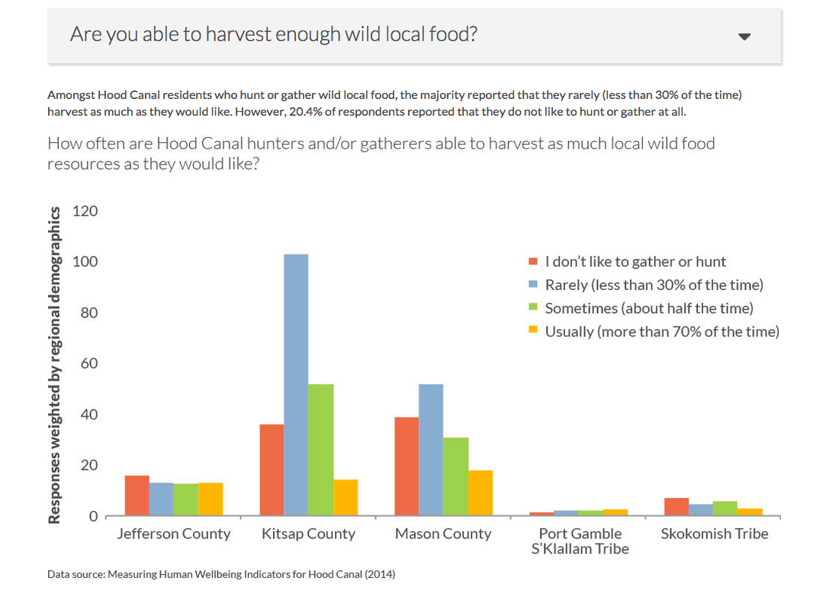
Traditional Resource Practices

