Slide 1
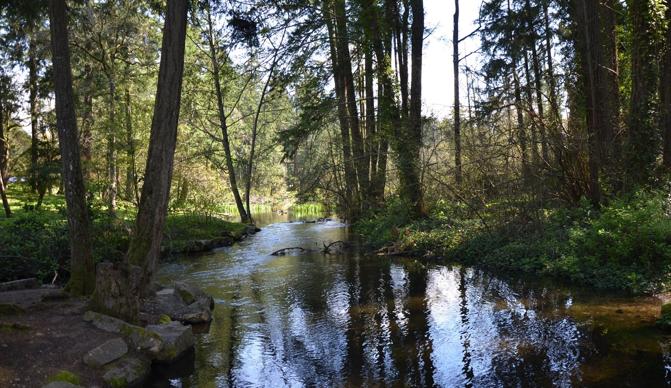
Spanaway Lake Watershed: Watershed-Scale Stormwater Planning in a Watershed Dominated by Groundwater
August 2017 StormCon
Pierce County:
Tom Kantz
Shuhui Dun
Brown and Caldwell:
Mike Milne
Jon Turk
Notes:
MM

Slide 2
Background

Slide 3
Background
Pierce County is covered by Phase I Municipal Stormwater Permit (Permit), issued by state Department of Ecology
Permit requires development of a watershed-scale stormwater plan (WSP)
Pierce County selected the Spanaway Lake watershed
Notes:
MM

Slide 4
WSP Requirements
Implements requirements in Phase I Municipal Stormwater Permit (2013–2018)
Construct a continuous flow model of the Spanaway Creek/Lake watershed
Estimate historic and predict future hydrologic, biologic, and water quality conditions at full build-out for:
Copper & Zinc
Temperature
Fecal coliform bacteria
Changes in benthic community (B-IBI Scores) due to hydrologic change (DeGaspari et al. 2009)
Identify and model stormwater management strategies that fully support designated uses, and must consider:
Changes to development-related codes, rules, standards, and plans
Potential future structural stormwater control projects
Create an implementation plan and schedule, with responsible parties, costs, and funding mechanisms

Slide 5
Spanaway Watershed Overview

Slide 6
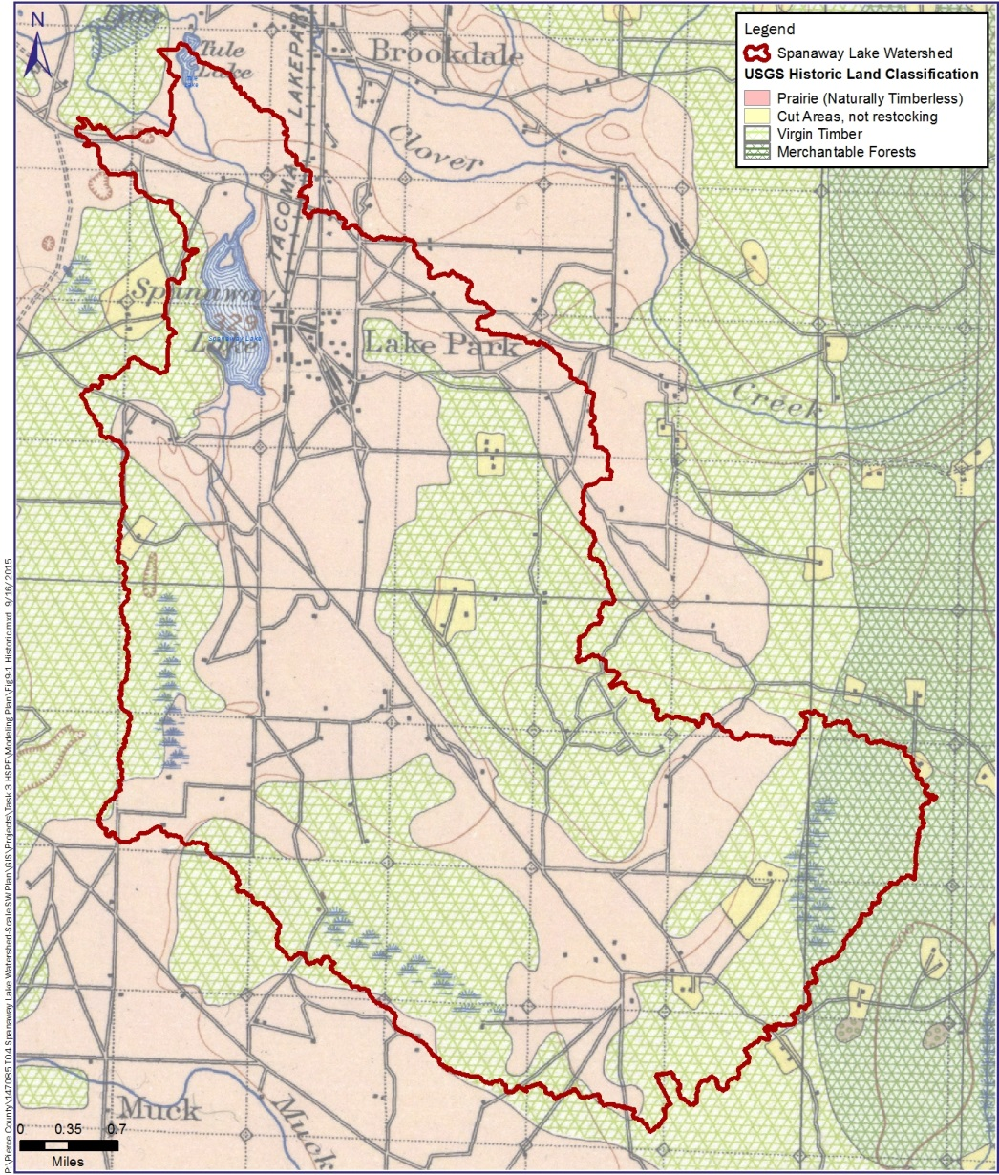
Historic Land Cover
Much of Spanaway WSP area was covered by prairie
Large wetland systems upgradient of Spanaway Lake
Spanaway Watershed 1897 (USGS)
Notes:
Public facilities (~3,000 acres)
Numerous stormwater infiltration facilities and septic systems

Slide 7
Permeable Soils Cover Most of Watershed
Table 4‑1. NRCS HSGs in Spanaway Lake Watershed
Hydrologic soil group | Description | % of watershed
A | Soils with high infiltrations rates. Usually deep, well-drained sands or gravels. Little runoff. | 79.7
B | Soils with moderate infiltration rates. Usually moderately deep, moderately well-drained soils. | 7.7ª
C | Soils with slow infiltration rates. Soils with finer textures and slow water movement. | See footnote a
D | Soils with very slow infiltration rates. Soils with high clay content and poor drainage. High amounts of runoff. | 1.0ª
a. There are no soils classified as HSG C; however, 8.8% of soils are classified as B/D, 0.4% are classified as C/D, and 2.4% are classified as unknown.
Spanaway Lake is a “kettle” lake with substantial groundwater inflow
Notes:
Permeable soils
Stormwater infiltrates so Little surface runoff
Coffee Creek is only appreciable surface water source

Slide 8
Current Land Use
67% unincorporated Pierce County
Residential & commercial
Parks/golf courses
Public facilities
33% JBLM
Undeveloped
Wetlands
Population (PSRC)
2014: ~44,200
2030: ~49,900
2040: ~50,500
Current Land Use (Pierce County 2016)
Notes:
Lake Park development
About 45,000 people live in watershed
Residential and commercial land uses (~10,000 acres)
Parks and golf courses (~70,000 acres)
Public facilities (~3,000 acres)
Numerous stormwater infiltration facilities and septic systems

Slide 9
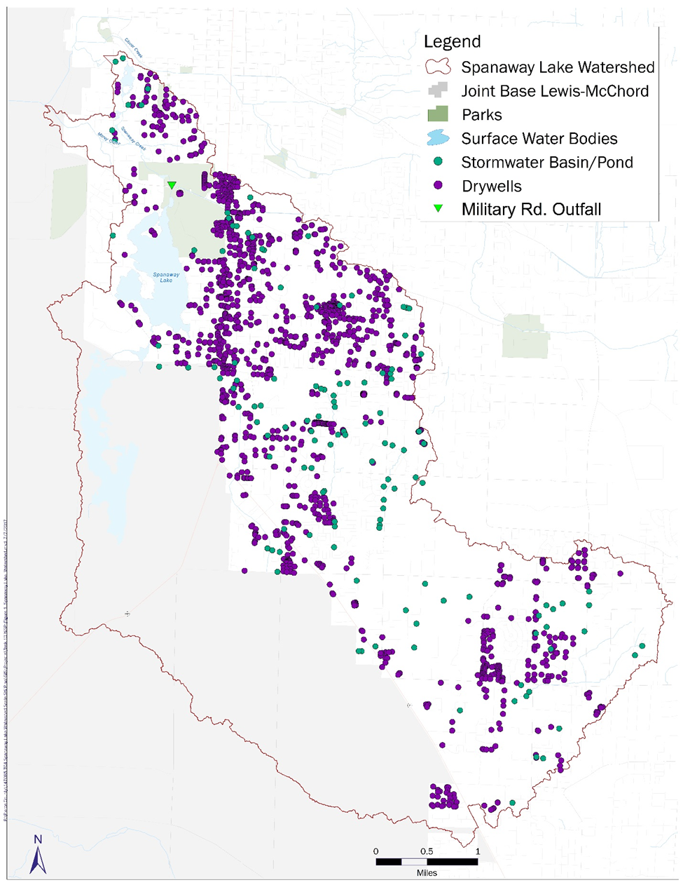
Stormwater Infiltration Facilities
~1,400 dry wells
~75 infiltration ponds
Only one large stormwater outfall (Military Rd)
Numerous infiltration facilities reduce surface flow to Military Rd. outfall
Notes:
~1,500 dry wells and 130 stormwater infiltration basins in watershed.
Many dry wells near lake have been replaced with infiltration galleries with pre-treatment vaults.

Slide 10
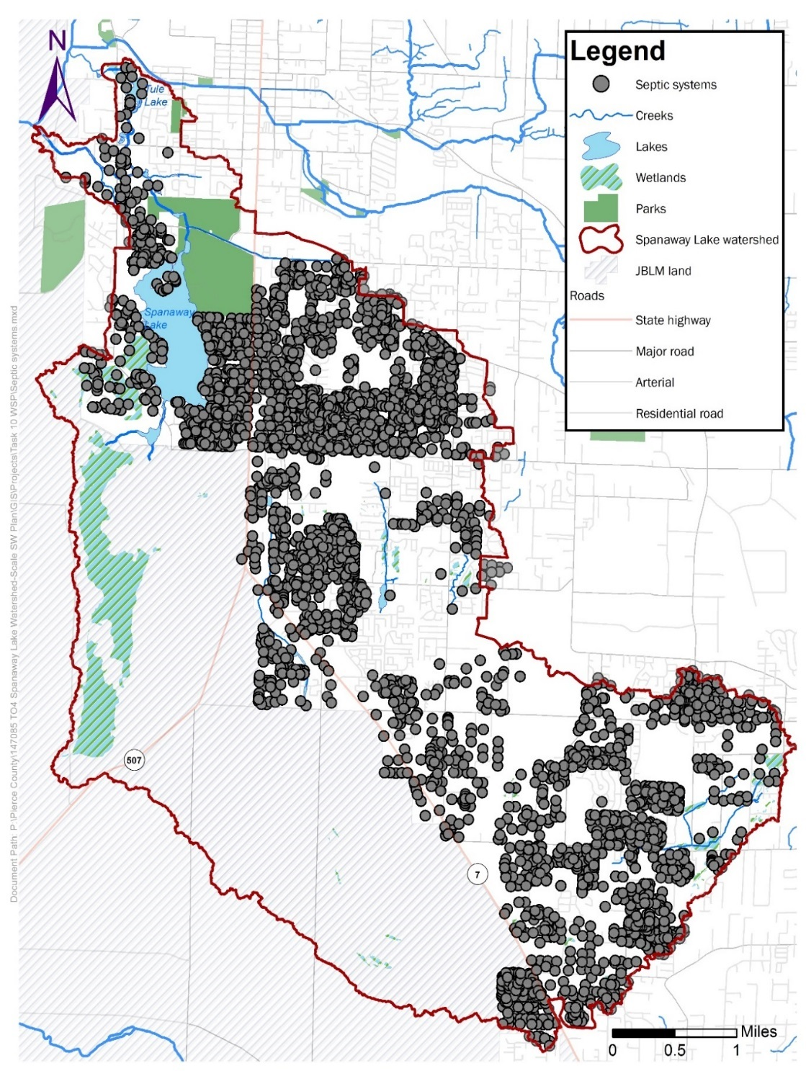
Septic Systems
>4,000 septic systems in Spanaway WSP area
Surface “failures” are very rare due to very permeable soils
Notes:
~1,500 dry wells and 130 stormwater infiltration basins in watershed.
Many dry wells near lake have been replaced with infiltration galleries with pre-treatment vaults.

Slide 11
Monitoring and Modeling Results

Slide 12
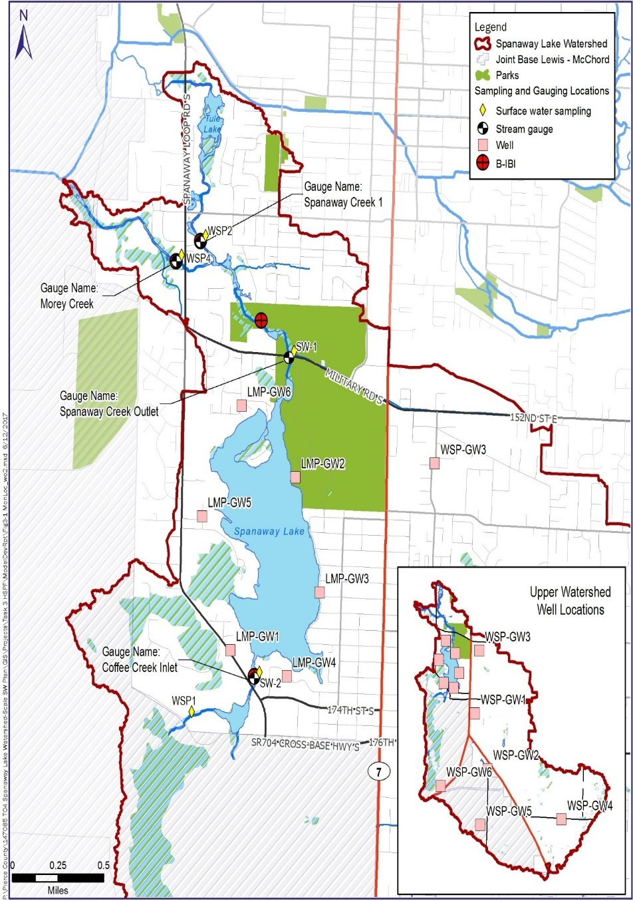
Spanaway WSP Monitoring Program (10/14-3/16)
Coffee, Spanaway & Morey Creeks flow, water quality, sediment, B-IBI
Baseflow and storm
Spanaway Lake water quality and elevation
Groundwater quality & elevation
Precipitation
Spanaway Monitoring Locations

Slide 13
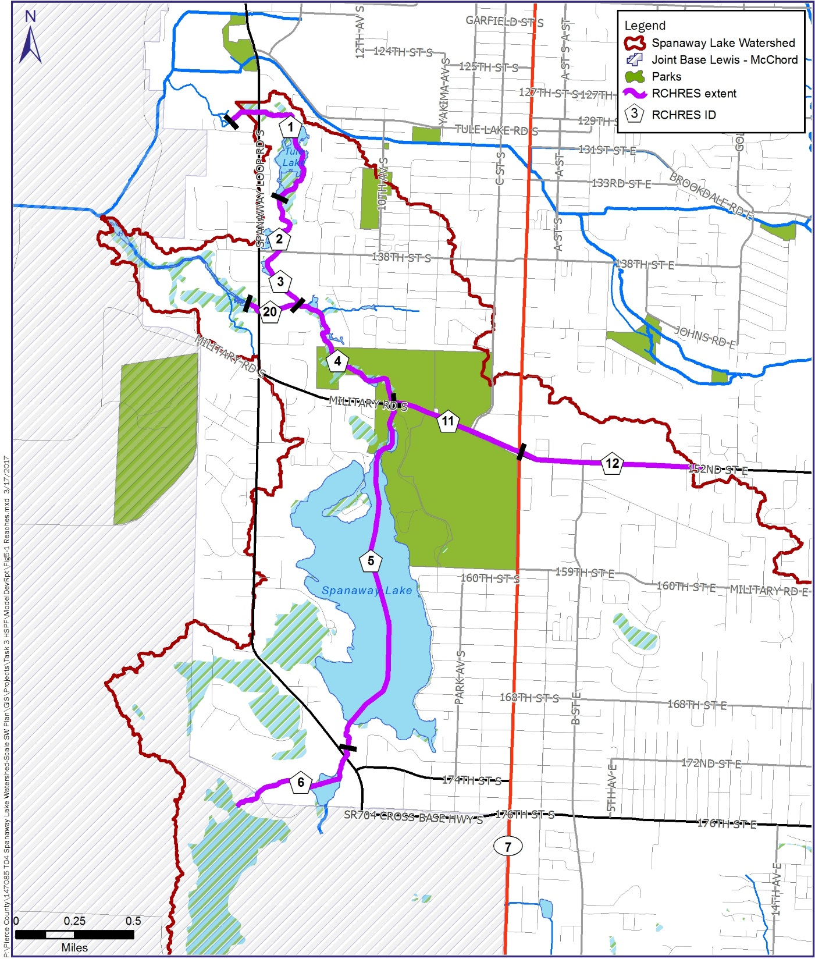
Hydrological Simulation Program – Fortran (HSPF)
Developed Hydrologic Response Units (HRUs) based on land use/land cover, soil, and slope
109 HRUs for pervious areas in WSP
32 HRUs for impervious areas in WSP

Slide 14
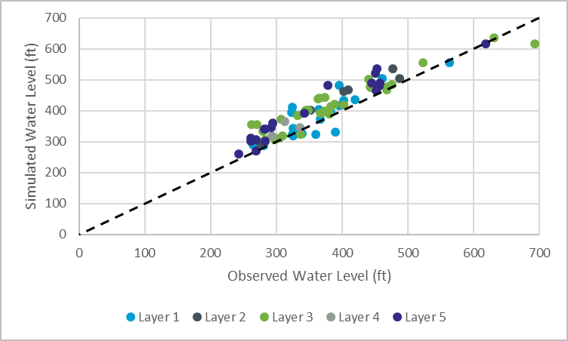
Refined and Calibrated MODFLOW Model
Observed vs. simulated water levels
Notes:
We rediscretized the regional USGS model to provide much finer resolution for Spanaway WSP, especially near lake and creeks. MODFLOW shows GW flow paths to lake/creeks, GW discharges rates, etc.

Slide 15
Simulated Hydrologic Metrics for Existing Conditions
Simulated Existing Hydrologic Flashiness Metrics
Hydrologic Flashiness Metric | SW-1 (Spanaway Creek Outlet) | SW-2 (Coffee Creek Inlet) | WSP2 (Spanaway Creek 1) | WSP4 (Morey Creek) | Mean (Range) from 16 streams in DeGasperi et al. (2009)
Low pulse count | 4 | 3 | 5 | 3 | 10 (2–28)
Low pulse duration | 25 | 48 | 25 | 20 | 26 (7–93)
High pulse count | 2 | 1 | 2 | 2 | 10 (2–22)
High pulse duration | 20 | 30 | 16 | 16 | 7 (2–31)
High pulse range | 106 | 104 | 113 | 114 | 168 (34–306)
Flow reversals | 56 | 39 | 58 | 60 | 55 (37–70)
TQ_{mean} | 0.43 | 0.4 | 0.45 | 0.37 | 0.31 (0.25–0.38)
Richards-Baker flashiness index | 0.04 | 0.03 | 0.04 | 0.07 | 0.27 (0.08–0.49)
Calibrated model shows that 99% of streamflow is from groundwater
Less flashy than other basins in Puget Sound lowlands

Slide 16
Simulated Hydrologic Metrics for Historic and Future Conditions
Table 6‑10. Simulated Historical and Future Hydrologic Flashiness Metrics
Hydrologic Flashiness Metric | Spanaway Creek Outlet (SW-1) | Coffee Creek Inlet (SW-2) | Spanaway Creek 1 (WSP2) | Morey Creek (WSP4) | Spanaway Creek Outlet (SW-1) | Coffee Creek Inlet (SW-2) | Spanaway Creek 1 (WSP2) | Morey Creek (WSP4)
 | Historical |  |  |  | Future
Low pulse count | 5 | 2 | 5 | 3 | 4 | 3 | 6 | 4
Low pulse duration | 18 | 61 | 26 | 17 | 26 | 39 | 20 | 18
High pulse count | 1 | 1 | 1 | 1 | 2 | 2 | 3 | 4
High pulse duration | 24 | 48 | 31 | 26 | 18 | 23 | 10 | 10
High pulse range | 81 | 88 | 86 | 76 | 105 | 126 | 138 | 140
Flow reversals | 54 | 26 | 46 | 49 | 56 | 52 | 66 | 71
TQ_{mean} | 0.42 | 0.4 | 0.43 | 0.43 | 0.43 | 0.4 | 0.46 | 0.36
Richards-Baker flashiness index | 0.03 | 0.02 | 0.03 | 0.04 | 0.04 | 0.03 | 0.06 | 0.09

Slide 17
Future Copper or Zinc Exceedances Are Unlikely
Table 6‑7. Simulated Dissolved Copper Results under Existing, Historical and Future Scenarios
Water Quality Criteria/Spanaway Lake WSP Model Run | Unit | SW-1 (Spanaway Creek Outlet) | SW-2 (Coffee Creek Inlet) | WSP2 (Spanaway Creek 1) | WSP3 | WSP4 (Morey Creek)
Minimum hardnessª | mg/L | 31 | 22.8 | 30.1 | 25.8 | 30.2
Copper acute life criteria: freshwater—acute | µg/L | 5.6 | 4.2 | 5.5 | 4.7 | 5.5
Copper acute life criteria; freshwater—chronic | µg/L | 4.2 | 3.2 | 4.1 | 3.6 | 4.1
Maximum Simulated Concentrations
Existing condition | µg/L | 0.4 | 2.4 | 0.8 | 0.9 | 0.8
Historical condition | µg/L | 0.5 | 1.2 | 0.7 | 0.7 | 0.7
Future condition | µg/L | 0.4 | 0.8 | 1.0 | 0.9 | 1.0
Minimum observed hardness from monitoring data

Slide 18
Water Temperatures in Spanaway Lake and Downstream Sites Often Exceeded 17.5

Slide 19
Fecal Coliform Monitoring Results

Slide 20
Spanaway WSP B-IBI Monitoring Sites
Table 5‑10. Observed B-IBI Results for Spanaway Lake WSP Monitoring Sites (10-50 Scale)
Basis of B-IBI Score | Spanaway Creek Outlet (SW-1) | Coffee Creek Inlet (SW-2) | Spanaway Creek 1 (WSP2) | Morey Creek (WSP4)
Observed B-IBI 2015 | 18 | 26 | 18 | 22
B-IBI Results for Spanaway Lake WSP Monitoring Sites (0-100 Scale)
Site Code | Site Name | Year | Scores: 0–100 Scale, 2012 taxa list
 |  |  | Overall Score | Taxa Richness | Ephemeroptera Richness | Plecoptera Richness | Trichoptera Richness | Clinger Richness | Long-lived Richness | Intolerant Richness | Percent Dominant | Predator % | Tolerant Percent
SW-1 | Spanaway Creek | 2015 | 11.0 | 0.3 | 0.0 | 0.0 | 2.5 | 0.6 | 5.0 | 0.0 | 1.3 | 1.3 | 0.0
SW-2 | Coffee Creek | 2015 | 40.5 | 4.1 | 4.3 | 5.7 | 3.8 | 4.1 | 2.5 | 0.0 | 5.3 | 3.3 | 7.4
WSP2 | Spanaway Creek | 2015 | 14.5 | 2.4 | 0.0 | 0.0 | 2.5 | 0.0 | 3.8 | 0.0 | 1.7 | 4.2 | 0.0
WSP4 | Morey Creek | 2015 | 35.3 | 9.7 | 1.4 | 0.0 | 2.5 | 2.4 | 2.5 | 0.0 | 4.4 | 10.0 | 2.4
Excellent | Good | Fair | Poor | Very Poor

Slide 21
Predicted B-IBI Scores Based on Simulated Hydrologic Metrics and Regression Equations
Table 6‑11. Observed and Simulated Existing B-IBI Scores Based on Hydrologic Metrics (10-50 Scale)
Basis of B-IBI Score | Spanaway Creek Outlet (SW-1) | Coffee Creek Inlet (SW-2) | Spanaway Creek 1 (WSP2) | Morey Creek (WSP4)
Observed B-IBI 2015 | 18 | 26 | 18 | 22
Low pulse count | 32 | 36 | 31 | 35
Low pulse duration | 27 | 34 | 27 | 25
High pulse count | 40 | 41 | 39 | 39
High pulse duration | 39 | 44 | 37 | 37
High pulse range | 32 | 32 | 31 | 31
Flow reversals | 24 | 37 | 22 | 21
TQ_{mean} | 42 | 37 | 45 | 34
Richards-Baker flashiness index | 37 | 37 | 37 | 35
Regression equations from DeGaspari et al. (2009) over-estimate B-IBI scores
Hydrology is likely not a key stressor for benthic organisms in Spanaway watershed

Slide 22
Small Differences in Historic and Future B-IBI Scores Based on Regression Equations
Table 6‑12. Simulated Historical and Future B-IBI Scores (10-50 Scale)
Hydrologic Flashiness Metric | Spanaway Creek Outlet (SW-1) | Coffee Creek Inlet (SW-2) | Spanaway Creek 1 (WSP2) | Morey Creek (WSP4) | Spanaway Creek Outlet (SW-1) | Coffee Creek Inlet (SW-2) | Spanaway Creek 1 (WSP2) | Morey Creek (WSP4)
 | Historical |  |  |  | Future
Low pulse count | 29 | 39 | 30 | 34 | 32 | 34 | 28 | 33
Low pulse duration | 24 | 36 | 28 | 23 | 28 | 32 | 25 | 24
High pulse count | 41 | 43 | 41 | 42 | 40 | 40 | 36 | 36
High pulse duration | 42 | 49 | 44 | 42 | 39 | 41 | 32 | 33
High pulse range | 36 | 35 | 35 | 37 | 32 | 29 | 27 | 27
Flow reversals | 25 | 47 | 32 | 29 | 24 | 27 | 17 | 13
TQ_{mean} | 40 | 37 | 42 | 42 | 42 | 37 | 46 | 32
Richards-Baker flashiness index | 37 | 38 | 37 | 37 | 37 | 37 | 36 | 34
90% of average | 31 | 36 | 33 | 32
Average |  |  |  |  | 34 | 35 | 31 | 29
Future average B-IBI scores are only 1-3 points less than 90% of historical average

Slide 23
Comparison of Spanaway WSP B-IBI Scores to Other Puget Sound Lowlands Sites

Slide 24
Temperature & Habitat Simplification Appear to be Key Stressors of Benthic Community
~1,400 infiltration facilities help offset elevated water temperature in creeks by minimizing direct stormwater discharge and increasing cool baseflow
Very little direct discharge, so little opportunity for more infiltration

Slide 25
MS4 Discharge Not a Major Limiting Factor in Spanaway
Table 7‑1. Summary of Predicted Excursions and Causes
WSP Parameter | Meets Criteria? |  | Causes or Sources for Excursions
 | Existing | Buildout | Primary | Secondary
Water temperature | No | No | Natural warming in Spanaway Lake | Reduced shade in some creek reaches
Fecal coliform | No | No | Waterfowl and other riparian wildlife | Stormwater runoff from Military Road sub-basin; runoff from shoreline areas with wildlife and domestic animals; shoreline septic systems; shoreline stormwater infiltration systems
Dissolved copper and zinc | Yes | Yes | Meets criteria | Meets criteria
B-IBI | No | No | Elevated water temperature, lack of habitat complexity | DO, fines, embeddedness
Notes:
Encourage redevelopment of older residential and commercial areas west of Pacific that developed prior to SW quality regs.
Two samples collected from well near boat ramp contained elevated zinc, but lake and creek samples were well below WQS for zinc

Slide 26
Potential Strategies

Slide 27
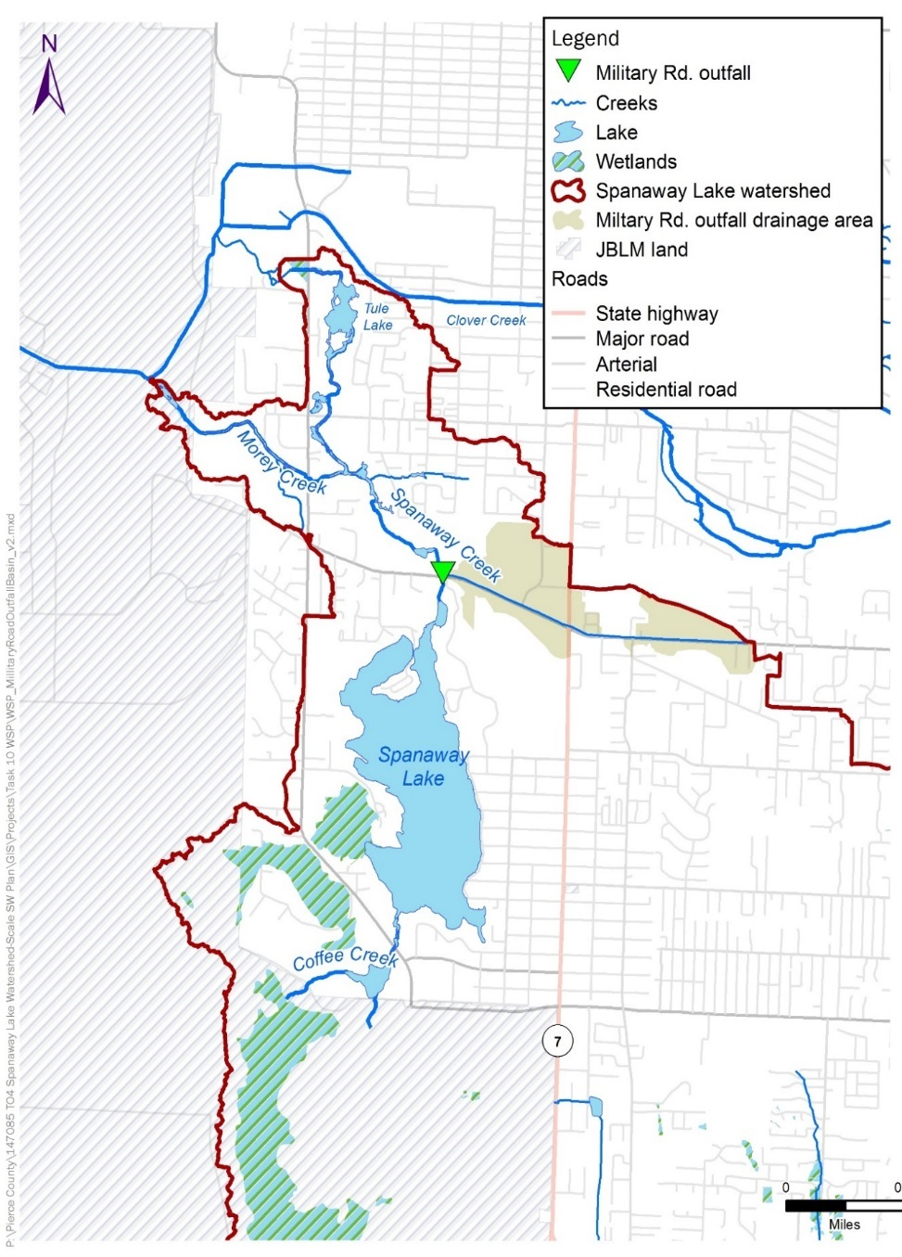
Military Road Stormwater Basin
Only 1 significant MS4 outfall in Spanaway WSP
County has already retrofitted this basin with:
Dry wells
Permeable pavement
Hydrodynamic separator

Slide 28
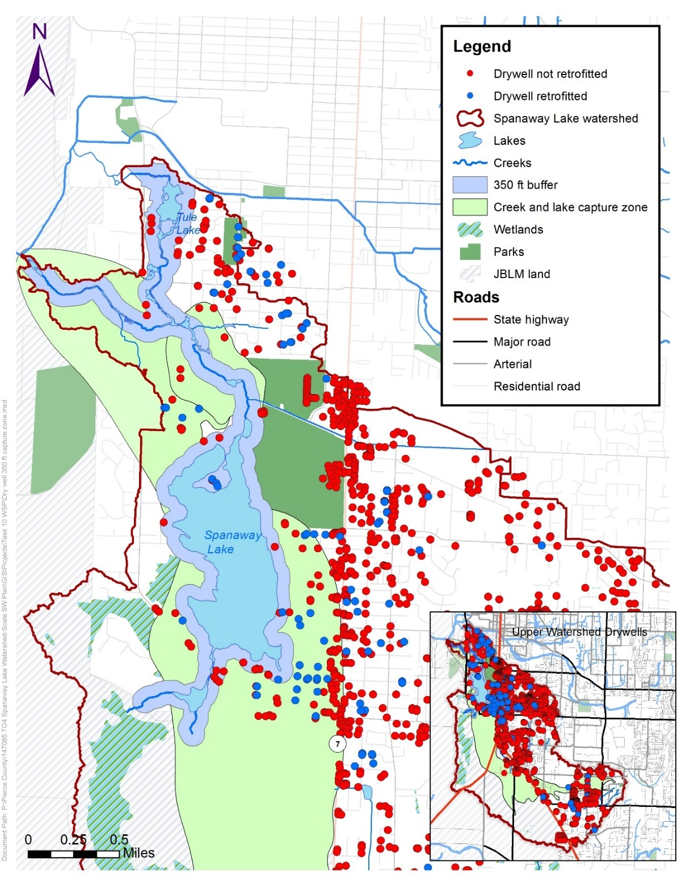
Drywells in Groundwater Capture Zones

Slide 29
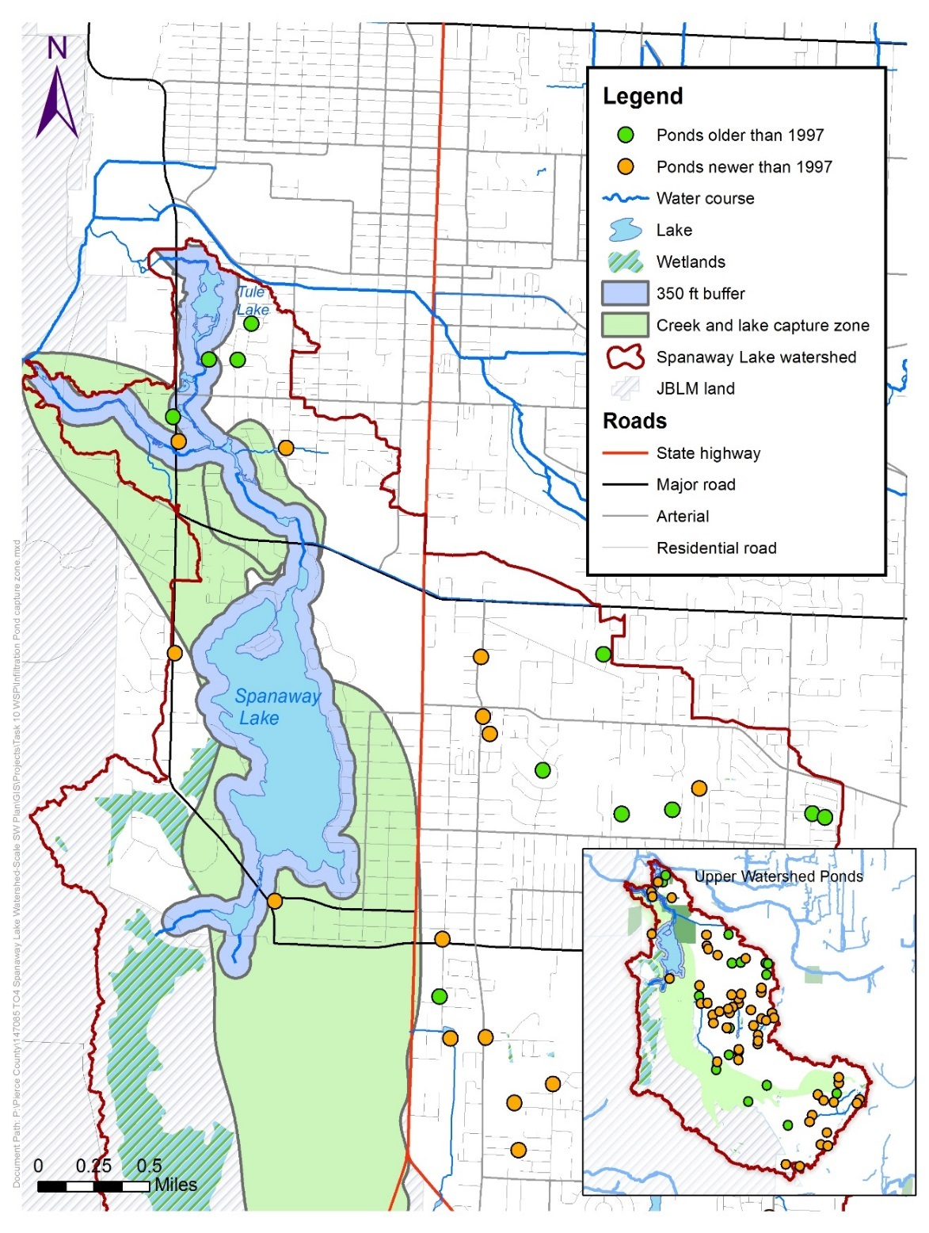
Infiltration Ponds in Groundwater Capture Zones
Ponds built before 1997 were not required to include water quality treatment

Slide 30
Stormwater Management Strategies for Spanaway WSP
Table 8-1. Planning-Level Cost Estimates for Potential Stormwater Strategies
Stormwater Strategy Project | Total Direct Construction Cost (2017 dollars) | Construction Cost Range (-30% to +50%) | 30-year Life Cycle Costª
Drywell retrofits (15) | $105,000 | $73,500--$157,500 | $120,000
SF 116 pond retrofit | $240,000 | $168,000–$359,000 | $313,000
SF 149 pond retrofit | $177,000 | $124,000–$265,000 | $212,000
Military Rd. infiltrating sand filter | $1,259,000^{b} | $881,000–$1,889,000^{b} | $1,355,000^{b}
Total | $1,781,000 | $1,246,500-$2,670,500 | $2,120,000
Net present value based on a 2% discount rate. Includes total estimated capital costs. Drywell retrofit estimate assumes vactoring catch basins every 5 years. Pond retrofits estimates assume filter cartridges will be replaced twice per 5 years, with minimal annual maintenance. Military Road estimates assumes complete replacement of sand filter at 30 years, thorough raking every 5 years, and minimal annual maintenance. Includes rough estimate of land acquisition cost.

Slide 31
Potential Non-Stormwater Strategies
Potential non-stormwater strategies that could help but are not required by Permit:
Plant riparian areas (increase shade, deter resident waterfowl)
Increase outreach re: riparian landscaping, domestic animals
Creek channel improvements to enhance benthic habitat (e.g., add large woody debris)
Microbial source tracking to focus source controls
Toxicity testing of creek sediment
These non-stormwater strategies are described in a separate document
Notes:
Encourage redevelopment of older residential and commercial areas west of Pacific that developed prior to SW quality regs.
Two samples collected from well near boat ramp contained elevated zinc, but lake and creek samples were well below WQS for zinc

Slide 32
Conclusion
Groundwater contributes 99% of streamflow in Spanaway watershed
Pierce County currently infiltrates a large majority of stormwater
Water quality and benthic community impairments mostly from non-stormwater causes
Natural conditions (e.g., lake temperature, wildlife)
Adjacent land cover & land use (e.g., lake of riparian shade, domesticated animals, septic systems)
Opportunities exist to infiltrate additional stormwater and retrofit existing facilities, but will likely have only a modest impact

Slide 33
Thank You!
Tom Kantz
tkantz@co.pierce.wa.us
(253) 798-4625

