Slide 1
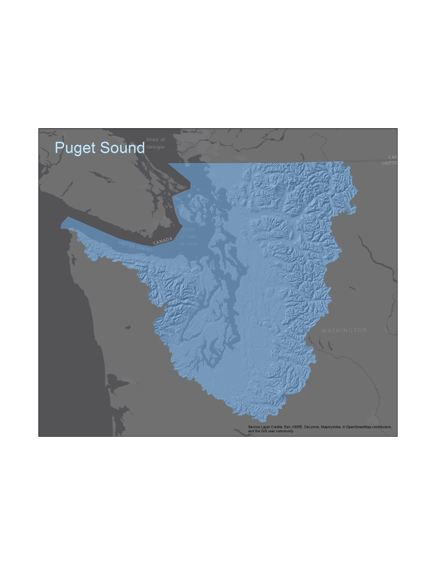
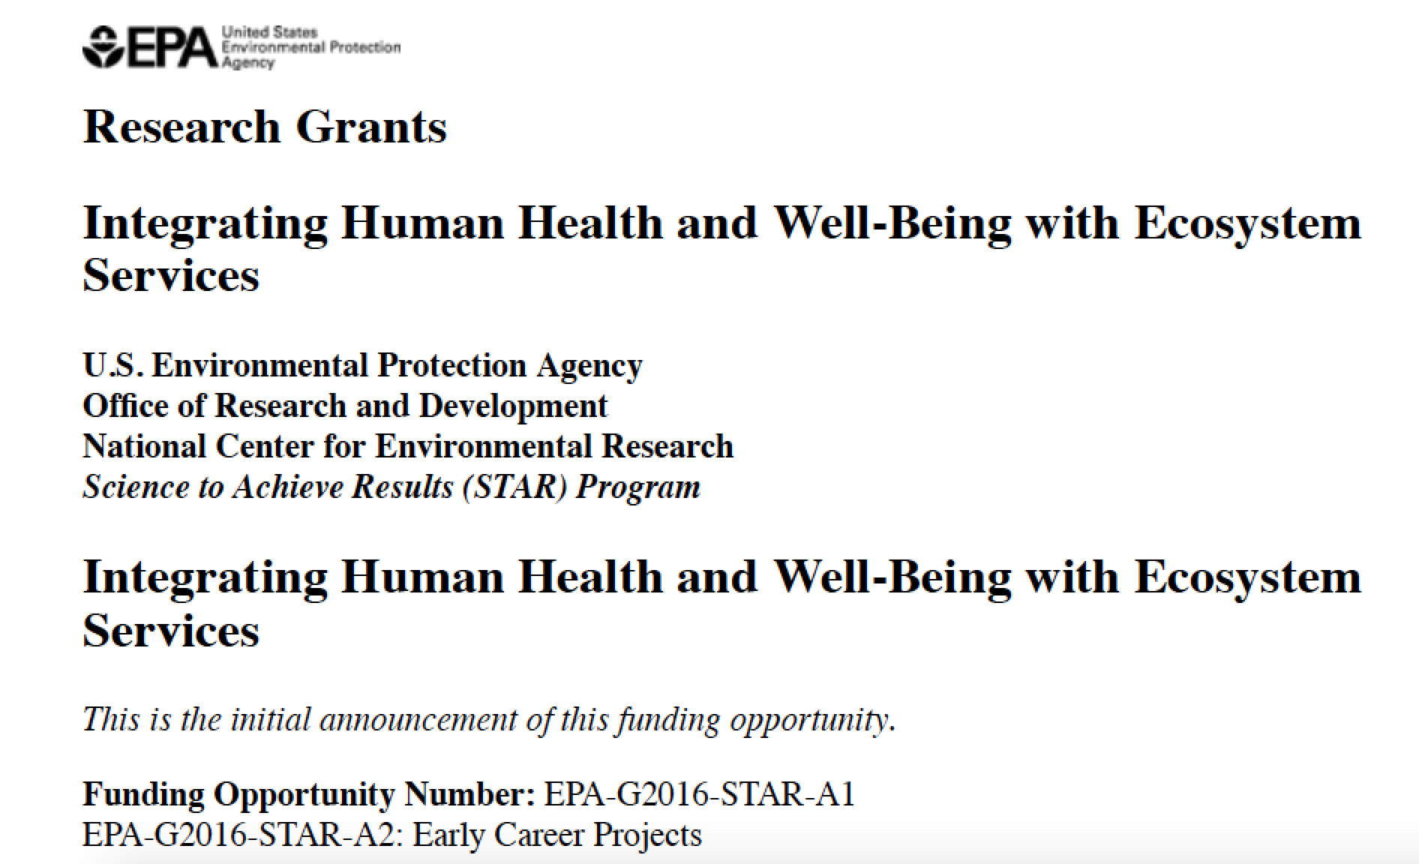
David J. Trimbach, PhD
Postdoctoral Research Associate & Project Manager
Department of Fisheries & Wildlife
Oregon State University
david.trimbach@oregonstate.edu

Slide 2
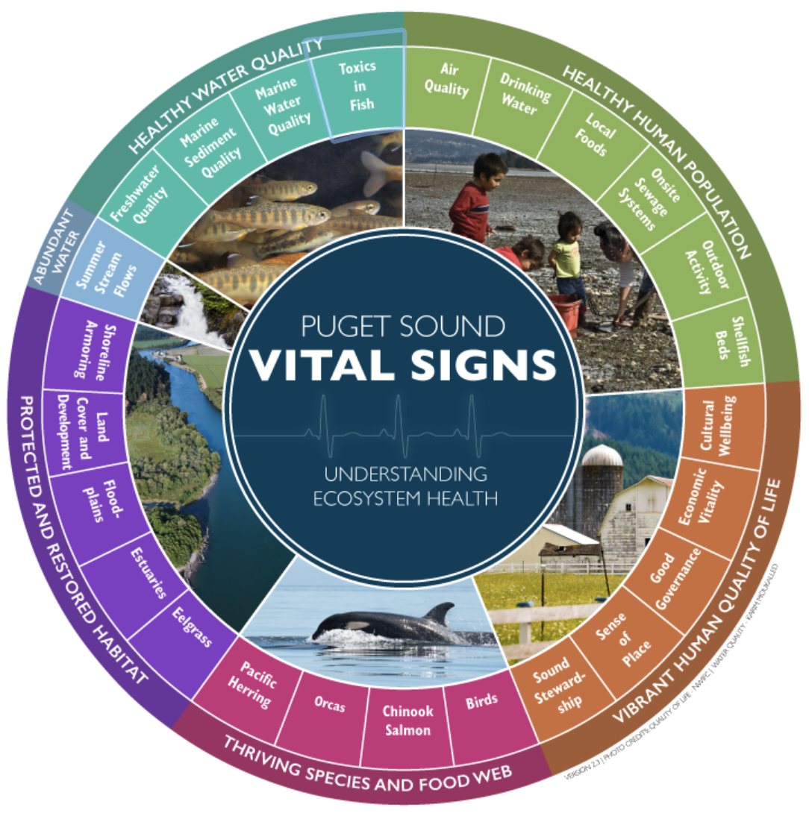
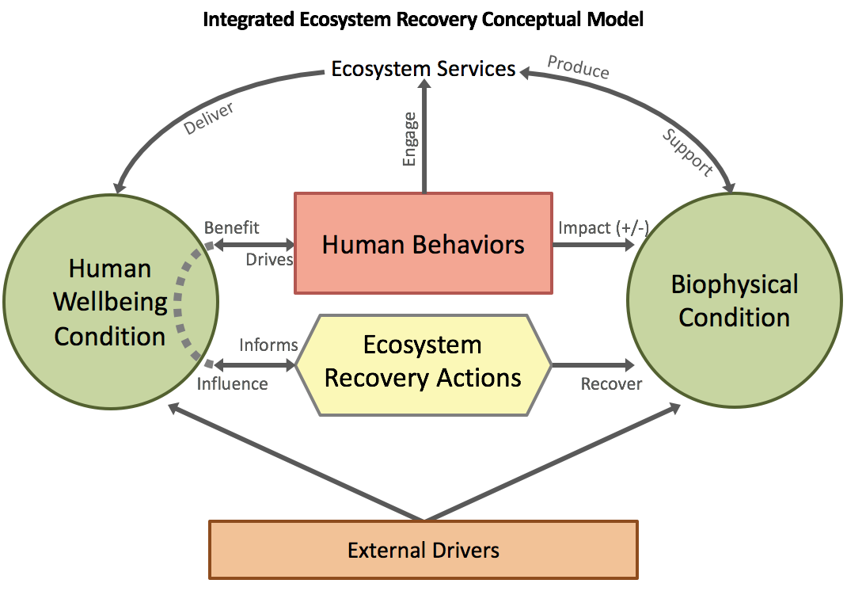
Ongoing Process and Effort
Schneidler & Plummer 2009, p. 1
Von Reis 2016, p. 1
Cranston & Biedenweg 2016
Harguth et. al. 2015

Slide 3
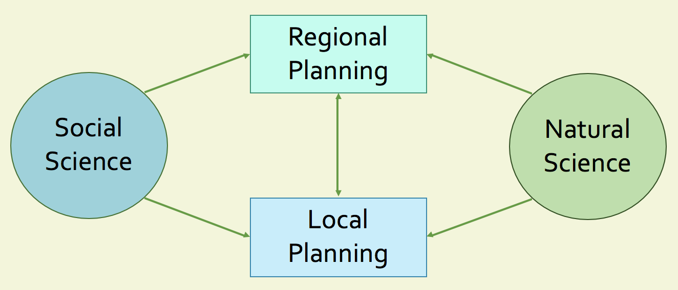
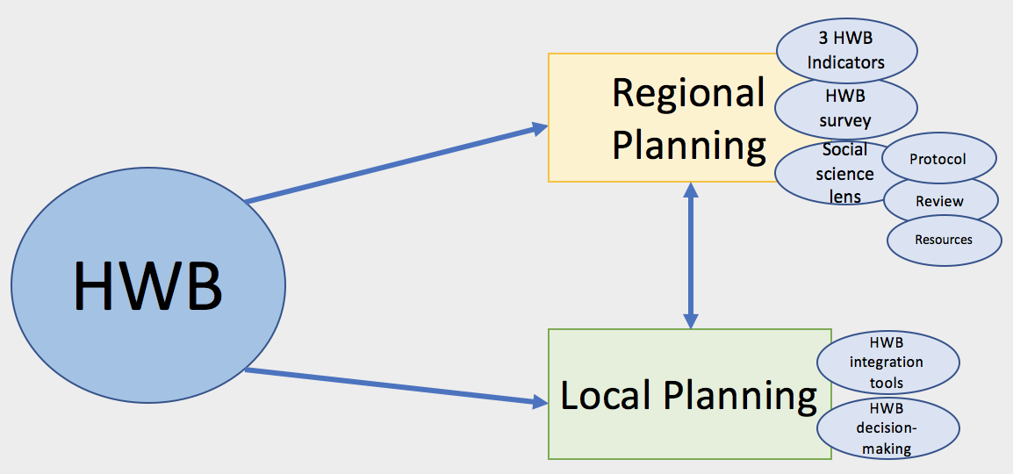
Ongoing Process and Effort

Slide 4
Project Objectives
Understand how LIOs function (structure, membership, decision-making, etc.) and understand/integrate human wellbeing (and social data/science more broadly) into local recovery efforts.
Integrate human wellbeing indicators with ecological indicators in LIO decision-making (overarching planning process), including NTA development and scoring process.

Slide 5
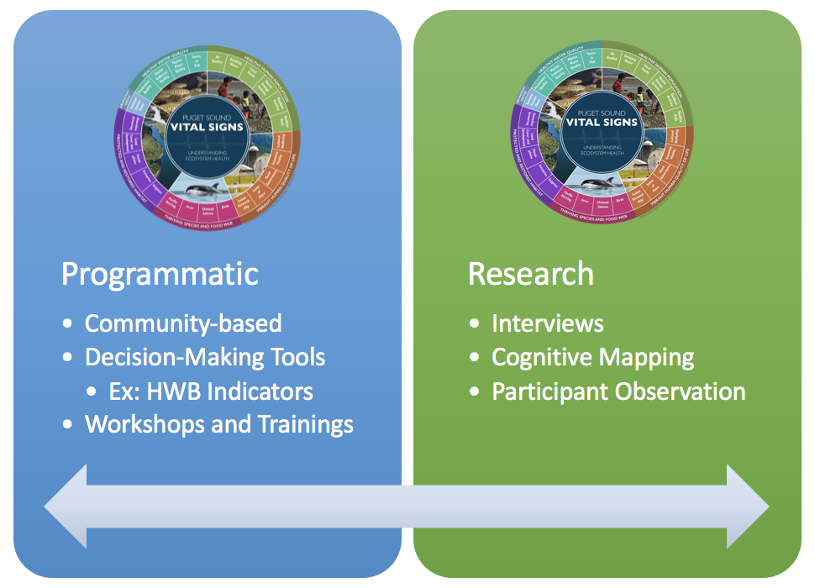
Overlapping Project Components
Currently working closely with 4 LIOs
For comparative purposes, the HWB Project benefits from participation and input from all LIOs.

Slide 6
Component Details
Programmatic (tools/resources)
Miradi/Results Chains
Structured Decision Making (Consequence Tables)
Bayesian Belief Networks
Spatially-explicit impact overlays
Cost-benefit analysis
Best Available Social Science (BASS)
Thorough understanding of human wellbeing indicators and how they might be integrated into local efforts or discussions
EPA’s Decision Analysis for a Sustainable Environment, Economy & Society (DASEES)
Research
Conducted before and after Programmatic Component
Observation (meetings, etc.)
Interviews (open-/closed-ended questions)
Cognitive Mapping Activity
Free listing and card sorting exercise

Slide 7
Why this topic matters (broadly) or what do these goals entail?
Builds upon the Partnership’s ongoing efforts.
Provides opportunities and resources to better integrate human wellbeing (i.e.: the Vital Signs) and ecosystem services (specific valued resources) into LIO decision-making (planning and efforts) via specific tools or strategies.
This will be designed and implemented with engagement and input from LIOs themselves.
This is a community-based project, so it is meant to be tailored to LIO needs and interests with an intended low-impact.

Slide 8
LIO Benefits and Support
This project offers: practical tools, capacity, and resources – all tailored to LIOs’ needs and interests
Funding ($3,000 for tools/resources – facilitated through OSU) and Miradi support funds ($20K total for all LIO work)
Direct assistance with better understanding and integrating HWB and HWB Vital Signs into LIO efforts through conceptual models, identifying best practices for for social data integration, updating recovery plans, identifying tradeoffs, and identifying factors that support engagement and use of data (from state agencies, etc.)
AHSS has identified Shellfish as a HWB component.
This project could help provide tools or strategies to help AHSS better understand and address Shellfish and its corresponding Vital Sign and how Shellfish may relate to other HWB components or Vital Signs.
The project could also help integrate and better understand the new HWB Survey data and findings within the AHSS local geography (depending of sample).

Slide 9
Next Steps
Multi-year project that aims to benefit all LIOs (regardless of participation level)
Kickoff occurred in January 2018
Currently – working closely 4 LIOs on both programmatic and research components
Working together to increase interest among LIO members and to integrate project into work plans
Research stage 1 is currently underway (Summer 2018)
Interviews and cognitive mapping with LIO members (as many as possible to better reflect LIOs and their ongoing efforts throughout the region)
Programs (resource/tool provision – e.x.: workshops, trainings, etc.) will being in Winter 2018, followed by research stage 2 in 2019-2020 (hopefully with same individuals and LIOs for comparison – before/after)
All LIOs will continue to see and/or hear about the project moving forward.

Slide 10
Next Steps
How you can help? – Participate in interviews!
Your participation will provide a better reflection of the LIO landscape and more nuanced information about what LIOs do and how they do it.
This will provide a more accurate portrayal of the terrific work all LIOs are doing at the local level.
Questions? Thank you!

