Slide 1
PSP required to develop PSEMP (authorizing statutes, 2007)
Forerunner: Puget Sound Ambient Monitoring Program (PSAMP, 1985)

Slide 2
-- Established by PSP Leadership Council in 2011 as a coordinated ecosystem monitoring and assessment program -- To serve the needs of the PSP and the many organizations and entities across the Puget Sound basin that are committed to helping the PSP through their individual and collective actions achieve the goal of restoring and protecting the health of Puget Sound -- PSEMP Charter approved by PSP (2011) -- Biennial PSEMP workplans -- Guidance for monitoring workgroups -- Funding strategy (2014) -- Monitoring Inventories and Gaps analysis -- Communication and information sharing (reports, forums, conferences)
Puget Sound Ecosystem Monitoring Program (PSEMP)

Slide 3
PSEMP Objectives (2011)
1. Answer questions about (a) the status of the ecosystem and progress toward ecosystem recovery and (b) the effectiveness of restoration and protection actions
2. Support decision making (by the Puget Sound Partnership and other organizations) about recovery efforts and their adaptation by ensuring that monitoring and assessment findings (data, results, and conclusions) are (a) credible and trusted with known precision, accuracy, and (b) provided to decision-makers and broad audience of partners and stakeholders.
3. Work in a collaborative, transparent fashion to coordinate and integrate monitoring programs across Puget Sound and the rest of the Salish Sea as a system of data collection and evaluation that is efficient and effective for all partners.
Notes:
This section presents objectives for coordinated monitoring and assessment and strategies for achieving these objectives.
This version of objectives was developed through business planning conversations in late 2017 and early 2018 with PSEMP Steering Committee members and other advisors. These objectives build from program goal and purpose statements in the PSEMP charter and in the articulation of program purpose and scope developed in late 2014.
The strategies (at the end in appendix) were identified through an analysis of program strengths, weaknesses, opportunities and threats (SWOT) related to each of the objectives. Most of the strategies below were identified as approaches to use strengths, overcome weaknesses, take advantage of opportunities, and avoid threats. A few of the strategies were inspired by the recommendations made in the 2014 program review (Ruckelshaus Center, 2014). These strategies are largely captured in the way we’ve characterized the flow of information and the products and services of PSEMP in the following slides. At this stage, these two different ways of articulating PSEMP connection, activities, and strategies may not be entirely reflective of each other, but this is an iterative process, and we hope to emerge with a cohesive road map that will be useful for PSEMP participants, and PSP staff.

Slide 4
Recent Reviews of PSEMP:
2014 Ruckelshaus Center evaluation
2016 JLARC Audit (as part of PSP review)
2018 PSP response to Governor & JLARC
2019 Revised PSEMP structure, objectives & workplans
PSEMP website: https://sites.google.com/a/psemp.org/psemp/

Slide 5
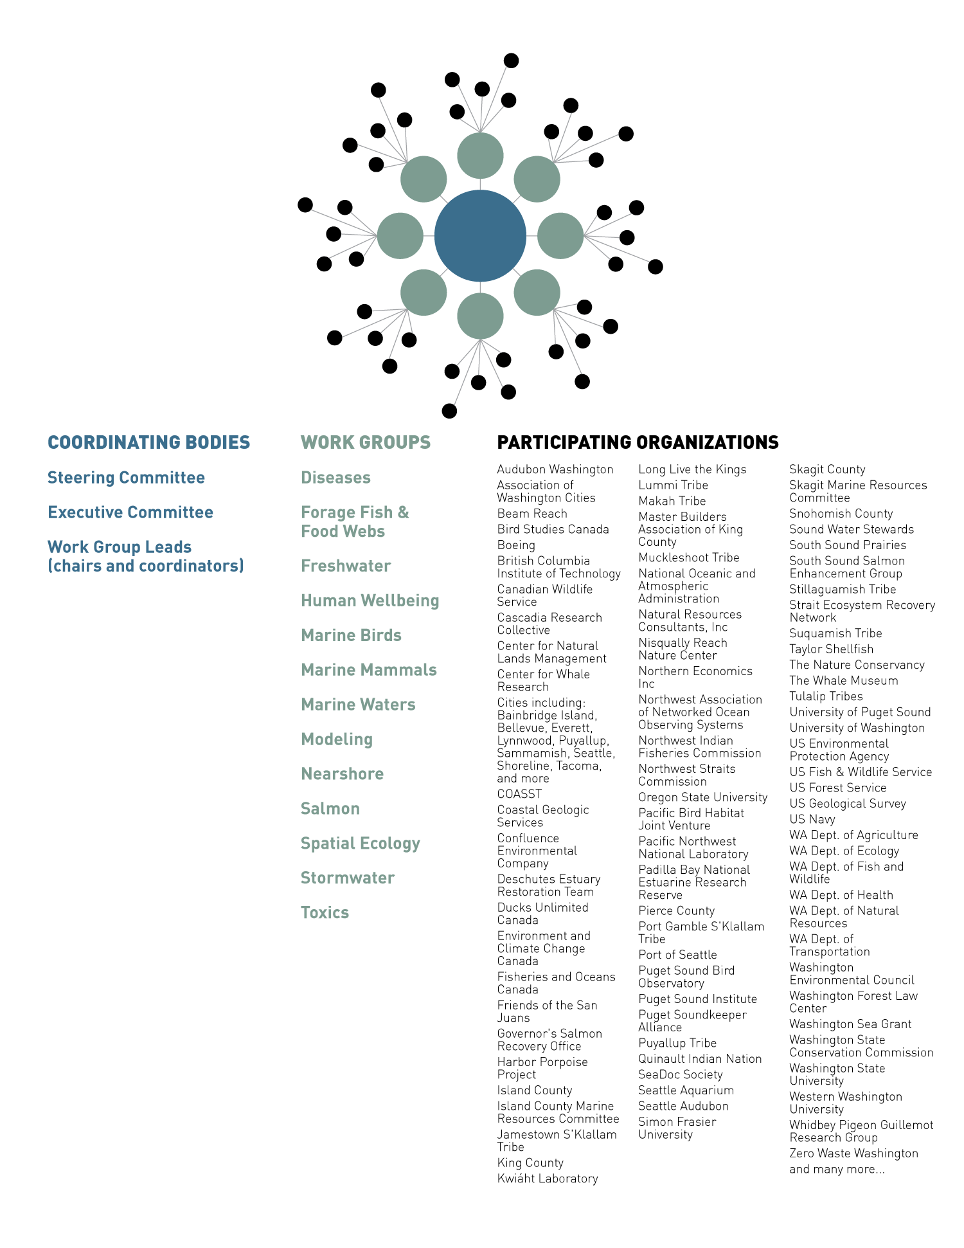
[JJ(1]
[JJ(1]Coloring changed to improve readability. Deschutes Estuary will become Deschutes Estuary Restoration Team

Slide 6
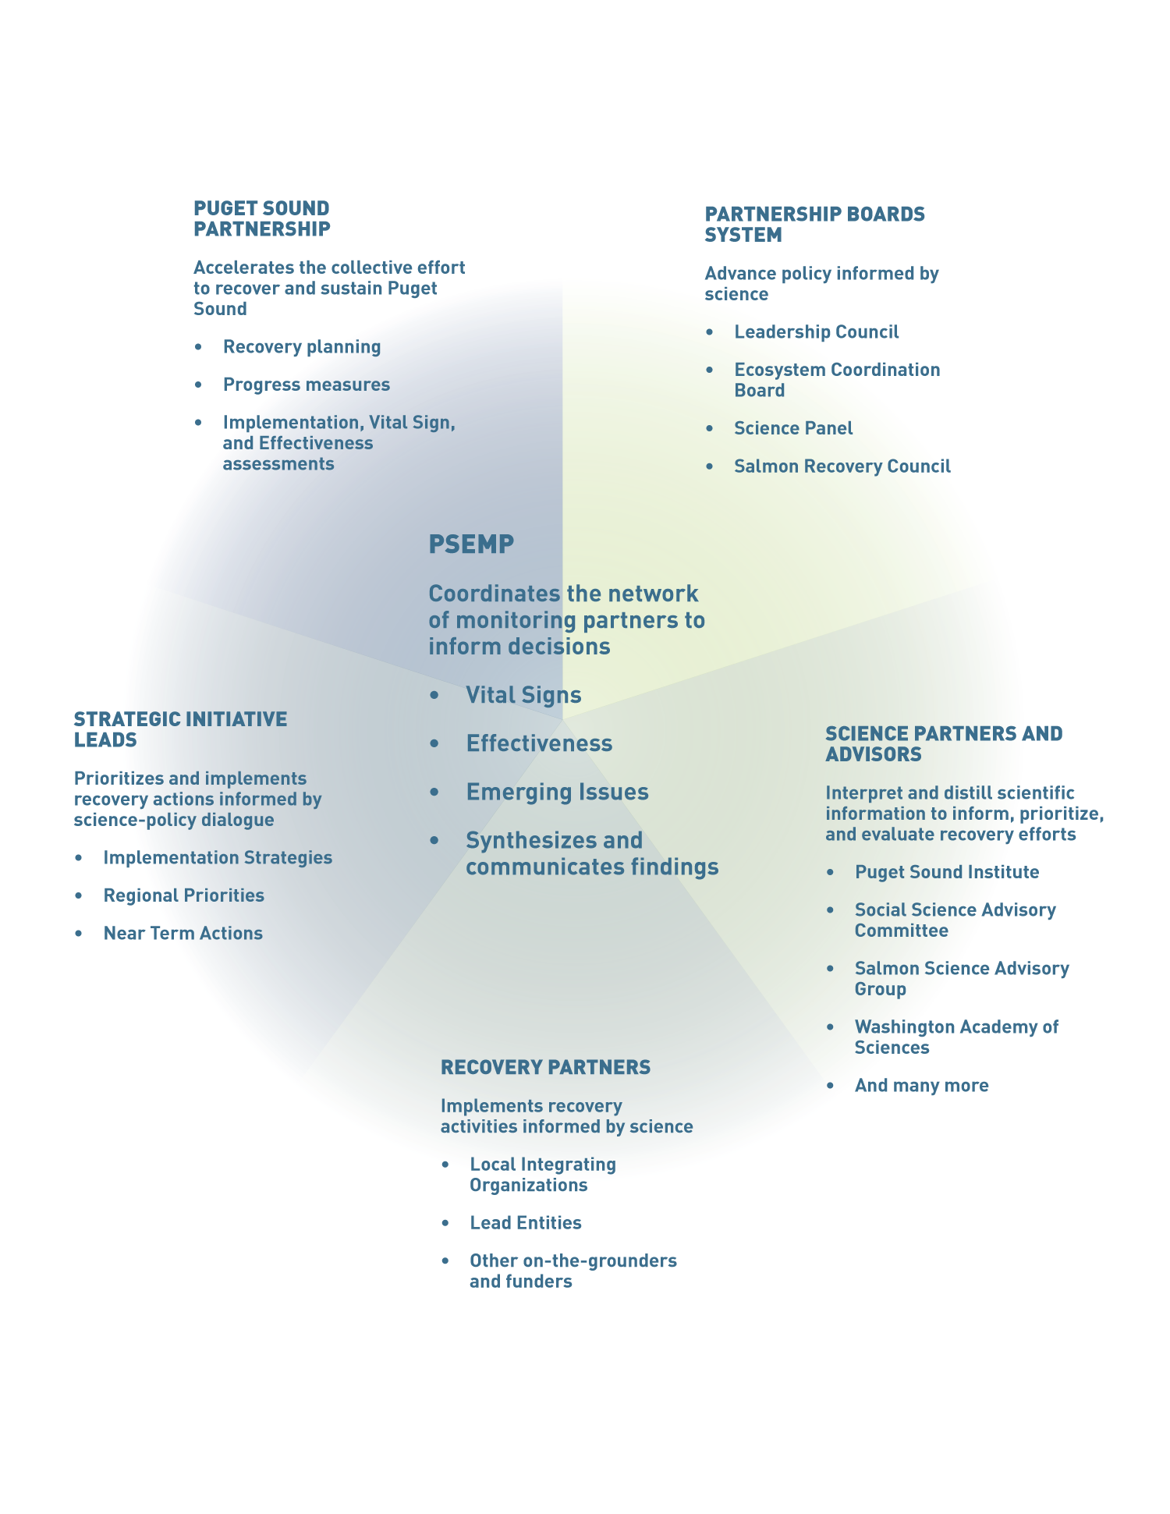

Slide 7
Revised PSEMP Mission & Objectives (2018)
Mission: Convene a collaborative network of subject matter experts who organize, synthesize, and communicate scientific information from many monitoring organizations and different parts of the ecosystem to directly address foundational management and science questions critical to recovery of the ecosystem.
Create and maintain forums to increase collaboration across monitoring programs to improve effectiveness and efficiency of monitoring programs and their ability to meet the information needs of planners, managers, and decision-makers. Organize and synthesize the data being gathered by existing monitoring programs to increase access to available information, and highlight priority knowledge gaps to be filled.
Support adaptive management of recovery efforts by: evaluating the effectiveness of recovery actions and approaches so that those actions can be prioritized; engaging PSEMP members in planning processes such as Implementation Strategies (Figure 3); and facilitating the exchange of knowledge among PSEMP members and with planners, managers, and decision-makers (Figure 2).
Improve communication within the monitoring and assessment community and to audiences specified in a new communications plan in order to improve access to and use of credible information in decisions about Puget Sound recovery efforts.

Slide 8
Puget Sound Ecosystem Monitoring Program Strategic Plan 2018-2022
* PSEMP is unique and effective because of its coordinated network structure that harnesses commitment across geographies and organizations to improve efficiency of monitoring to inform the Puget Sound recovery effort.
* This Strategic Plan articulates a renewed mission for PSEMP to convene a collaborative network of subject matter experts who organize, synthesize, and communicate scientific information from many monitoring organizations and different parts of the ecosystem to directly address foundational management and science questions critical to recovery of the ecosystem.
* PSEMP spans the boundary between science and decision-making to facilitate the exchange of knowledge among monitoring programs, the Partnership and its boards system, and others working to advance Puget Sound recovery.
* Scientific evidence and syntheses vetted through PSEMP are used broadly to guide decisions and inform policies about Puget Sound recovery at local and regional scales.
* The Partnership submitted a funding request to the Governor and Legislature, for the 2019-2021 biennium, to put this plan in motion, and meet a growing need for timely, relevant, and credible information that directly links scientific findings to management decisions.
* This plan will be reviewed biennially and updated in four years, and yearly work plans for the Steering Committee and work groups will enable adaptive management at a fine scale, to reach the objectives of this plan.

Slide 9
PSEMP Steering Committee is composed of stakeholders from:
Local (Pierce Co., King Co.)
State (ECY, DNR, SRO, WDFW)
Federal (EPA, NOAA, USGS)
Tribes (NWIFC)
Academia (UW, Sea Grant, PSI, WWU)
PSP Science Panel
Citizen Science (vacant)
Environmental organizations (Audubon, DERT)
Local Integrating Organizations (vacant)
Watersheds (vacant)
Business & Consultants (vacant)

Slide 10
