Slide 1
Nathalie Hamel (and colleagues)
Vital Signs Reporting Lead, Puget Sound Partnership
November 20, 2019
Notes:
Acknowledge all the PSP staff and team involved in this report

Slide 2
“On the surface, Puget Sound looks beautiful, but it’s in grave trouble”
—Laura Blackmore, Executive Director, Puget Sound Partnership
Notes:
On the surface, Puget Sound looks beautiful, but it’s in grave trouble – quote from our executive director, Laura Blackmore
The damaging effects of pollution, and habitat degradation continue, while Southern Resident orcas, Chinook salmon, steelhead, and many other species are endangered. This is happening in the face of climate change and continued population growth, which stands to put more pressure on an already threatened ecosystem.

Slide 3
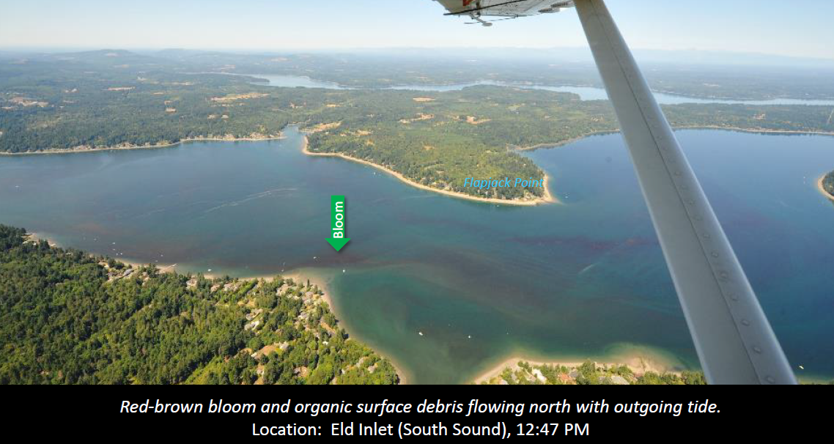
Puget Sound is complex
Notes:
Puget Sound is a complex and heterogeneous system –
This is a photo taken by oceanographers at the Department of Ecology who monitor water quality every month and try to make sense of the complex tides, currents, algae blooms from basin to basin – which shows differences up and down Puget Sound
Which means that managing the system is also complex and this can be very challenging and there isn’t a single solution for improving environmental health
Puget Sound is in trouble, to tell you more about the signs we see and report on but also to tell you about where we see positive signs and examples of amazing projects that can serve as role models for other communities and if multiplied, could make a difference for Puget Sound.
But first, let me tell you a bit about my agency and what we do

Slide 4
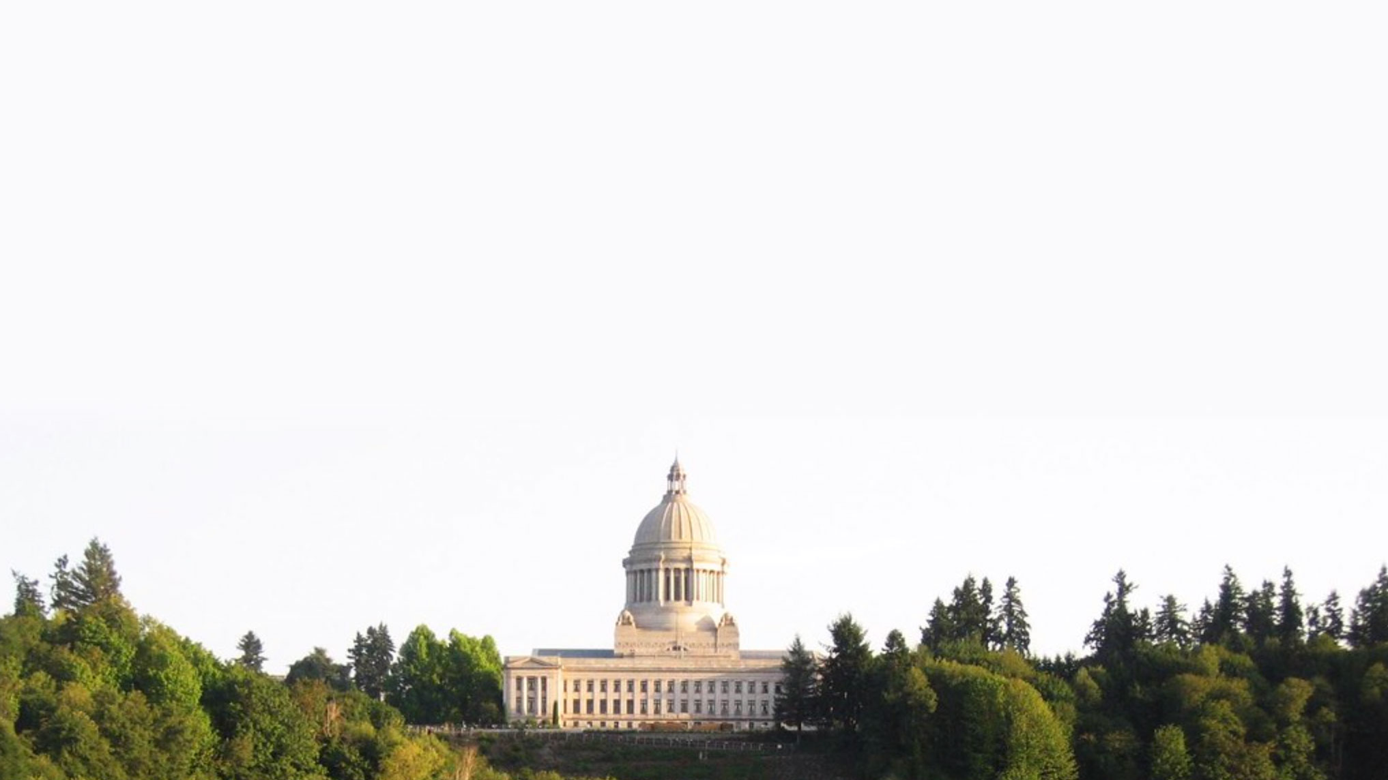
In 2007 the Washington State Legislature created the Puget Sound Partnership
Notes:
the Puget Sound Partnership, a state agency responsible for recovery of Puget Sound

Slide 5
Six legislated goals of the
Puget Sound Partnership
Healthy human population
Vibrant quality of life
Thriving species and food web
Protected and restored habitat
Abundant water quantity
Healthy water quality

Slide 6
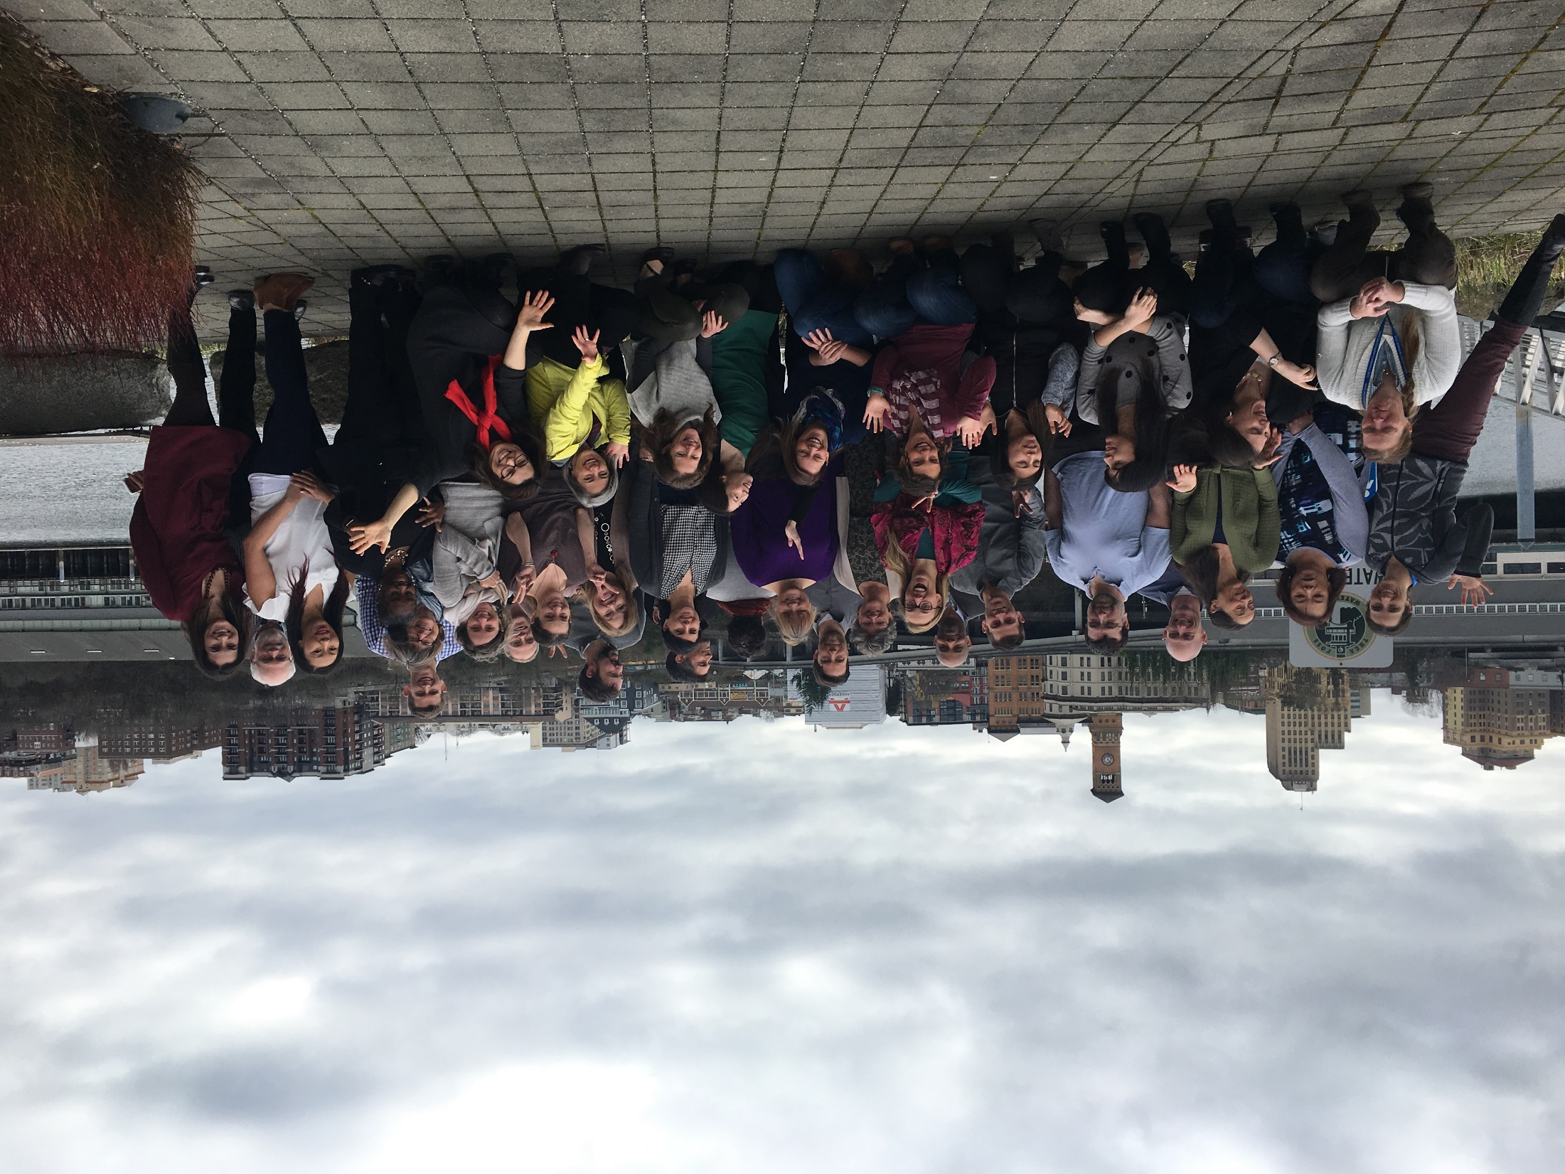
Non regulatory
Regional salmon recovery organization
Part of the National Estuary Program
Notes:
Non-regulatory agency, so we don’t administer laws and rules, we don’t have a “stick”
But we are the regional entity responsible also for salmon recovery
And we are part of the federal National Estuary Program
This is the staff, about 50 of us
Science & evaluation
Integrated planning
Communications
Government relations
Administration and fiscal
Science and policy boards

Slide 7
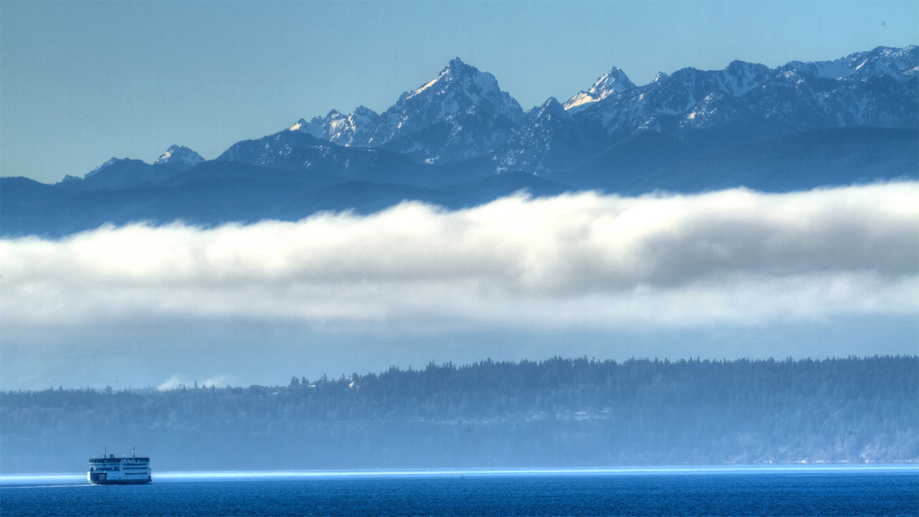
VISION
Vibrant, enduring
natural systems and communities
MISSION
Accelerate the collective effort to recover and sustain the Puget Sound
Notes:
Our mission to Accelerate the collective effort to recover and sustain the Puget Sound
We are the back bone organization
We cultivate partnerships with hundreds of organizations and bring them as partners to the table to coordinate actions to hopefully accelerate recovery

Slide 8
Backbone Organization:
Provides the infrastructure needed for diverse partners to develop and adaptively manage a common vision over time.

Slide 9
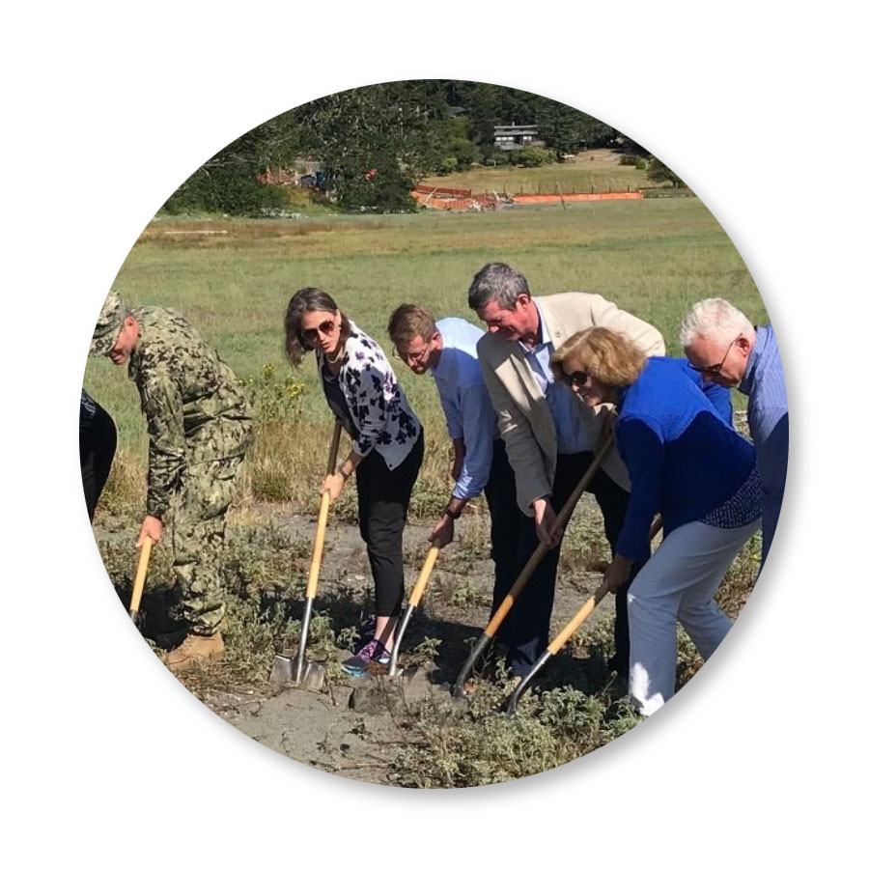
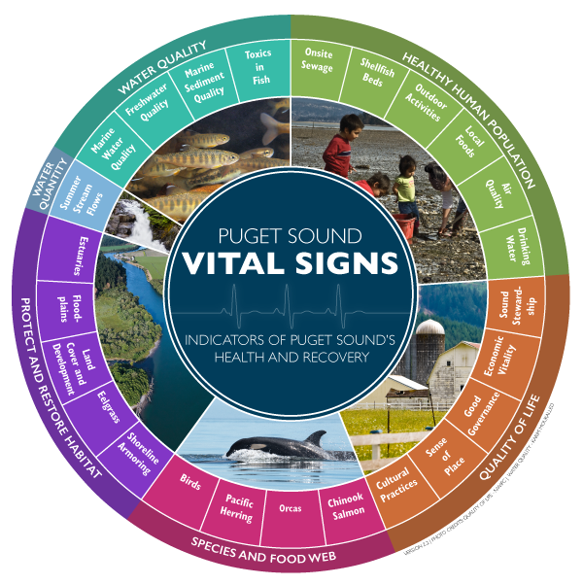
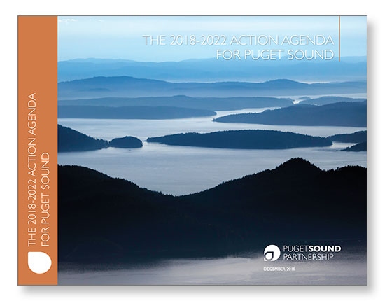
CHART THE COURSE
MANAGE SHARED MEASURES
SUPPORT PARTNERS
Notes:
More specifically,
We help chart the course for recover, by developing with our partners the plan for recovery (jargon is Action Agenda)
It’s a big list of vetted and ranked projects, The current one contains over 600 proposed projects from across Puget Sound.
By the way, you can find all the information on the Action Agenda and the actions on our website
We also have an accountability role to document and measure progress using shared measures called the Vital Signs
And finally, we support partners especially at the local level

Slide 10
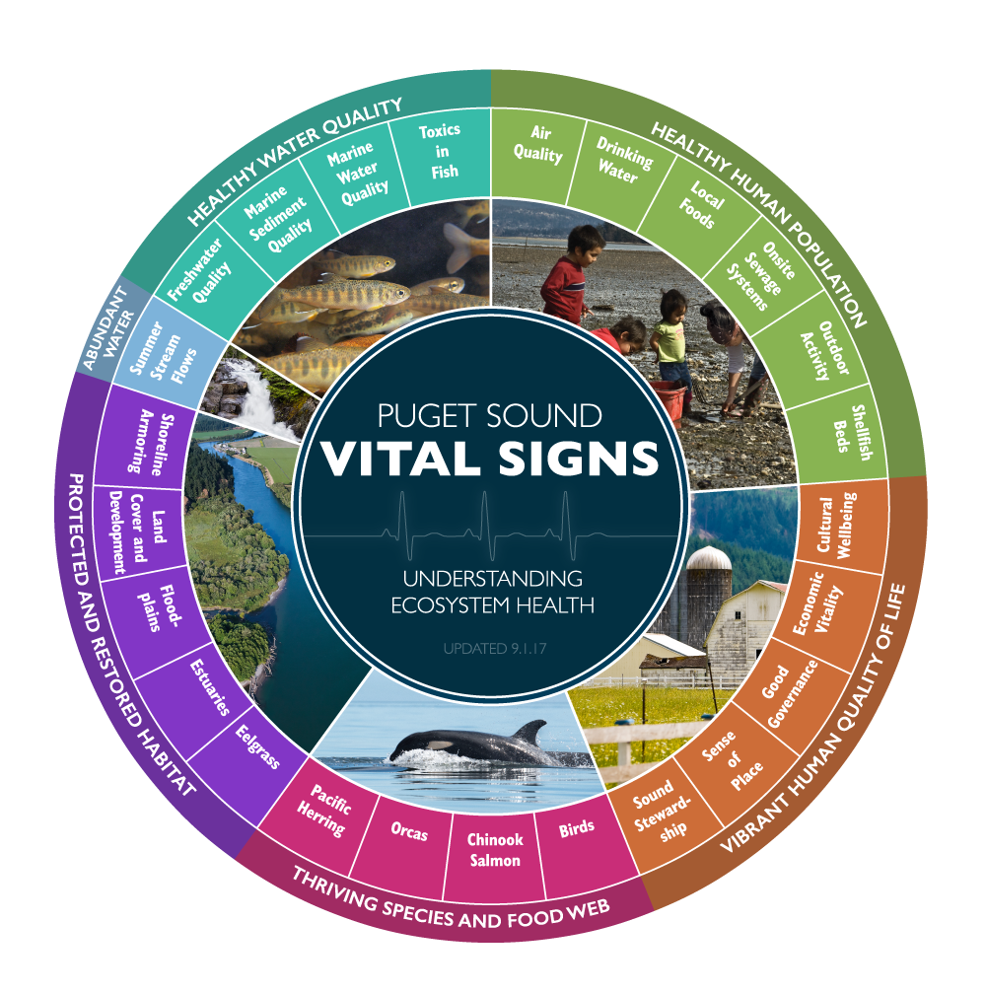
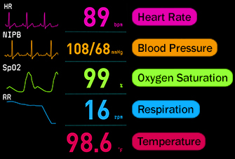
Notes:
To track ecosystem health,
We use a system of indicators called the Puget Sound Vital Signs. As if Puget Sound is a sick patient.
This is a system of indicators that the Partnership adopted to understand ecosystem health and but also assess progress towards our goals for recovery
Because the ecosystem is complex, we need quite a few measures, including measures of water quality, water quantity, habitat and species and food webs, but also goals for human wellbeing
Each of these are represented by one or more Vital Signs, each shown in these wedges.
So it’s nested set of measures

Slide 11
How we keep track of recovery
Target:
95 orcas by year 2020
Species and Food Webs
Number of orcas
Orcas
Notes:
As an example, let’s look at how our Orca Vital Sign works
In total, we track 52 indicators, many of which, but not, have targets

Slide 12
Notes:
Let’s dive right into our results
This is the big picture view of progress of indicators, that together say something about the condition of Puget Sound
The most common question is “so, how is Puget Sound doing, is it getting any better”
Answer is: it’s in trouble but it also depends on what you are looking at
10 getting better, read the buttons and then say, it’s mixed, progress is mixed
Give examples: shellfish beds and restoration of habitat; species like birds; not improving like eelgrass; getting worse like marine water quality and orcas
When we look at whether we will meet the 2020 targets, only 4 are already meeting them27 are not and are unlikely
Add to this a climate change lens and the fact that more and more humans will continue to move in this area, applying pressure, and we really start to get worried

Slide 13
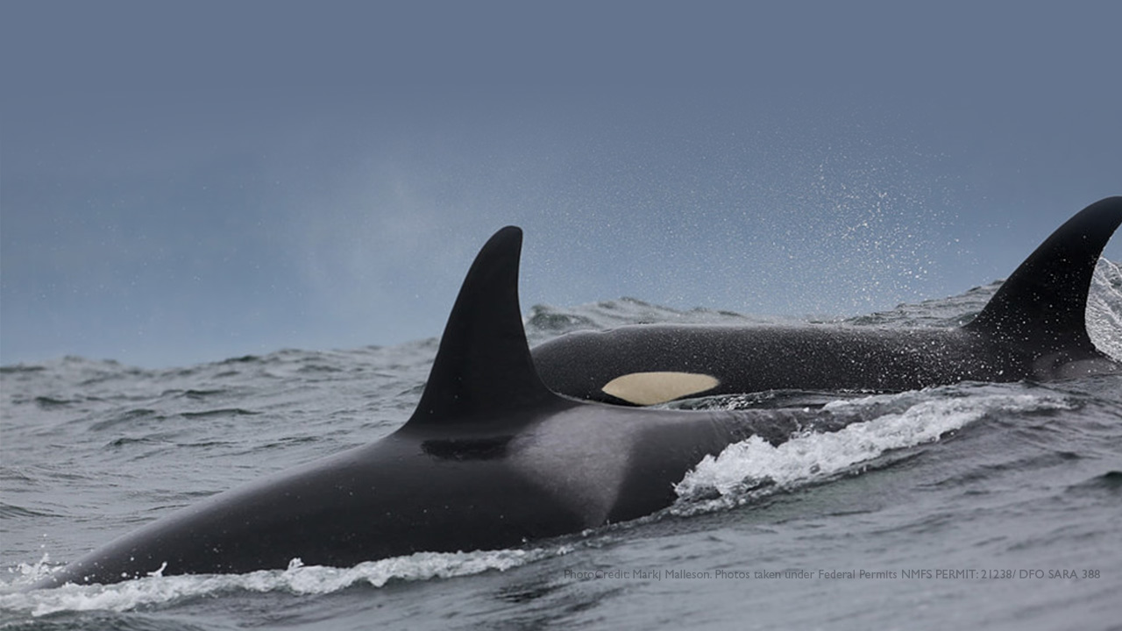
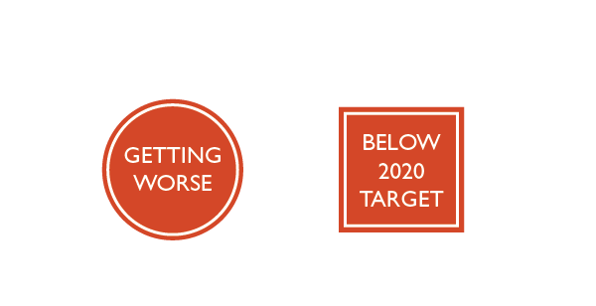
NUMBER OF SOUTHERN RESIDENT KILLER WHALES
We are down to 73 whales. Only 2 calves have been born and survived since 2015
Notes:
Next, I want to talk a little bit more about a few of our indicators, to tell a story about interconnections and the importance of lifting up species, all the way from the bottom of the food web.
Southern resident killer whales
Wonder up and down the Puget Sound and the Salish Sea, and the outer coast as well
A species that specializes on salmon for food, that’s all they like to eat, and they prefer Chinook salmon. Fairly narrow niche
We are down to 73 whales, an alarmingly low number
Only 2 calves have been born and survived since 2015

Slide 14
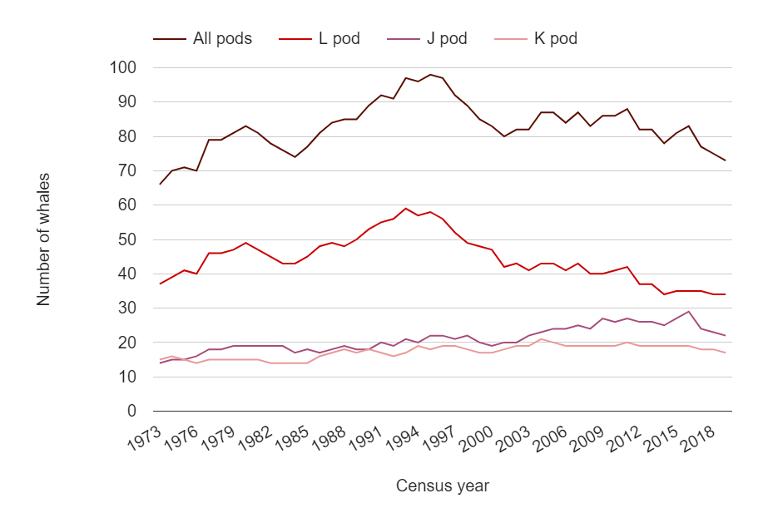
NUMBER OF SOUTHERN RESIDENT KILLER WHALES
Center for Whale Research
Notes:
This chart shows how the number of whales has changed through time, since 1973. The top line is for all pods, and the three below are for j, k and l pod.
You can see an increase throughout the 80s, then after reading a maximum in 1994, the population declined, then maybe stabilized and now we see signs of more decline.
The pattern may look a little different for the different pods
But knowing that their social structure is changing, knowing about contaminants in their blubber and all threats they face in Puget Sound
It’s aa species that is barely holding on

Slide 15
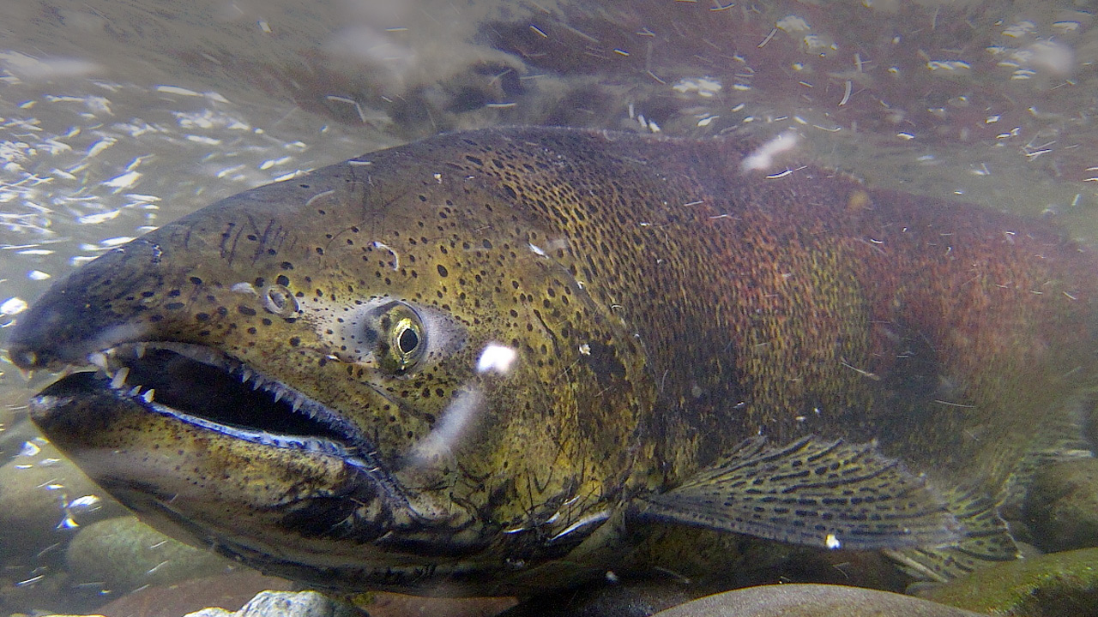
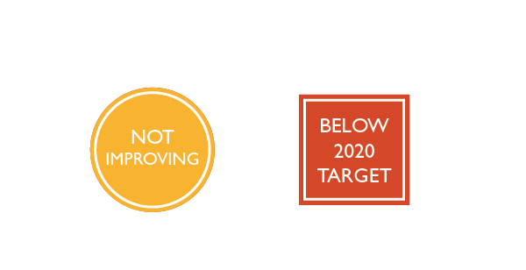
CHINOOK SALMON POPULATION ABUNDANCE
There is little sign of recovery of Puget Sound Chinook populations
Notes:
Chinook salmon:
A species that is important for recreational and commercial fisheries, important for the tribes, important for the ecosystem
It’s the preferred prey of orca
There is little sign of recovery of chinook populations in Puget Sound,

Slide 16
CHINOOK SALMON POPULATION ABUNDANCE
Washington Department of Fish and Wildlife, Salmonid Stock Inventory (SaSI) Populations Escapement
Washington Department of Fish and Wildlife, Salmonid Stock Inventory (SaSI) Populations Escapement
Notes:
This is our way to keep track of the size of each of the 22 populations
The question we ask here is: are chinook populations any different from when they were first listed as a threatened species on the Endangered Specie Act
Because since then, of course there have been plans, there’s been investments, lot’s happening to protect and recovery habitat, restraining from fishing, improving passage and dam operations.
The conclusion here is that the majority of populations have not changed significantly in abundance when comparing the time period around listing to the last five years.
That can be discouraging at first, but one way to see this result could be, well, they are holding the line, given all the pressures on the system, maybe we should be happy with that result

Slide 17
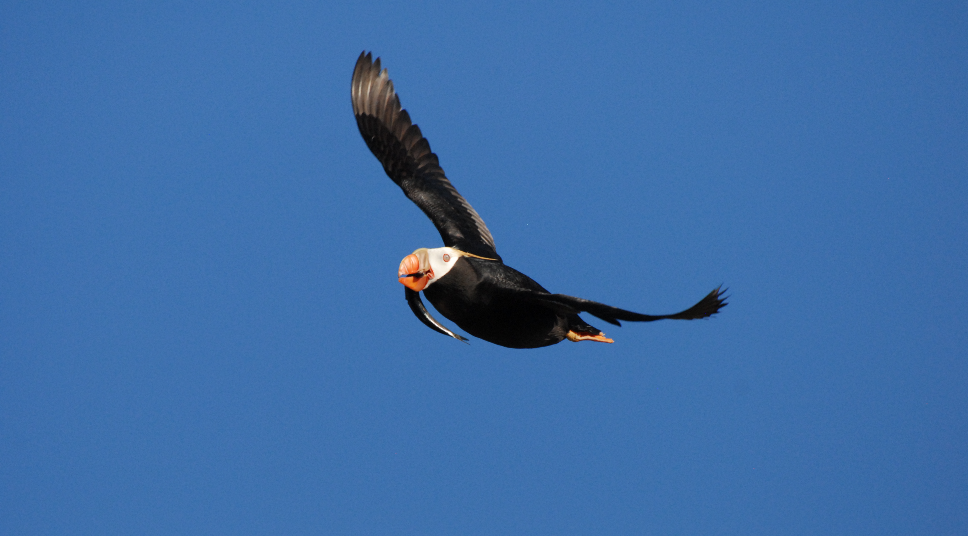
BIOMASS OF SPAWNING PACIFIC HERRING
Two of the three stocks have declined since 2010
Notes:
Another indicator is pacific herring
Everyone knows what herring are cause we eat them
We chose to show a herring here, being carried by a tufted puffin, a seabird species that is also declining in the Salish Sea
To make the point that herring are a forage fish, and forage fish are really important food for seabirds and marine mammals
But herring have declined in Puget Sound

Slide 18
BIOMASS OF SPAWNING PACIFIC HERRING
Washington State Department of Fish and Wildlife, Marine Fish Unit (Forage Fish)
Notes:
Here’s another figure
Showing the size of the population of herring since the late 1970s
Top black line is all the stocks combined and you can see this gradual decline
We even show here the targets that we set for each stock and that we are way under here in 2018
Conclusion: We just went over 3 indicators, the trends of the indicators going down and things are looking pretty grim for these species.
And it’s no coincidence that they are trending down, given their predator-prey relationships, their fate are intertwined and this reflects the magnitude of the challenges of recovering this system

Slide 19
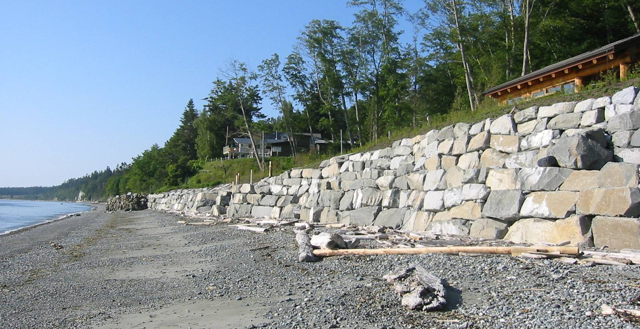
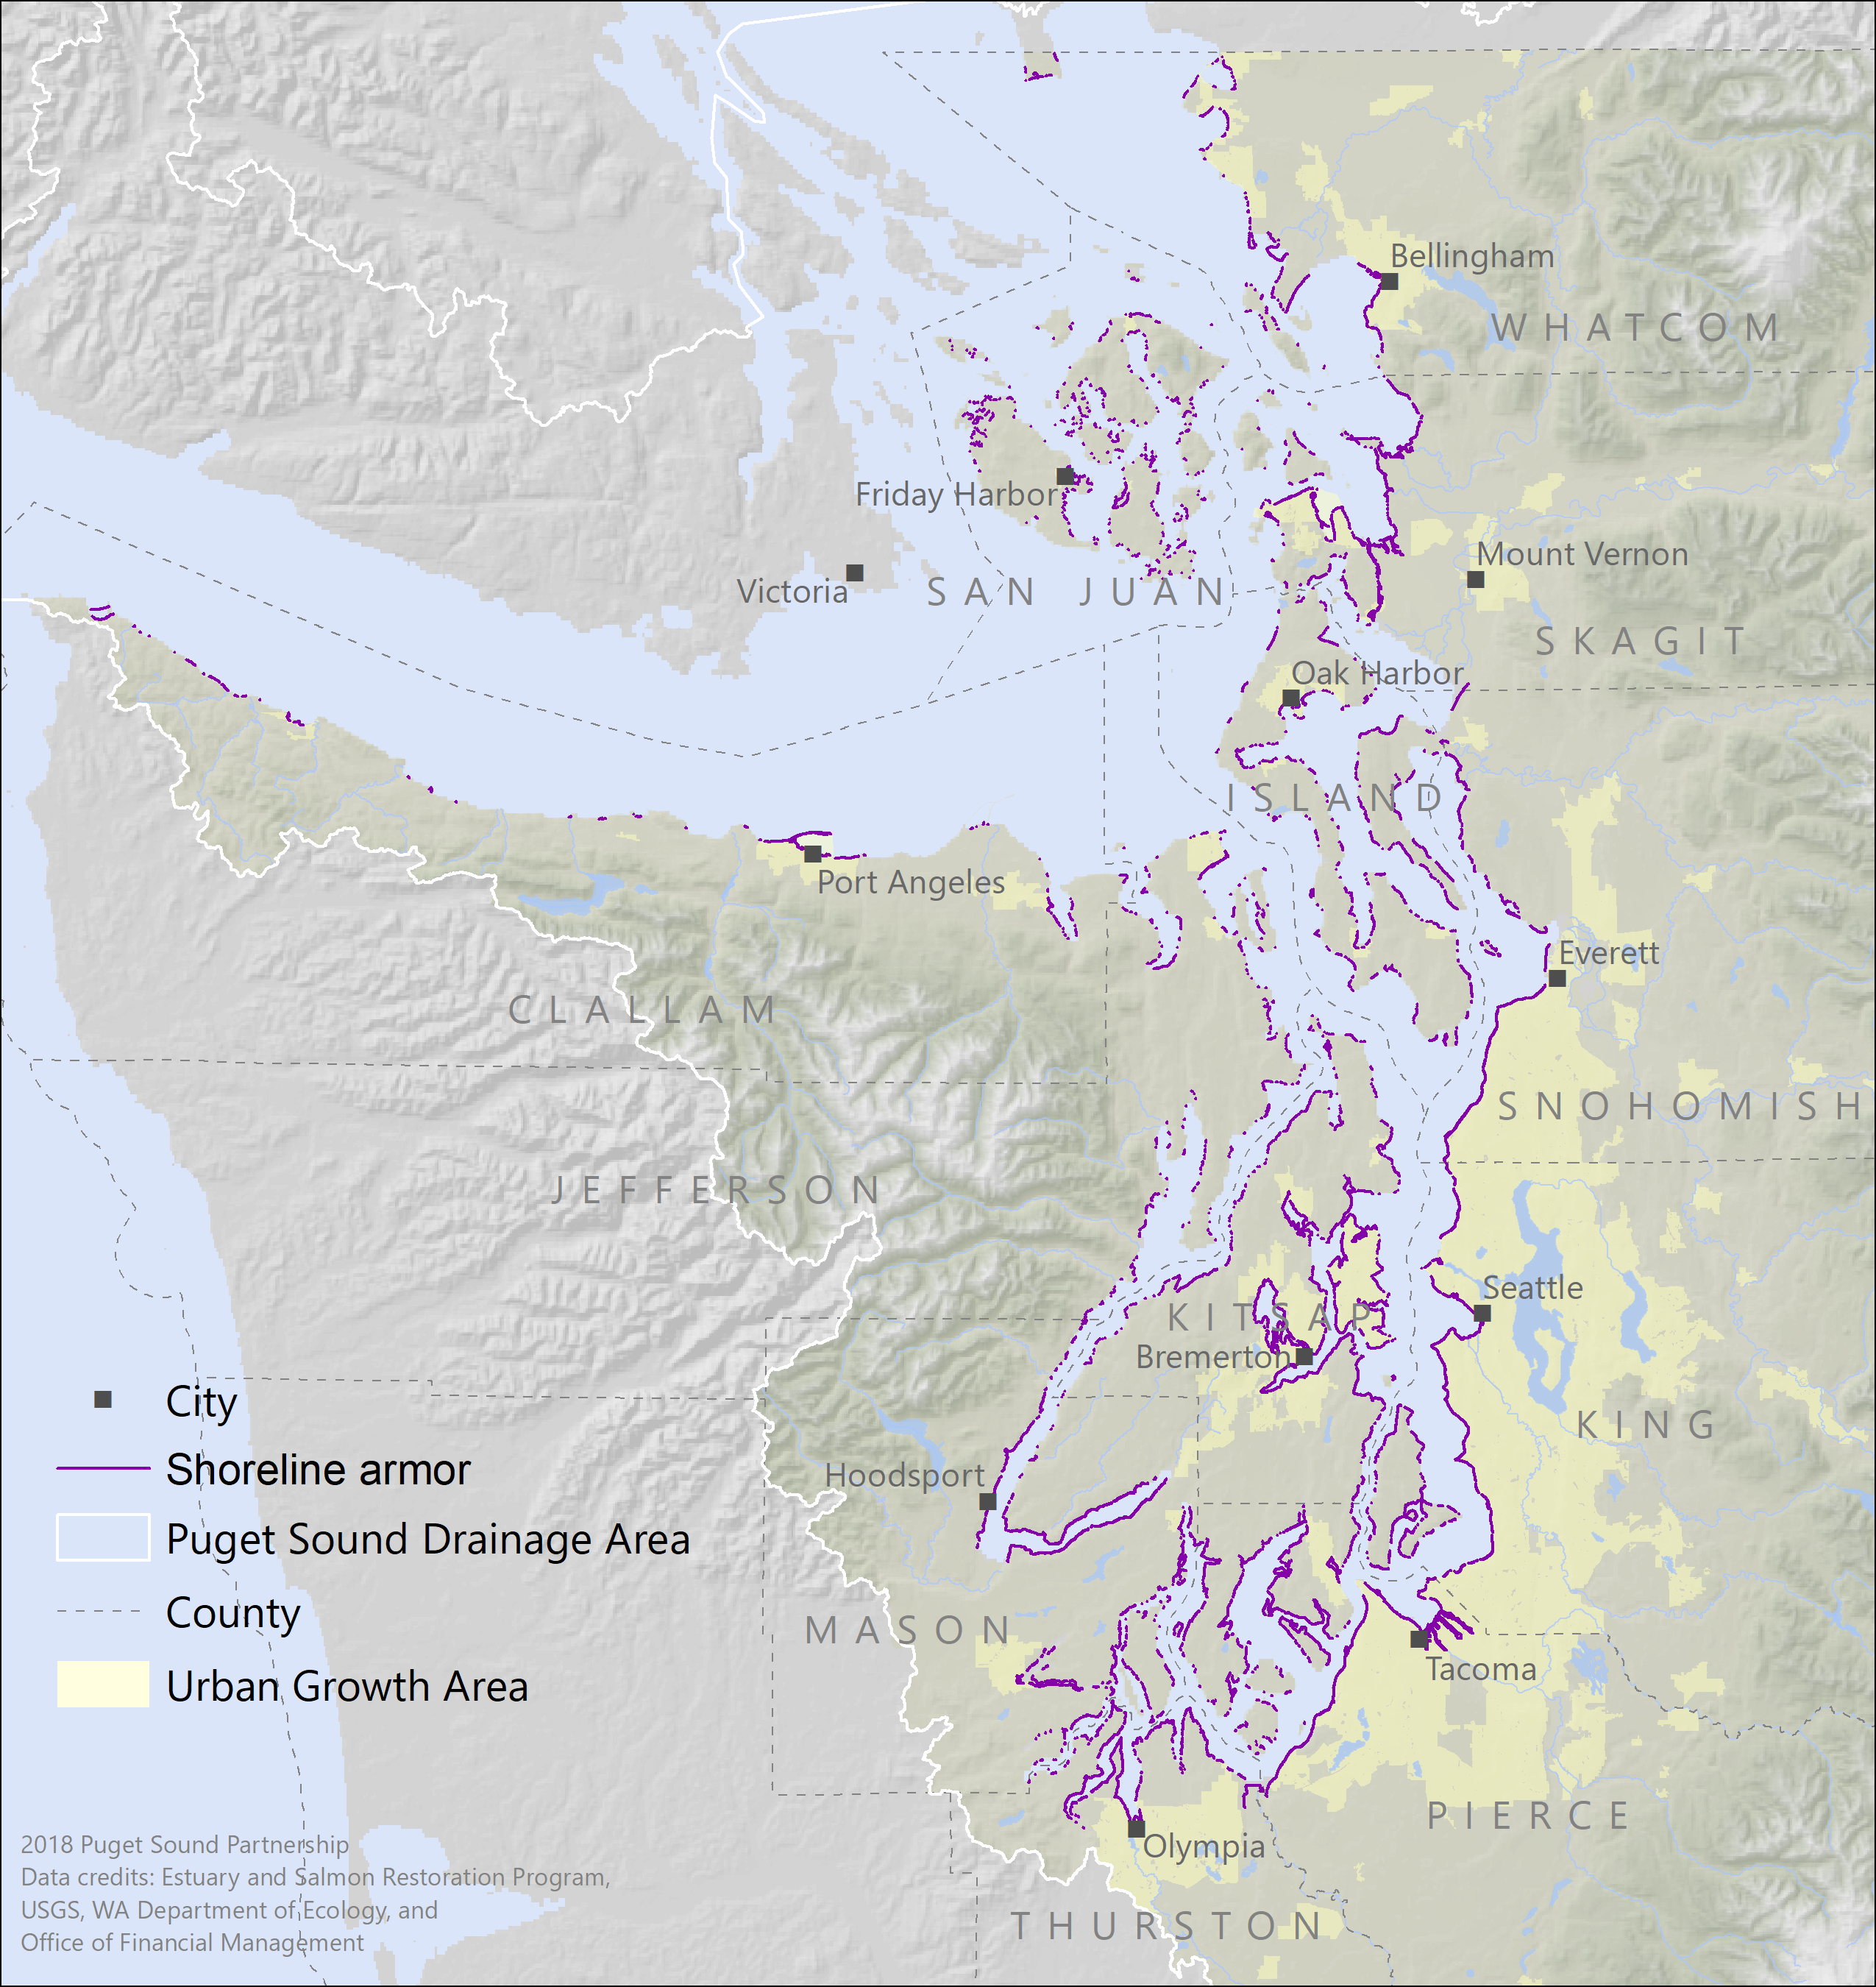
SHORELINE ARMOR
29% armored (hardened)
Notes:
But not all is grim, and the next few slides I will go through examples of 3 indicators will show more positive news
Shoreline armor
Refers to seawalls, made of cement, rocks, wood and all kinds of materials and it is built to prevent erosion
But it also has huge impact on the shoreline by destroying habitat for fish, by keeping sand from moving around, it disconnects the land from the sea, and over time, sand gives way to pebbles and rocks making it less and less suitable for forage fish to reproduce
In Puget Sound 29% of the shoreline is armored

Slide 20
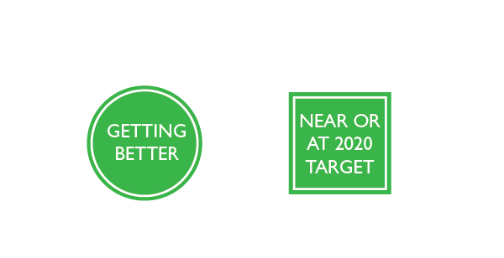
ARMOR ON FEEDER BLUFFS
An estimated 223 miles of Puget Sound's original 657 miles of feeder bluffs have been armored.
Notes:
Where the impact can be worse, is when the armor is at the base of a feeder bluff
What are feeder bluffs?
Wolf Bauer coined the term "feeder bluff" decades ago for the eroding bluffs that contribute sand and gravel to Puget Sound beaches and the term has stuck.
These bluffs erode over time and all that sediment is great for beaches
Unfortunately, folks have built armor at the base of these bluffs, hoping to stop that erosion process
An estimated 223 miles (34 percent) of Puget Sound's original 657 miles of feeder bluffs have been armored
But we think things are getting better has there signs that fewer and fewer bluffs are being armored, and there is even some restoration of shorelines removing armor at the base of bluffs

Slide 21
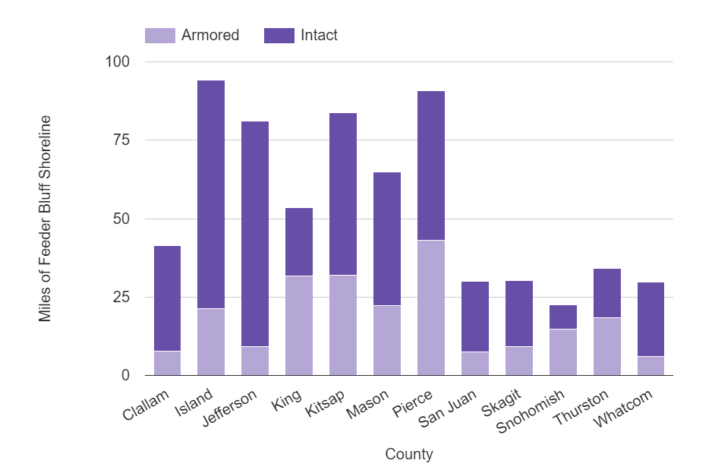
ARMOR ON FEEDER BLUFFS
Coastal Geological Services, Inc. and Washington State Department of Fish and Wildlife, Aquatic Protection Permitting System (APPS) and Hydraulic Project Approval (HPA)
Notes:
The bars in this figure shows the miles of shoreline with bluffs and we can measure how much of that is armored
So in Pierce County, there’s about 88 miles of shoreline with bluffs, and about 50% of that is intact bluffs and the rest has armor

Slide 22
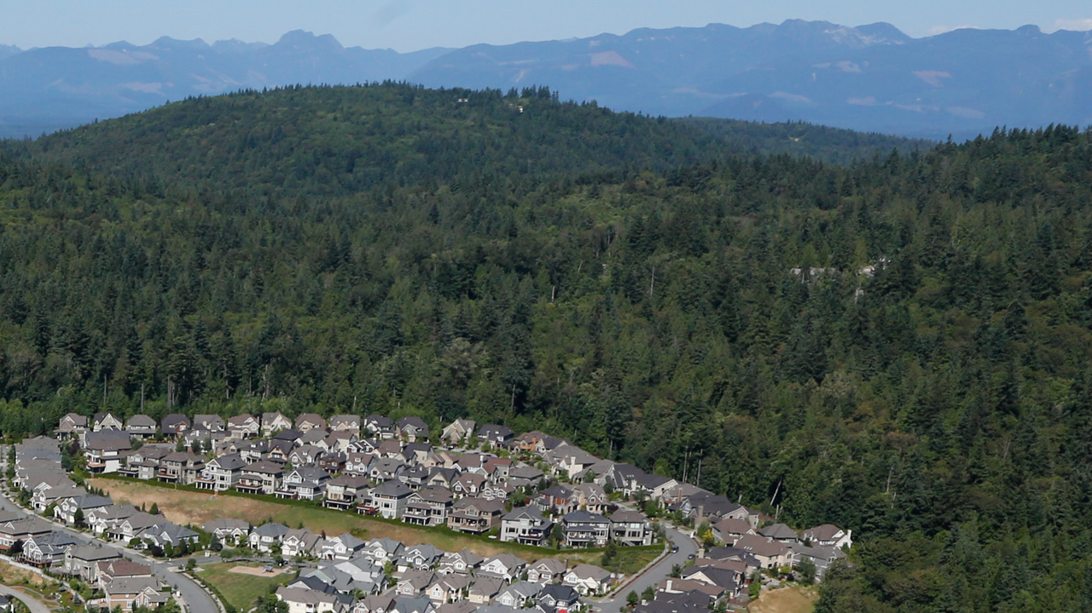
RATE OF FOREST LOSS TO DEVELOPMENT
Still loosing forests, but decline has slowed since 2011
Notes:
We track the rate of forest loss to development
Still loosing forest, but the declined has slowed since 2011 so we concluded that it’s an indicator that is making progress

Slide 23
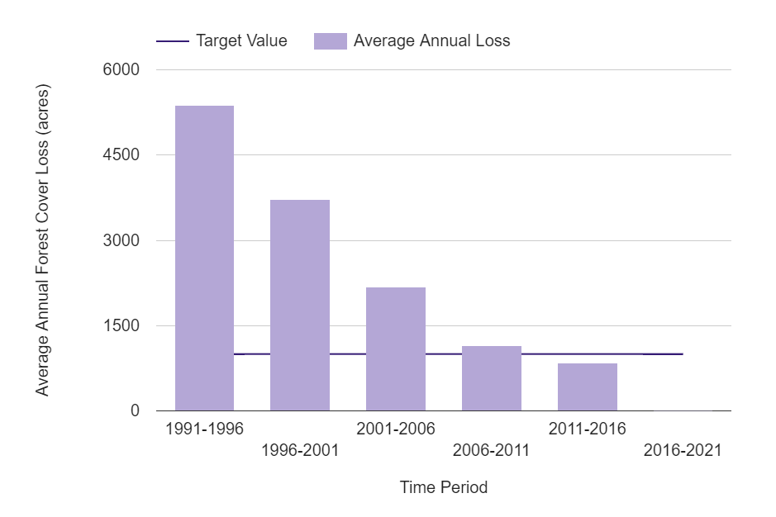
RATE OF FOREST LOSS TO DEVELOPMENT
Washignton State Department of Fish and Wildlife
National Oceanic and Atmospheric Administration Coastal Change Analysis Program (C-CAP Land Cover Atlas)
Notes:
What makes us say this?
We look at loss of forest for a 5 year time period, and we compare those time periods.
With every time period, we see that loss get smaller and smaller
And we’ve already met out target for this indicator

Slide 24
Human wellbeing and Puget Sound health are both closely intertwined, and mutually reinforcing
Notes:
One of the things that I am really proud of at the Partnership is that we consider humans in our Vital Signs
Puget Sound is not just about the salmon and whales, but of course humans too!
Human wellbeing and Puget Sound health are both closely intertwined, and mutually reinforcing

Slide 25
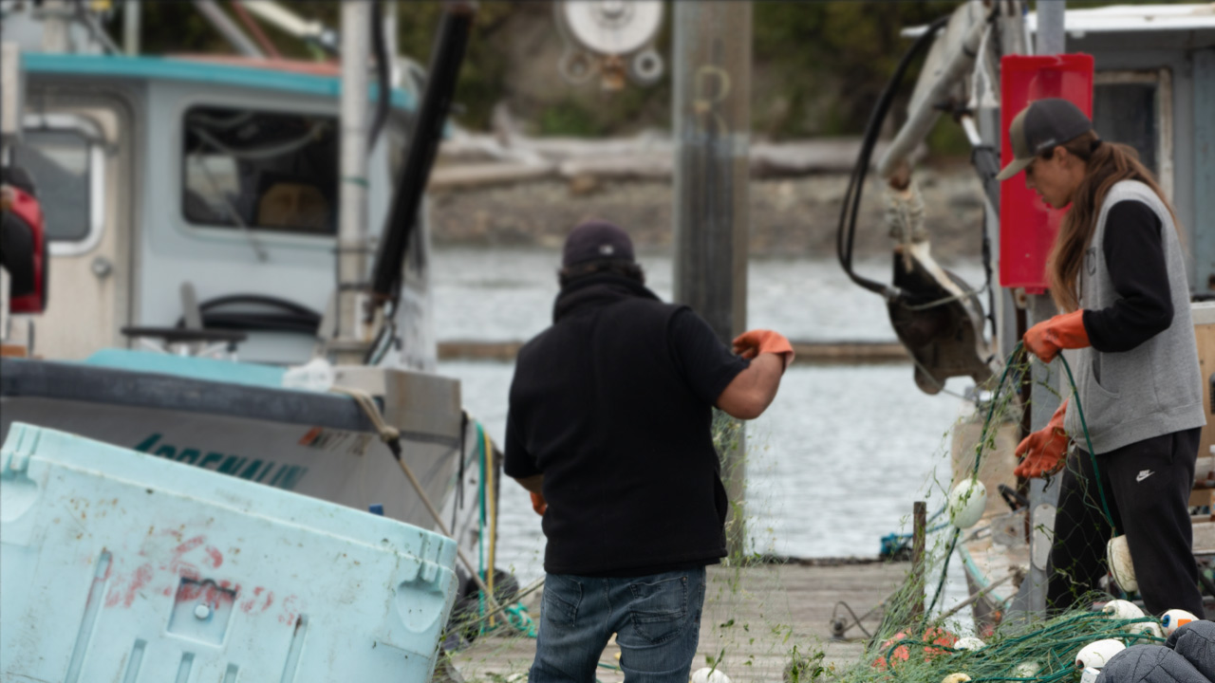
EMPLOYMENT IN NATURAL RESOURCE INDUSTRIES
There were 96,850 jobs in natural resource industries in 2016, or 3.1% of all industries.
Notes:
We look at economic indicators
For example employment
Jobs and wages in the natural resource industries, like aquaculture, timber, fishing, recreation and tourism,
Have increased a lot over the past 15 years or so.
There were 96,850 jobs in natural resource industries in 2016, or 3.1% of all industries.
This may not seem like a lot but for some counties, it’s really important

Slide 26
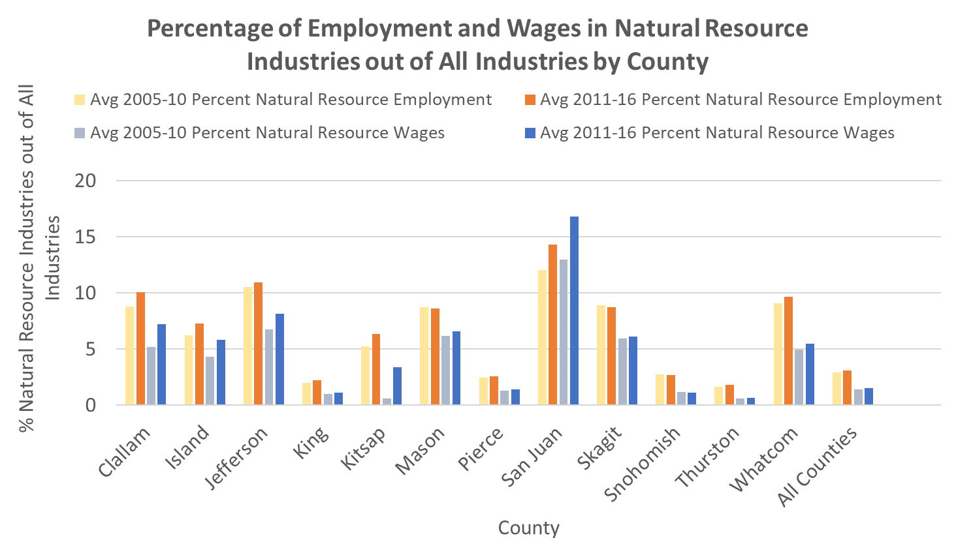
EMPLOYMENT IN NATURAL RESOURCE INDUSTRIES
National Oceanic and Atmospheric Administration (NOAA) Economics: National Ocean Watch; Bureau of Labor Statistics (BLS) Quarterly Census of Employment and Wages (QCEW); Bureau of Economic Analysis (BEA) Regional Data: Local Area Personal Income and Employment; Headwaters Economics: Economic Profile System (HW EPS), Washington State Department of Natural Resources (WADNR), Washington State Department of Agriculture (WSDA)
Notes:
The more rural counties have higher rate like San Juan, Jefferson have much higher rates of employment in the natural resource industries
Pierce County is among the lowest here

Slide 27
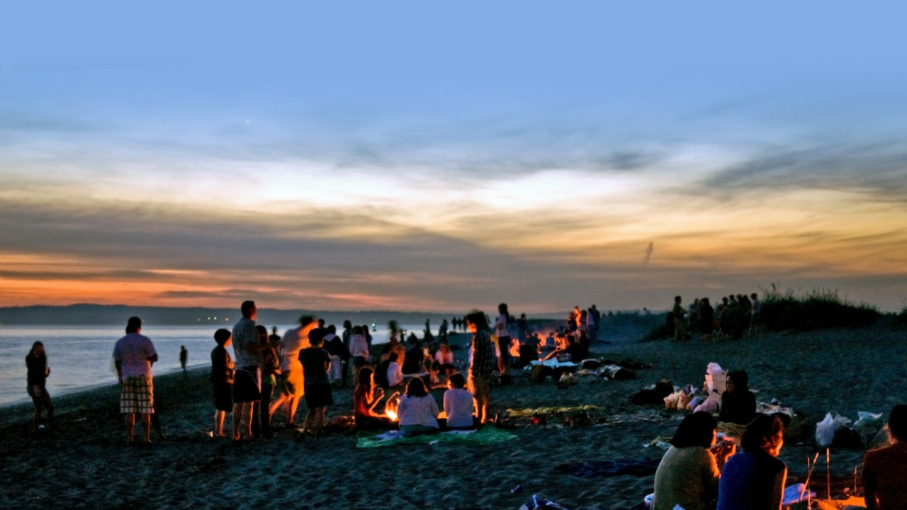
SENSE OF PLACE
Over 70 percent of Puget Sound residents “agree” or “strongly agree” that Puget Sound plays role in their identity, pride, and attachment.
Notes:
Another indicator we track is sense of place
The extent to which people identify with and feel positively attached to a specific place.
Several studies have demonstrated that not only does a strong sense of place contribute to human wellbeing, but that it can also contribute to a desire to protect the natural environment.
Our survey results show that over Over 70 percent of Puget Sound residents “agree” or “strongly agree” that Puget Sound plays role in their identity, pride, and attachment.
This is a really high percentage, that plays in our favor because it can lead to stewardship which is one of the actions that can lead to recovery
In a 2018 survey, 25% of residents in the Pierce County area stated that they frequently engage in stewardship activities that are personally meaningful to them and that they believe will benefit the environment.

Slide 28
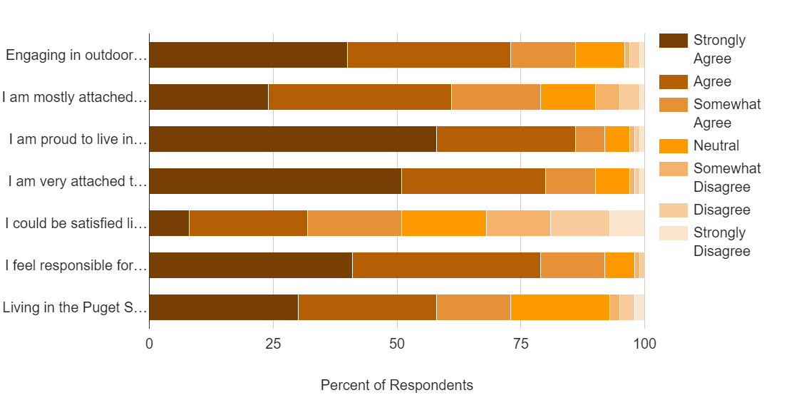
SENSE OF PLACE INDEX
Oregon State University Human Dimensions Lab

Slide 29
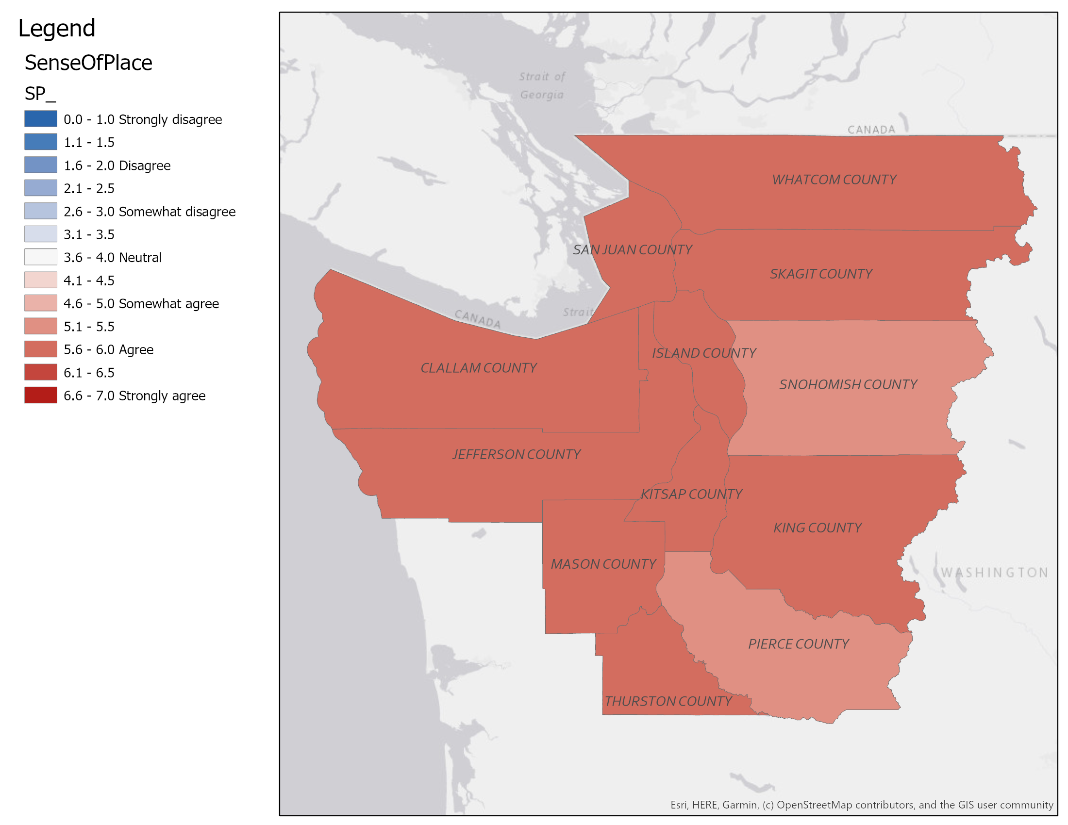
SENSE OF PLACE INDEX
Oregon State University Human Dimensions Lab

Slide 30
Notes:
All the indicators we have, we have thanks to many contributing partners and their monitoring programs.
These are agencies, tribes, local jurisdictions, and NGOs, countless dedicated scientists and practitioners that serve as the region’s eyes and ears to assess ecosystem
We need these programs to keep doing the good work they do, so we can understand and communicate about Puget Sound

Slide 31
The thousands of passionate people who are devoted to seeing the return of a healthy and resilient Puget Sound give us hope
Notes:
So, what I have presented so far may make us feel like there’s some pretty grim stories out there, like it’s complicated, but then there’s also some positive signs
And it’s the thousands of passionate people who are devoted to seeing the return of a healthy and resilient Puget Sound give us hope
In our latest State of the Sound report, we included three stories to shine light on the efforts currently underway, making a difference
I will briefly go over these three stories

Slide 32
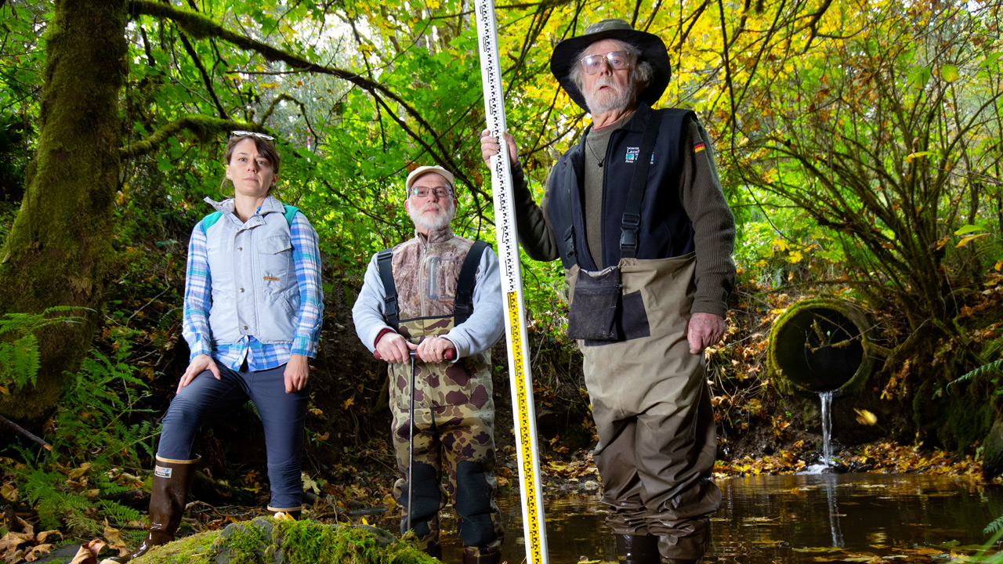
STORIES OF RECOVERY
Trekking backroads to count culverts for salmon
Notes:
The first one has to do with culverts
Culverts block fish from reaching their spawning grounds in many ways. They can become blocked with debris or have too little water flowing through them for fish to swim through, they can be too steep for fish to navigate, or water flowing through the culverts can be moving too quickly for fish to swim upstream.
There’s a need to fix those culverts in our state and it’s a big priority for salmon recovery.
Walking countless miles and feeling for pipes in chest deep water, local volunteers clocked nearly 300 days identifying and recording hundreds of road culverts blocking salmon passage.
This is in Clallam County
It was the Lower Elwha Klallam Tribe’s Habitat Restoration Manager Mike McHenry that advocated for a mapped inventory of culverts
Once they know where the culverts are, they can figure out a plan to remove or fix them so salmon can get through to healthy places to spawn and rear their young.”

Slide 33
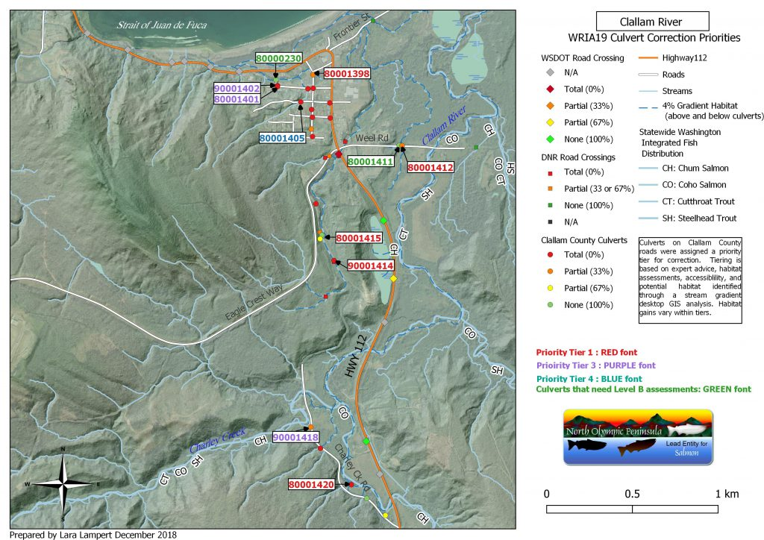
Notes:
Here’s an example of a map
The dots represent a culvert that they found
And the colors show their priority order

Slide 34
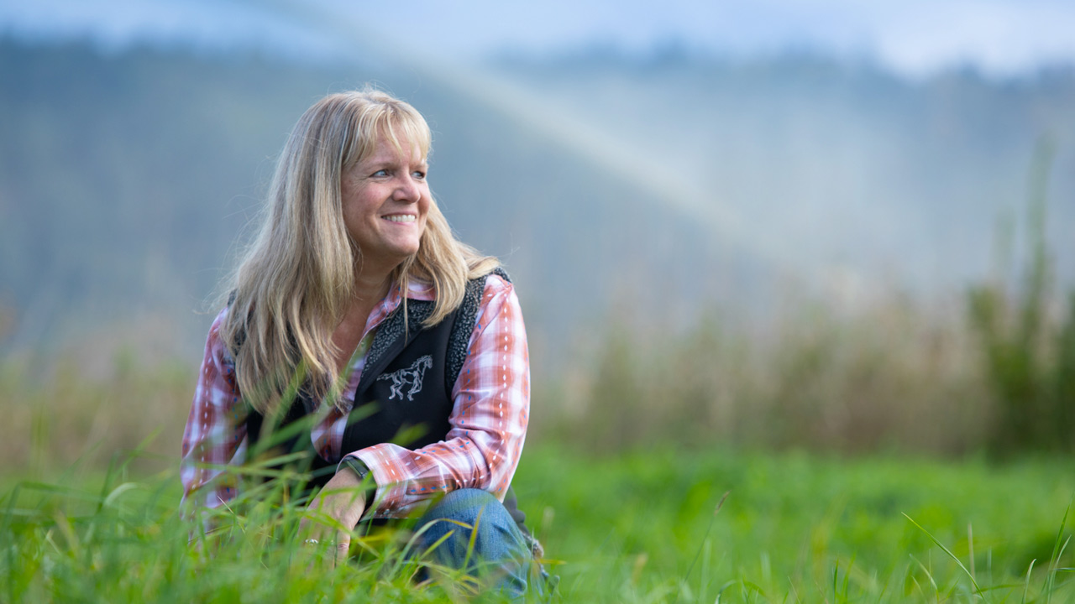
STORIES OF RECOVERY
Setting the table for fish, farms, and floodplains
Notes:
The second story is about fish, farms and floodplains.
These are connected and this story describes the Sustainable Lands Strategy (SLS), a project that has brought the agricultural community, tribes, local government, state and federal agencies, and environmental stakeholders together in Snohomish County
The SLS recognizes the need for fish, farm and flood management interests to work together and collaboratively develop solutions to shared problems.
In the Puget Sound region, farmers are being squeezed by the economics of global commodities, the pressures of development, and the impacts of climate change. Farmers need to deal with environmental impacts affecting their crops and livestock while also making sure their business operations remain financially viable. Climate change has made it more difficult to maintain year-round cattle operations because flooding patterns are now less predictable,
The SLS provides a regional model for collaboration and cooperation, demonstrating how such sustainable agriculture can thrive at the same time as addressing urban sprawl, protecting and restoring threatened salmon and reducing flood risks to residents and infrastructure.

Slide 35
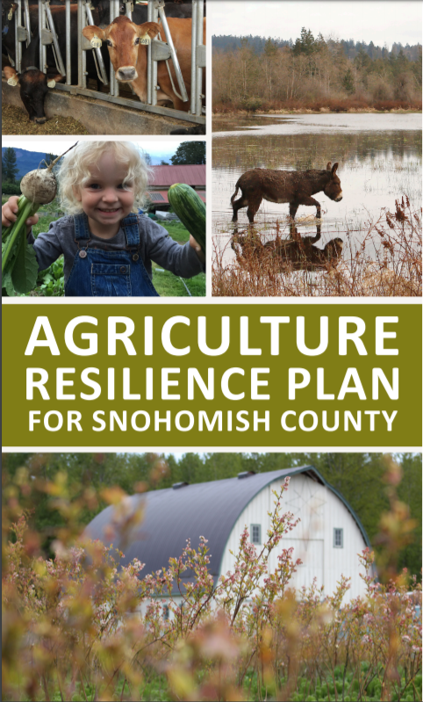
Notes:
This Agriculture Resilience Plan is an example of product that the SLS supported

Slide 36
STORIES OF RECOVERY
Kids kick asphalt out of the school yard for cleaner water
Notes:
The third and final story is about a project in Tacoma
Where students, their parents, and local volunteers pried up thousands of pounds of asphalt in the school play ground and replaced it with a green space.
Not only this was better for the kids, but it also was good for the environment as you are taking an impervious surface and replacing it with soil and plants, which tend to absorb water.
Removing the 15,000 square feet of asphalt from Holy Rosary’s parking lot and playground area prevents approximately 360,000 gallons of polluted stormwater from entering local waterways and instead nourishes a landscape designed to fit the school’s needs.
This project brought a community together, created a sense of accomplishment, and helped children renew their love of nature.
If we can do that at scale, just imagine what the Puget Sound would be like if hundreds of thousands of square feet of asphalt were transformed into greenscape. Not only does the stormwater benefit, just think how much better of a place it would be to live,” reflects Allan Warren, the Communication and Development Director at Pierce Conservation District,

Slide 37
Sufficient funding for the priority habitat protection and restoration, water quality protection, and salmon recovery programs, described in the Action Agenda for Puget Sound, remains the biggest barrier to recovery.
Notes:
These stories shows that by coming together, great projects happen that can make a difference
But these projects need funding too, not just people.
And sufficient funding for the priority habitat protection and restoration, water quality protection, and salmon recovery programs, described in the Action Agenda for Puget Sound, remains the biggest barrier to recovery.

Slide 38
Notes:
This two figures show the total funding needed to fund all those actions in the AA
Let’s just focus on the recent AA
We estimated that there was a need for 1.3 billion, for 631 actions
And only about 20% so far is funded, or a 80% funding
We aren’t done implementing this Action Agenda and more funding will turn up but we know from experience that it won’t be enough
So, our indicators may continue to suffer

Slide 39
2019 STATE OF THE SOUND
CALL TO ACTION
Each of us has a role to play in achieving Puget Sound recovery.
Notes:
Each of us has a role to play in achieving Puget Sound recovery.
Our partners, our Puget Sound recovery community, we’re all working hard, it’s not enough. We must redouble our efforts to combat climate change and the effects of a growing population that threaten ecosystems and disproportionately affect vulnerable communities.
So we put together a call to action in the State of the Sound

Slide 40
STATE LEGISLATURE
Authorize new funding that will provide reliable, dedicated funding in the amounts needed for Puget Sound recovery, as recommended by the Leadership Council.
STATE AGENCIES
Work with the Partnership and the Leadership Council to develop the Puget Sound Budget. Submit budget requests to implement the 2018-2022 Action Agenda for Puget Sound.
LOCAL GOVERNMENT
Participate in watershed-scale recovery planning and implementation efforts, via Local Integrating Organizations and salmon recovery Lead Entities.
CONGRESS
Fund the Puget Sound Geographic Program at a level commensurate with the Great Lakes and Chesapeake Bay.
.
Notes:
Actions for different parts of the PS recovery community
Like the state legislature, state agencies, local government, and congress even

Slide 41
TRIBES
Work with the Department of Fish and Wildlife and the Leadership Council to help us integrate habitat, harvest, and hatchery efforts in Puget Sound.
FEDERAL AGENCIES
Work with the Leadership Council to identify and implement changes to federal policies and programs that will accelerate recovery while benefitting all communities equitably.
NGOs
Increase public awareness of the condition of Puget Sound, why it matters, the effects of human activities and climate change on Puget Sound, and how individuals can support Puget Sound recovery.
PUGET SOUND PARTNERSHIP
Tell the story of Puget Sound recovery. Increase diversity, equity, and inclusion to represent everyone in the recovery effort.
Notes:
Also, tribes, federal agencies, NGOs like yourselves, and us, the Puget Sound Partnership
And looking at this call for action for NGOs, I’d say you are doing this!

Slide 42
THE PUBLIC
Get involved. Volunteer on a habitat restoration project or in a community-based science program. See orca.wa.gov for links to organizations to join. Or plant a tree at home.
Quiet the waters of Puget Sound to help orcas find food. If you’re a boater, give orcas space. Follow the BeWhaleWise (bewhalewise.org) guidelines for whale watching. And please use pump-out stations to keep sewage out of Puget Sound.
Drive less. Support efforts to improve alternative transportation options in the Puget Sound region.
Keep plastics and toxic chemicals out of our waterways. Recycle. Use environmentally friendly products in your home and on your landscape, fix vehicle leaks, use a commercial car wash, and have your vehicle oil changed by a professional.
Speak up for Puget Sound. Vote. Tell a friend. Make sure your local, state, and federal representatives know how important Puget Sound is to you.
Notes:
And then we have a call for the public
Read

Slide 43
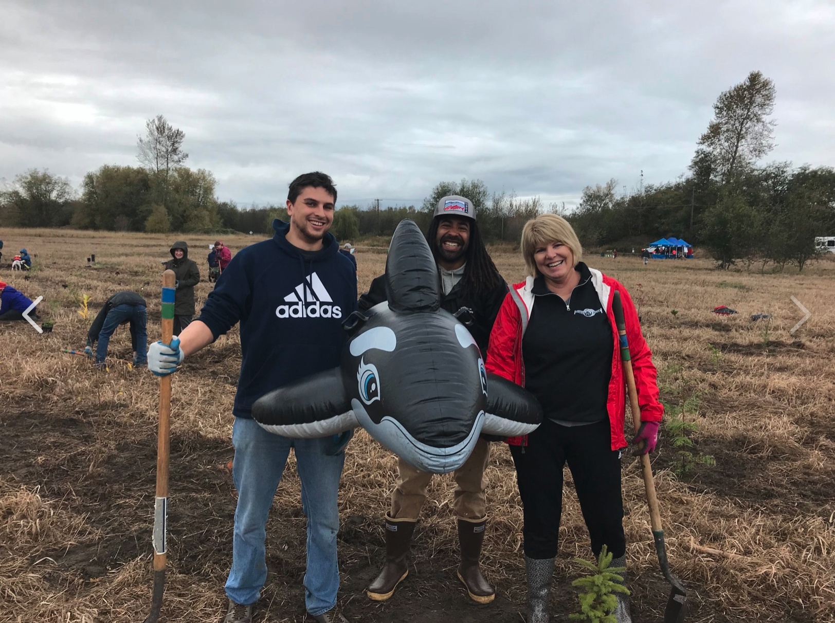
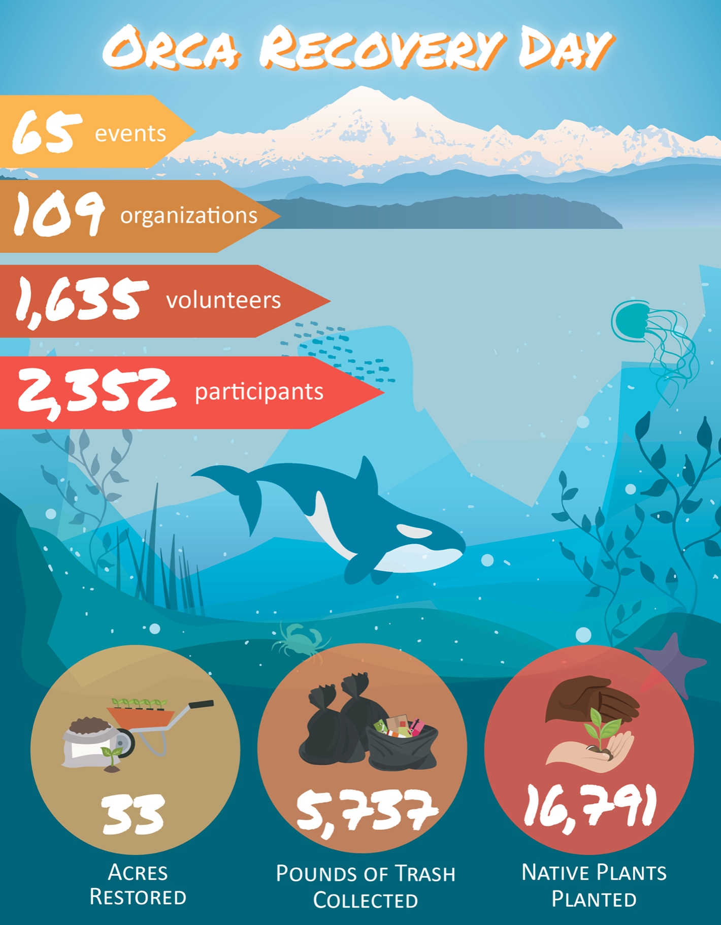
Notes:
I also want to mention Orca Recovery Day, as an example where to get involved.
It just happened a few weeks ago, and this event has had huge impact
Read slide…
This is just the second year and much larger this year compared to last year
This is an event that offers hope

Slide 44
www.stateofthesound.wa.gov

