Slide 1
South Sound Shellfish Recovery

Slide 2
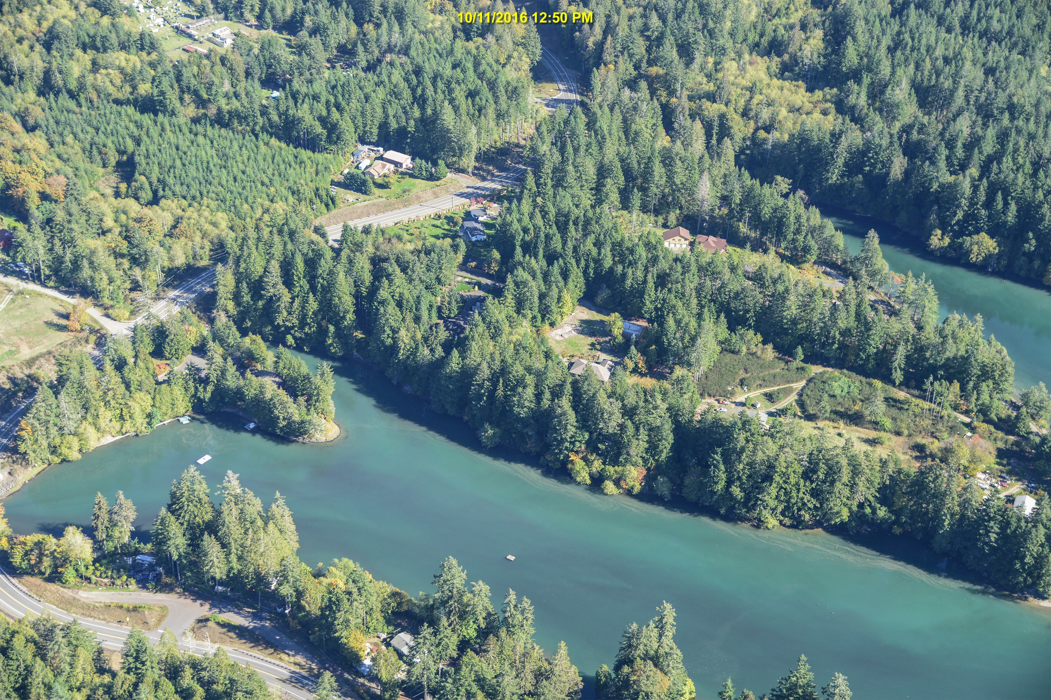
South Sound Clean Water Partners
A partnership approach to protecting and improving water quality in South Sound shellfish watersheds.
Provide a coordinated response to all aspects of pollution prevention, identification, and correction.
Recover downgraded areas and prevent downgrades.
McLane Cove

Slide 3
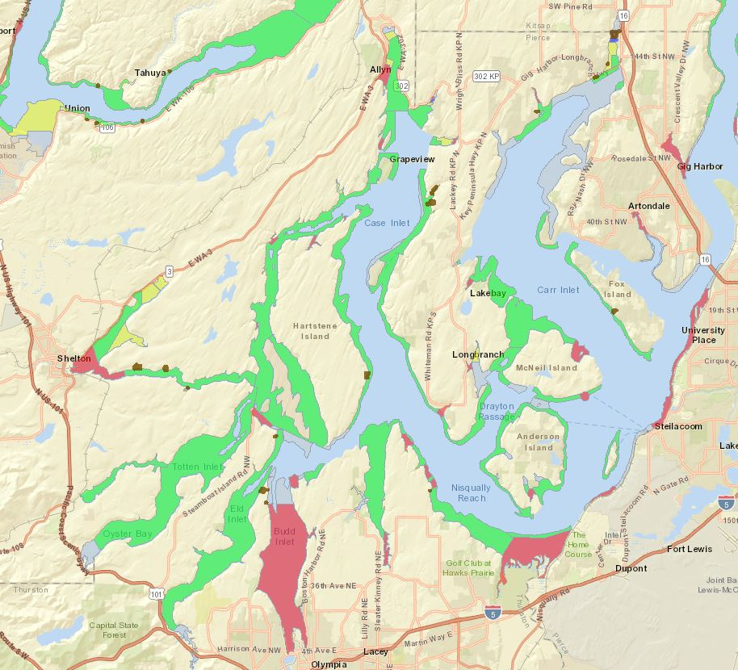
South Sound Shellfish Growing Areas

Slide 4
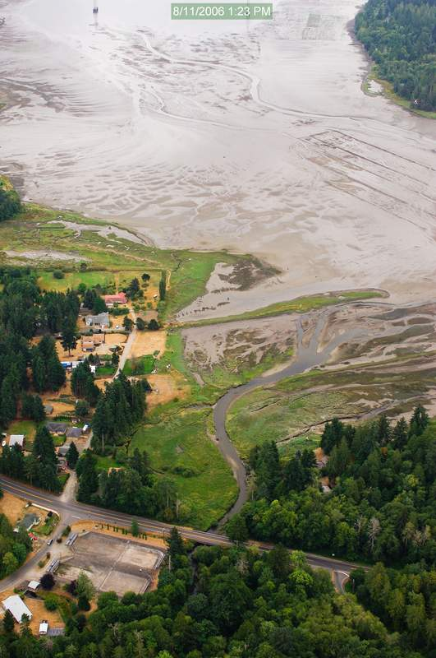
Original Shellfish NTA Proposal (1.0)
Limited to existing Shellfish Protection Districts
Fully implement Closure Response Plans
Pierce: Burley Lagoon, Rocky Bay, Filucy Bay, Vaughn Bay
Mason: Oakland Bay, McLane Cove
Thurston: Henderson Inlet/Nisqually Reach, Totten/Little Skookum
$5.6 million funding gap identified
Offered $300,000 + $100,000 AHSS contribution (Shellfish NTA 1.0)
North Bay

Slide 5
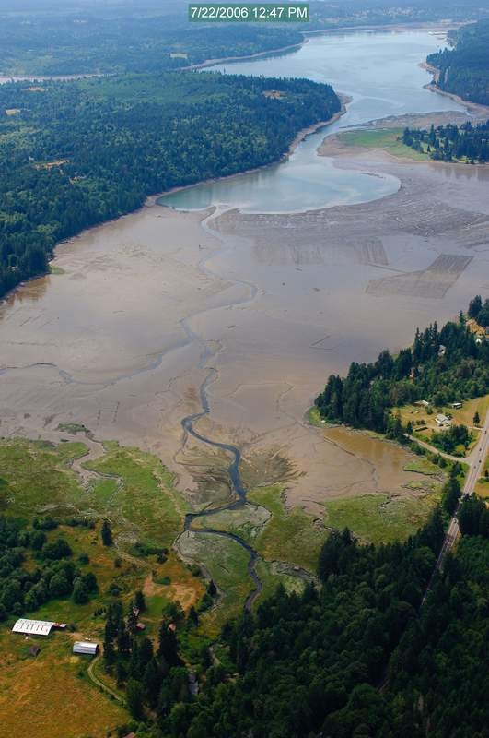
Shellfish NTA 2.0
Tiered proposal
Offered $732,000 + $100,000 AHSS contribution
Total = $1,232,914
Add Mason Public Health and Squaxin Island Tribe as partners
Add to areas: North Bay, Burley Lagoon, & Rocky Bay
Distribute evenly between counties
Based on gap analysis from original NTA – most need or complete implementation
Oakland Bay

Slide 6
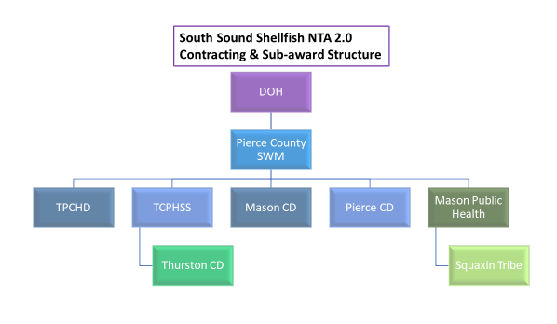
Shellfish NTA 2.0
Components
60 separate deliverables – budget & reporting
QAPPs – 3
Admin & Agreements – 6 subrecipients + 2 sub-subrecipients
Water quality sampling & hotspot identification
Sanitary survey/Septic system dye tests & correction
Stormwater- field screening & compliance
Agriculture – technical assistance & BMP installation
Education & outreach – Water quality reports, workshops, & events
North Bay CRP implementation
Planning – Strategic Plan + 4 CRP updates
Present findings

Slide 7
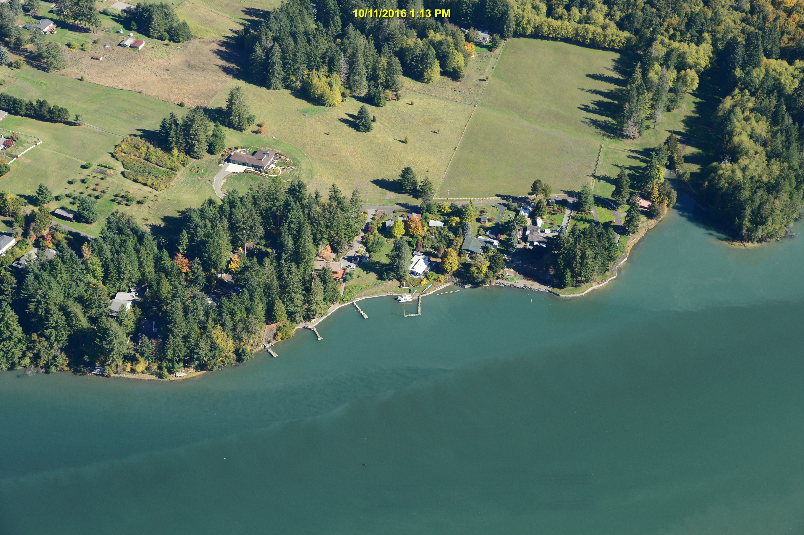
Shellfish NTA Progress
Accomplishments
November 2019 – 172 acres of Oakland Bay upgraded
All agreements & QAPPs & amendments
Over 800 water quality samples
27 failing septic systems identified
Over 90 ag technical assistance site visits
Inventory of Camping Club systems complete
12 Workshops
2 Water Quality Reports
Updated Closure Response Plans finished for Henderson Bay & Burley Lagoon
Mason – inventoried 430 septic systems
Mason – completed boat usage inventory
Quarterly meetings for Henderson, Burley, Filucy, Rocky, and Vaughn
Approximately $350,000 spent
Henderson Inlet
Burley Lagoon

Slide 8
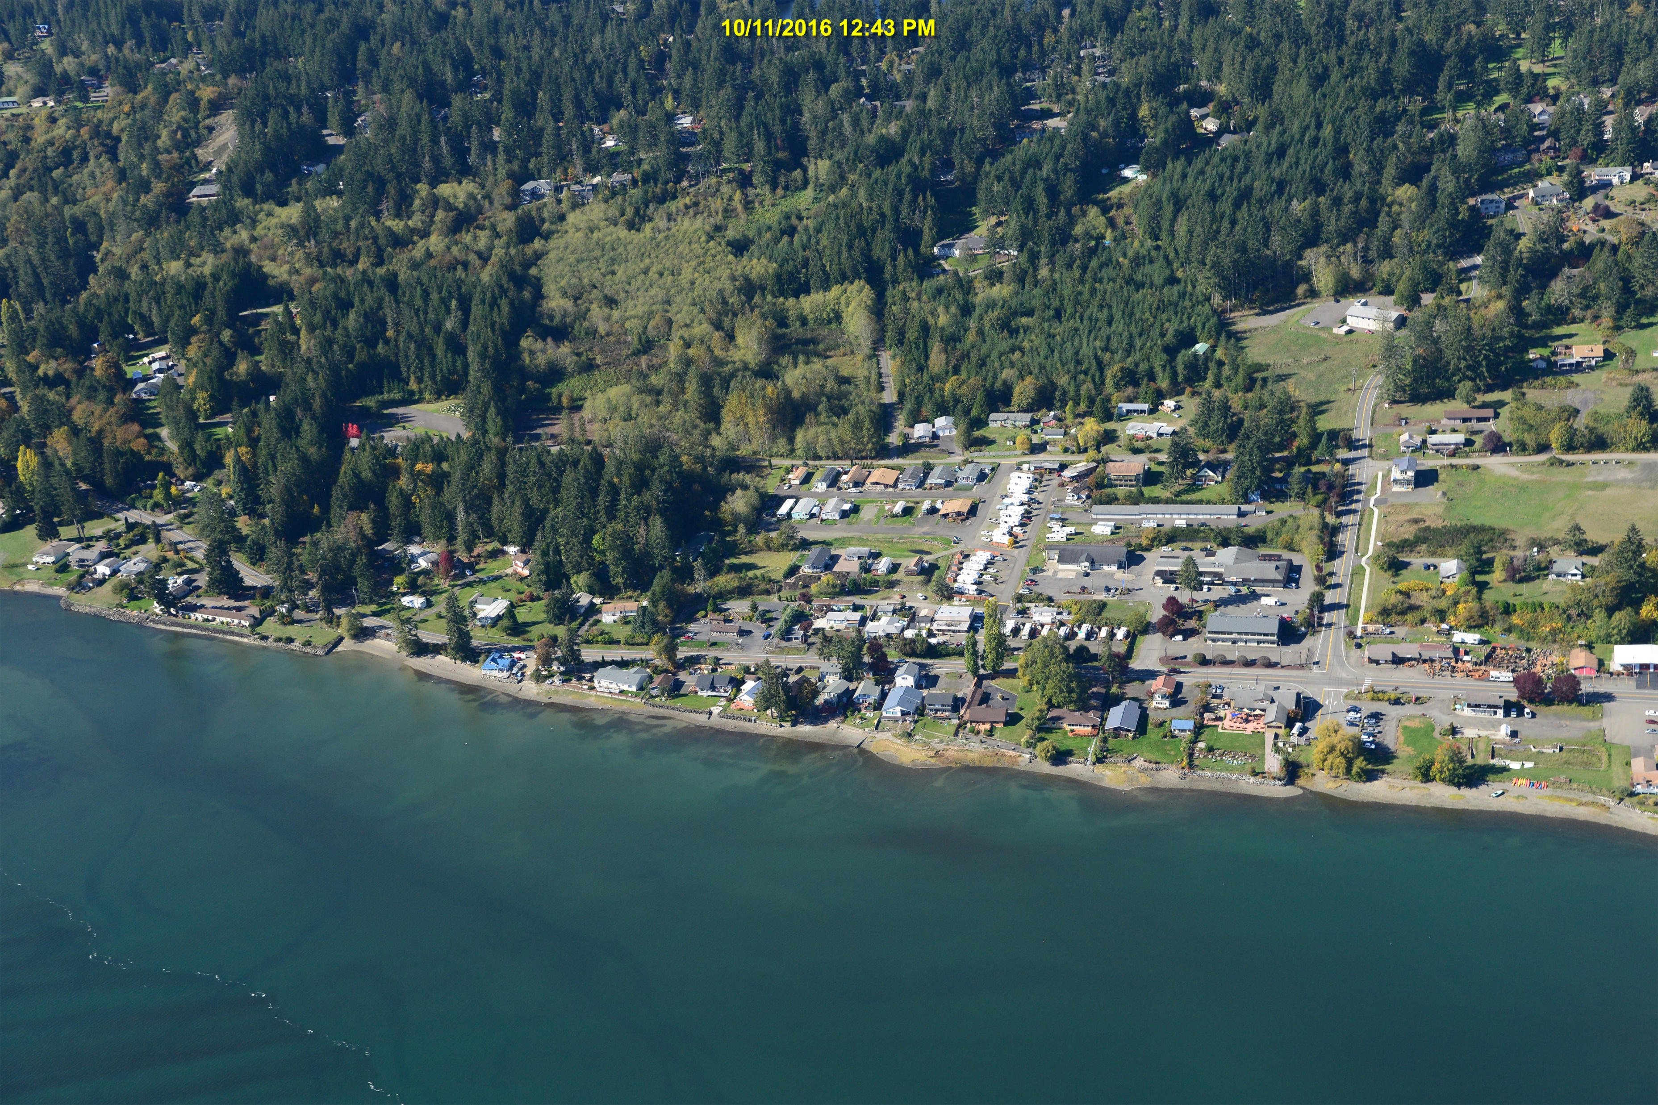
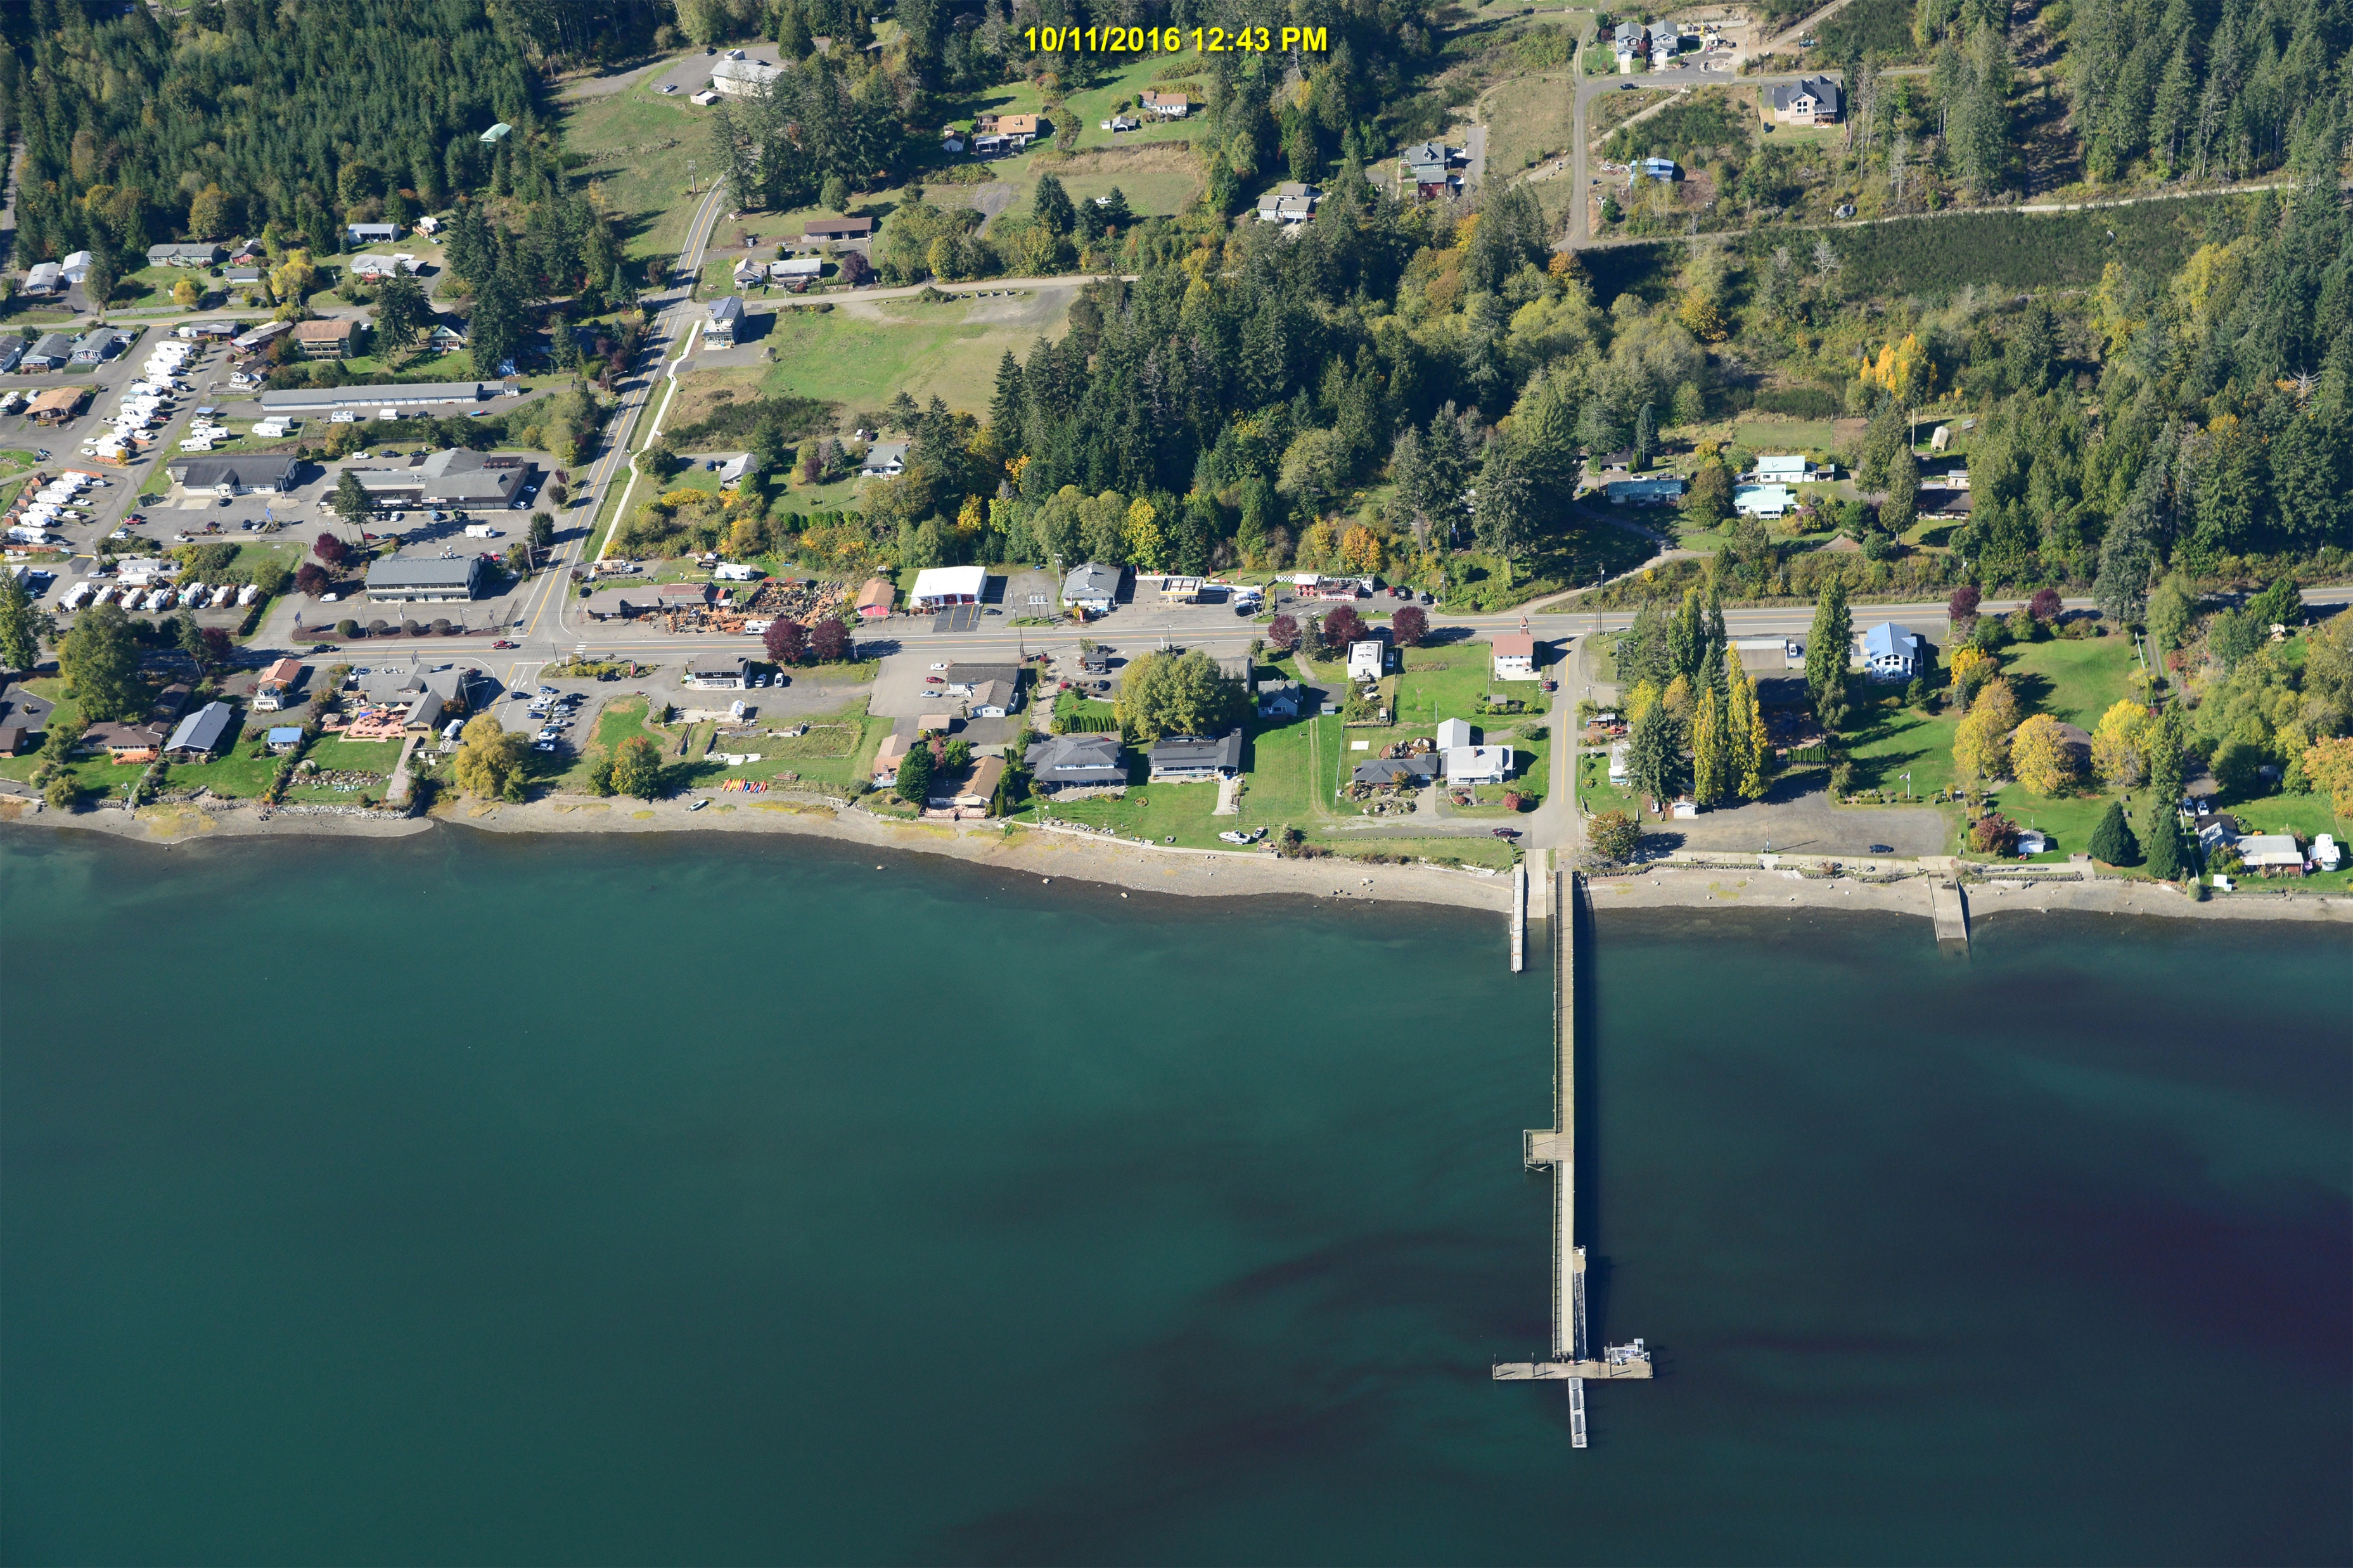
Shellfish NTA 2.0
What’s Next
Water Quality Reports – Mason & Thurston
Filucy & Vaughn updated Shellfish Protection Districts
Allyn sewer camera inspection
Camping Club alternatives
Thurston – updated PIC
Strategic Plan
Ag BMPs installed
Burley Lagoon sanitary survey
Extension request
Allyn - South
Allyn - North

Slide 9
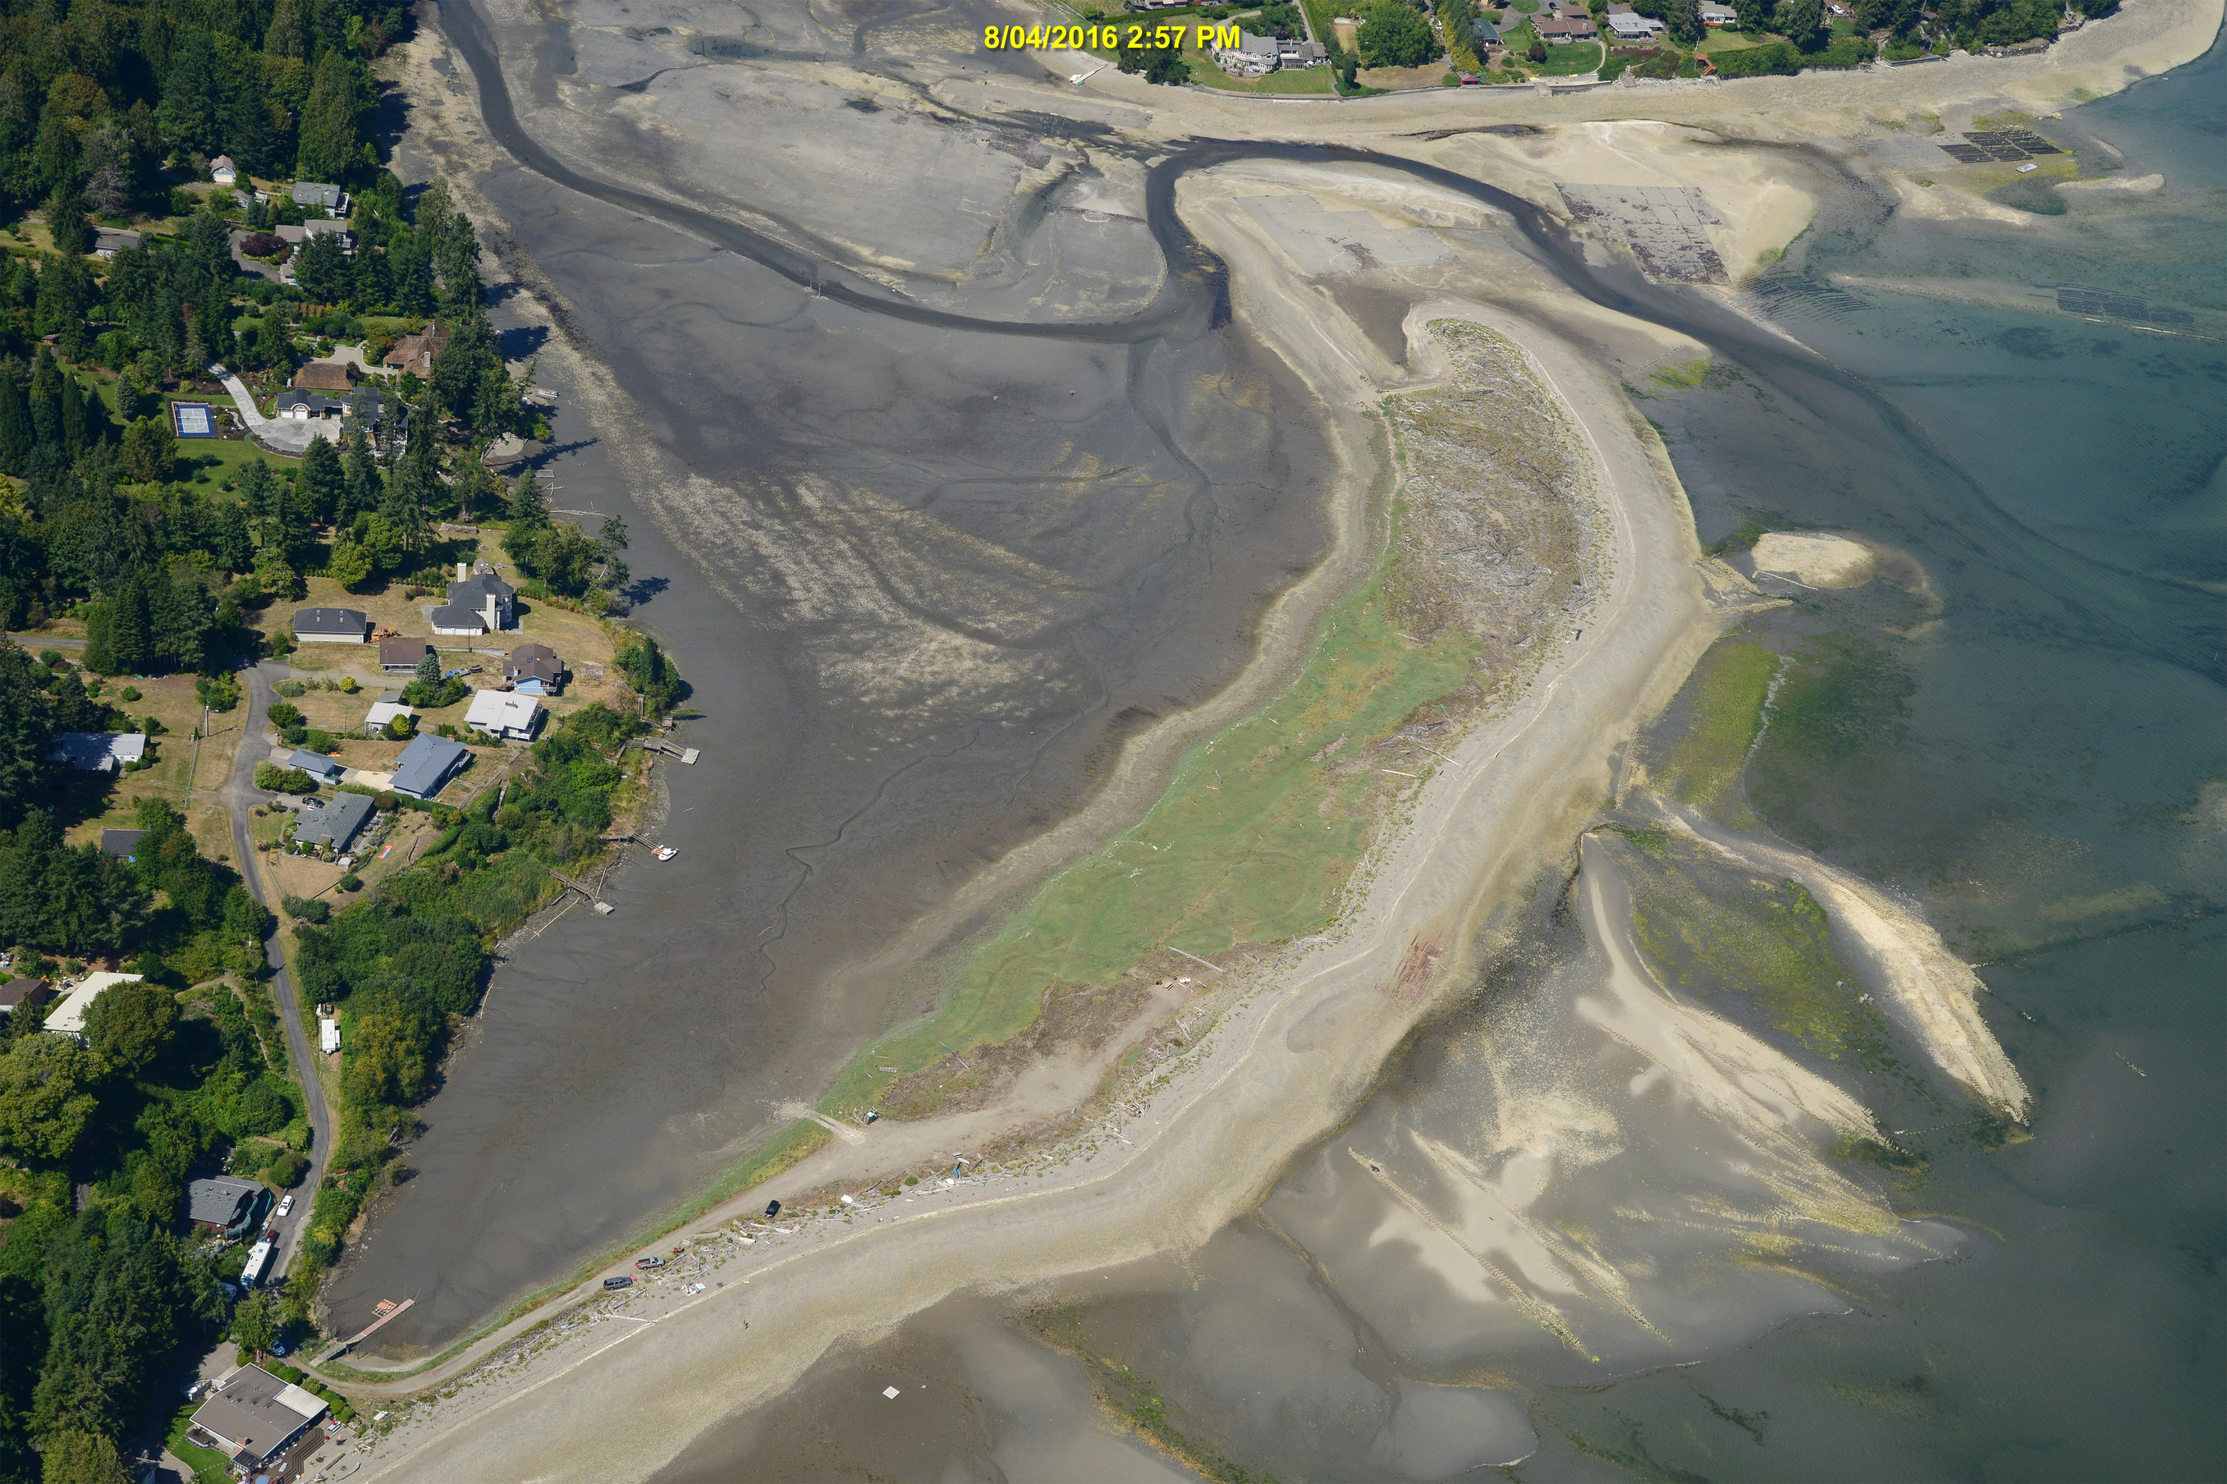
Beyond NTA 2.0
Applied for joint septic incentives grant
Submitted NTA 3.0 for all South Sound
Shellfish SIAT funding request
Minter Bay downgrade
Lack of storm events
Thurston – OS funding restored
Present project at Salish Sea Conference
Minter Bay
Burley Lagoon

Slide 10
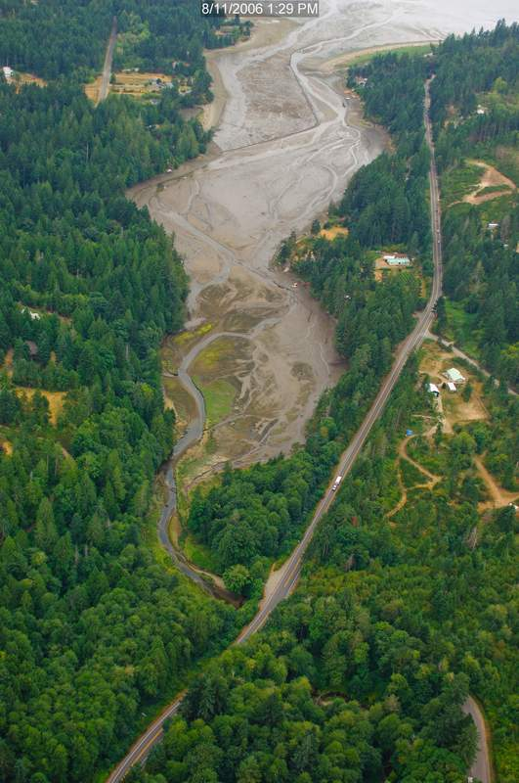
Contact Information
Barbara Ann Smolko
bsmolko@co.pierce.wa.us
(253) 798-6156
Jeff Barney
jbarney@co.pierce.wa.us
(253) 798-7620
Rocky Bay

